Slide 1
DISEASES OF THE UPPER AIRWAYS

Slide 2
Diseases of the Nose & Sinuses
Clinical Signs
Most Common :
Nasal discharge
Sneezing
Stertor
Open mouth breathing
Inspiratory dyspnea
May Be Present :
Anorexia
Facial deformity or pain
Gag, cough or retch

Slide 3
NASAL DISCHARGE
SEROUS
Normal
Viral Infection
Early precursor to mucopurulent discharge

Slide 4
NASAL DISCHARGE
MUCOPURULENT
Viral
- Feline Herpes Virus
- Feline Calicivirus
Bacterial
Fungal
- Aspergillus
Nasal Prarasites
+/- HAEMORRHAGE
Foreign Body
- Grass Awns
Nasopharyngeal polyps
(cats)

Slide 7
Initial Data Base
Nasal Disease
History
Clinical Pathology :
CBC -- minimal value :
Anemia & Inflammation
Platelets & Coagulation
Serum chemistries --
Minimal value
Unless systemic disease
Serology :
Viral
Rickettsial
Fungal ?
Physical examination :
Ophthalmologic funduscopic exam
Thoracic auscultation :
Open mouth breathing
Closed mouth breathing
Special emphasis :
Philtrim and nares
Symmetry of face
Palate, gingiva & teeth

Slide 8
Specific Procedures (Non-invasive -- Nasal Disease)
Radiography :
General anesthesia
Often Essential
Views -- lateral, DV, open mouth VD & “skyline” Localize area of disease
Reveal -- osseous involvement, masses or foreign bodies

Slide 9
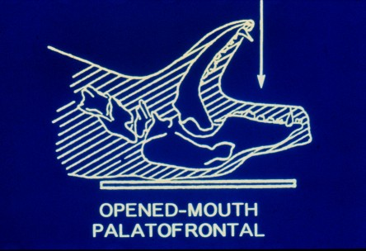
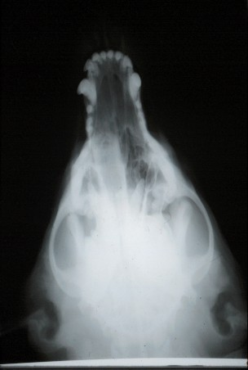
Radiography

Slide 10
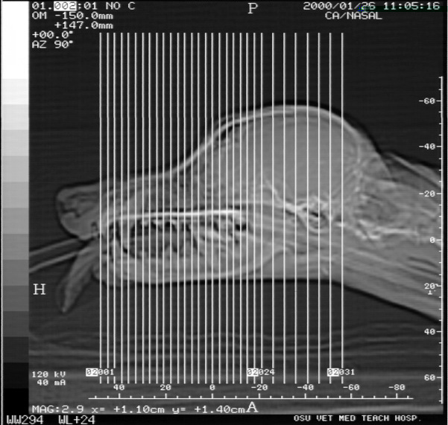
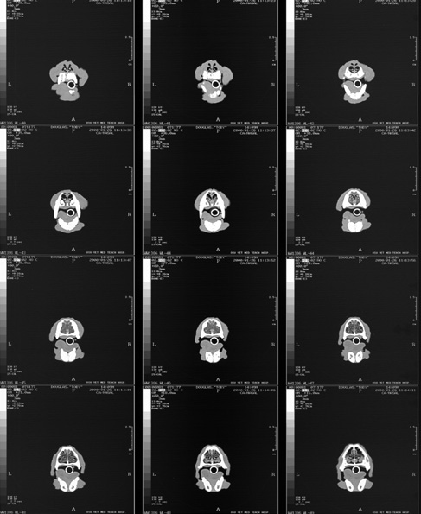
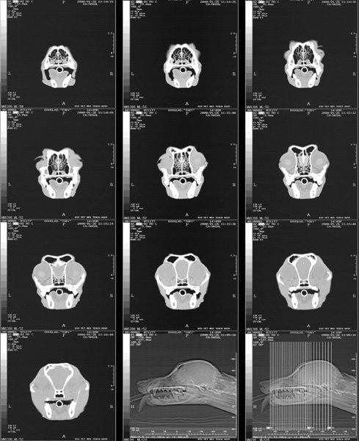
Specific Procedures (Non-invasive -- Nasal Disease)
CT (“Cat”) Scan:
General anesthesia
Serial Views

Slide 11
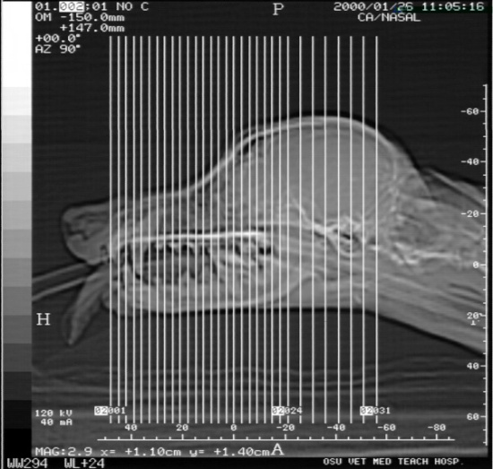
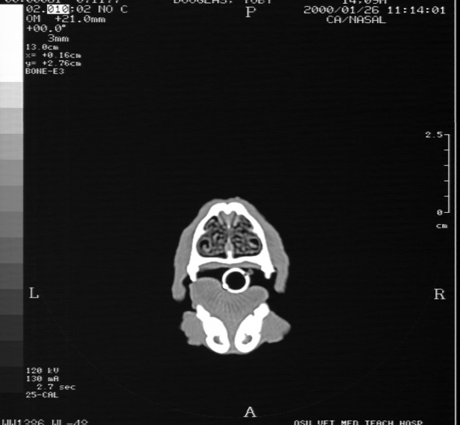
CT Scan

Slide 12
Specific Procedures (Invasive -- Nasal Disease)
Endoscopy (Rhinoscopy) :
General anesthesia
Always plan to take samples !
Cultures, Cytology & Biopsy :
Minimal equipment
Often diagnostic :
- Impression smears
- Aspirates/brushings
- Nasal flush
- Biopsy
Rhinotomy/Turbinectomy:
Diagnostic :
- Histology
- Cultures
Treatment :
- “Debulking” - Removal

Slide 13
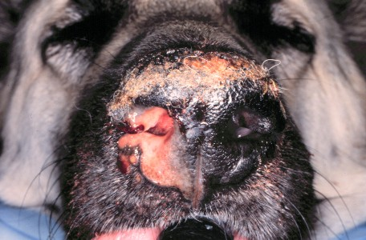
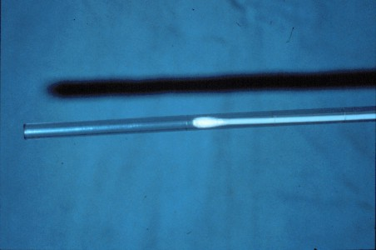
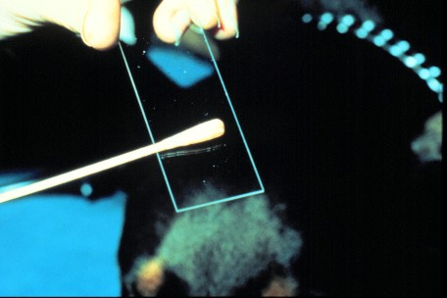
Nasal & Conjunctival Cytology - Cultures
Swab
Smear

Slide 14
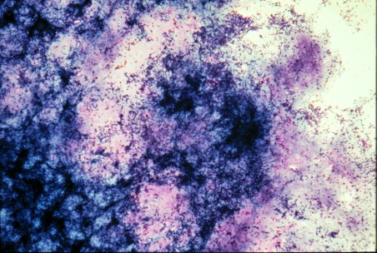
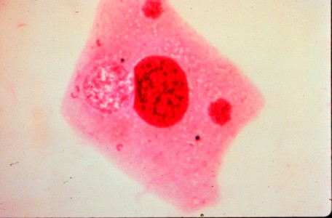
Cytology
Exudate
Exfoliative Cells

Slide 15
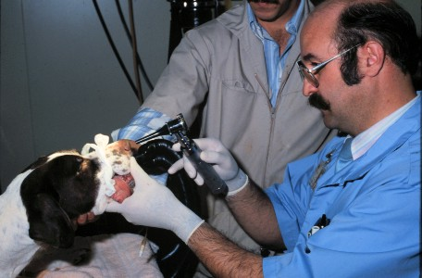
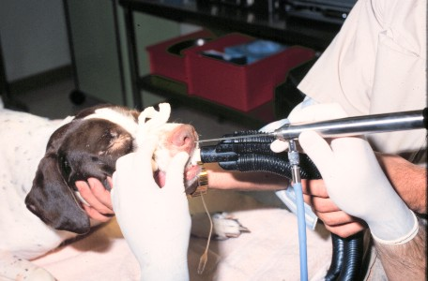
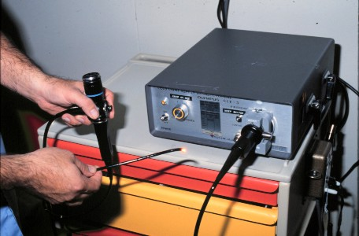
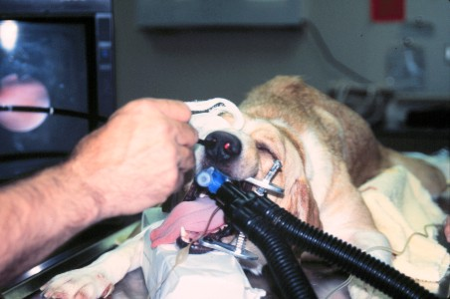
Rhinoscopy Otoscope - Rigid - Flexible

Slide 16
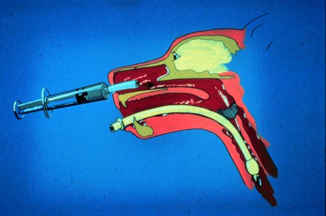
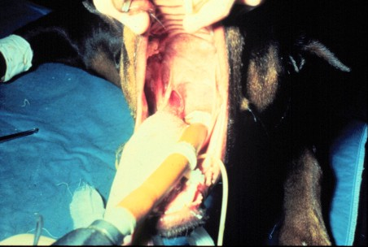
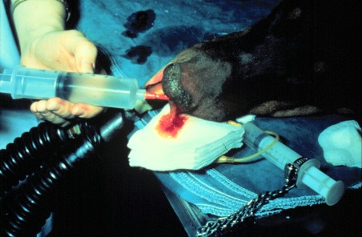
Nasal Flush/Aspirate

Slide 17
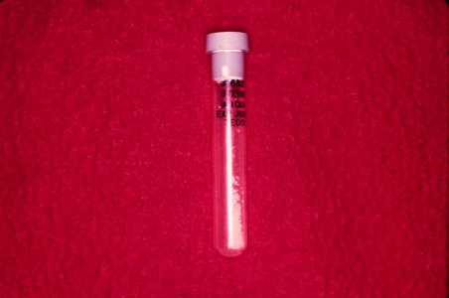
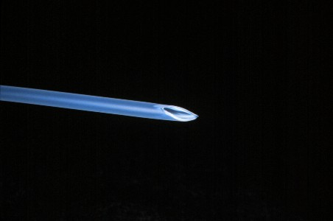
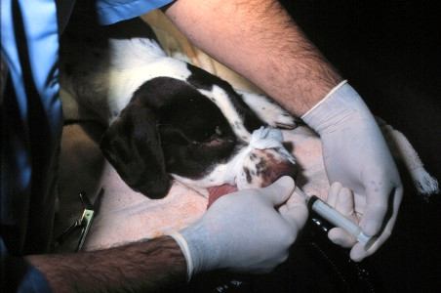
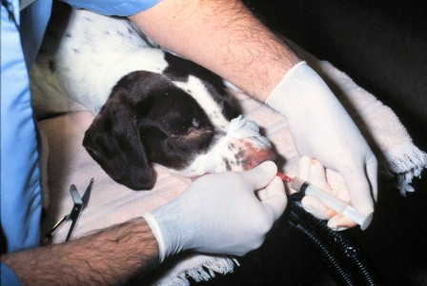
Biopsy
Hemostasis
Urinary Catheter

Slide 18
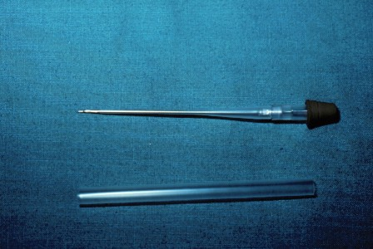
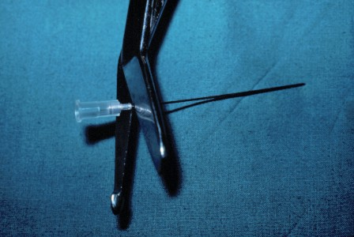
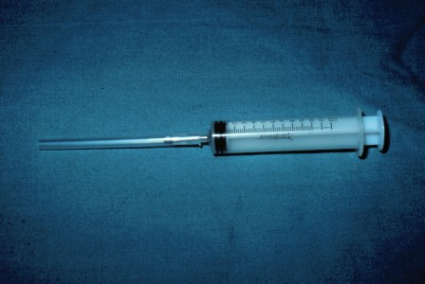
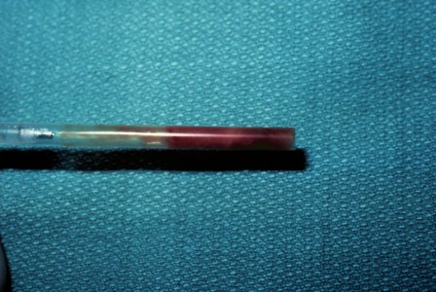
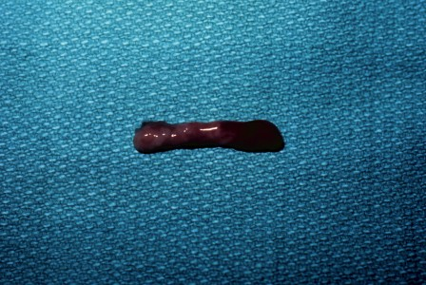
“Core” Biopsy

Slide 19
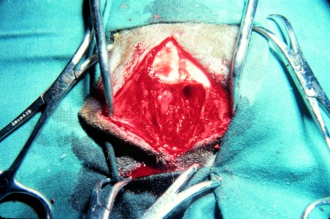
Rhinotomy/Turbinectomy

Slide 20
Disease of the Pharynx & Larynx
Clinical Signs
Most Common :
Pharynx :
Dysphagia
Choking, gagging or retching
Stertor
Larynx :
Change in vocalization
Stidor (inspiratory)
Cough
May Be Present :
Anorexia & weight loss
Exercise intolerance
Open mouth breathing
Pain
Swelling or mass
Cyanosis
Pale membranes

Slide 21
Initial Data Base
Pharyngeal/Laryngeal Disease
History
Clinical Pathology :
CBC -- minimal value :
inflammation?
platelets & coagulation
Serum chemistries :
minimal values
unless systemic disease
Endocrinology -- hypothyroidism ?
Physical examination :
Laryngeal & Thoracic auscultation :
Open & closed mouth breathing
Before & after exercise
Special emphasis :
Palpation pharynx & larynx
Examine tongue
Observe drinking & eating

Slide 22
Specific Procedures (Non-invasive -- Pharyngeal & Laryngeal Disease)
Radiography :
Lateral view may be helpful
Contrast studies (barium swallow)
-- if abnormal deglutition !
CT (“Cat”) Scan

Slide 23
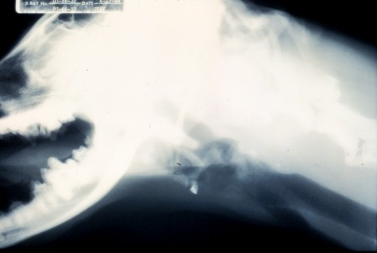
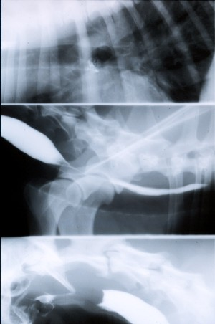
Radiography (Pharynx/Larynx)
Barium Swallow
Cervical Soft Tissues

Slide 24
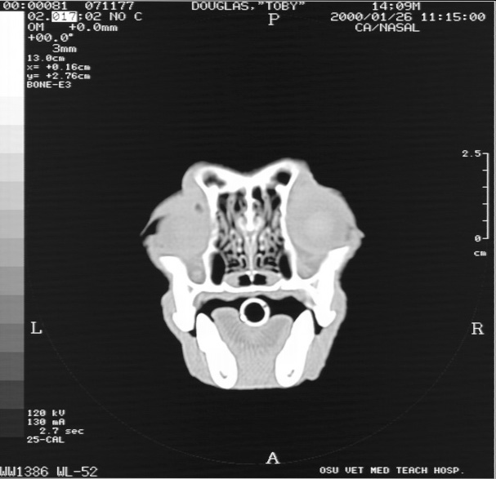
CT Scan

Slide 25
Specific Procedures (Invasive -- Pharyngeal & Laryngeal Disease)
Endoscopy (Pharyngoscopy-Laryngoscopy) :
Heavy sedation or General anesthesia -- Stabilize patient first !
Use rigid or flexible scope
Observe deglutition, dorsal to soft palate & vocal folds adduct-abduct
Cultures, Cytology & Biopsy :
Often minimal value:
- Aspirates/brushings
- Biopsy (neoplasia)
Electromyography:
Denervation
Neuropathies
Myopathies

Slide 26
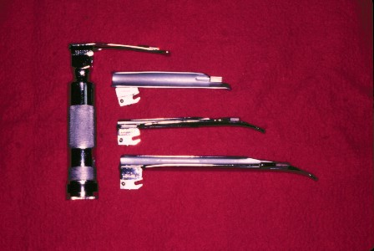
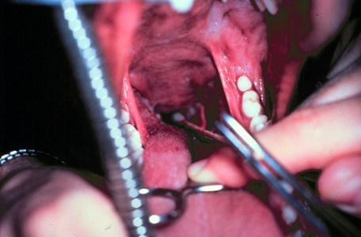
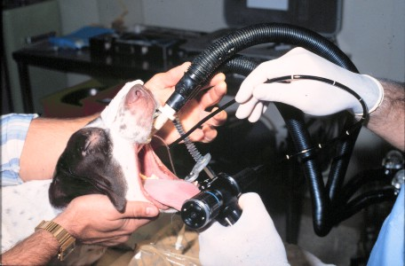
Laryngoscopy/Pharyngoscopy
(Rigid or Flexible)

Slide 27
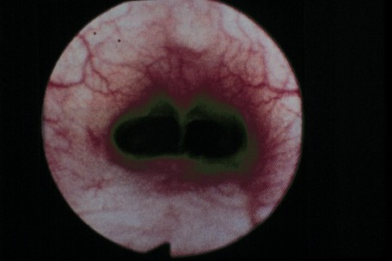
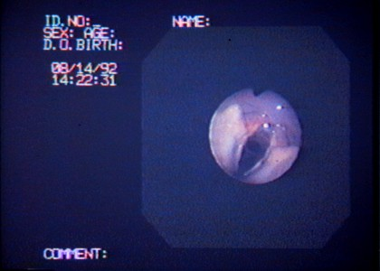
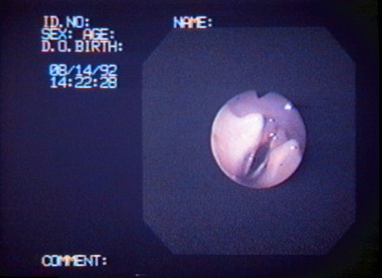
Laryngoscopy/Pharyngoscopy
NasoPharynx
Larynx
Inspiration
Expiration

Slide 28
DISEASES OF THE UPPER AIRWAYS
Congenital Disease
- Cleft Palate (Palatoschisis)
- Obstruction syndrome airways Brachycephalic
- Stenotic Nares
Acquisition Disease
- Epistaksis
- Rhinitis
- Neoplasia Nasal
- laryngitis

Slide 29
DISEASES OF THE LOWER AIRWAY

Slide 30
Disease of the Trachea, Bronchi & Bronchioles
Clinical Signs
Most Common :
Cough :
Usually harsh
Productive vs Non-productive
Honking
Dyspnea (variable) :
Tachypnea/hyperpnea
Inspiratory = extrathoracic
Expiratory = intrathoracic
May Be Present :
Exercise intolerance
Anorexia & weight loss
Open mouth breathing
Discharges -- edema, exudates & hemoptysis
Cyanosis
Pale membranes

Slide 31
Initial Data Base
Tracheal & Bronchial Disease
History
Clinical Pathology :
CBC -- inflammation
Infectious
Hypersensitivity!
Serum chemistries :
Minimal values
Unless systemic disease
Parasitology :
Fecal float/sediment
Serology
Physical examination :
Thoracic auscultation :
Characterize sounds :
Normal
Abnormal
Inspiration -- crackles
Expiration -- wheezes
Before & after exercise
Special emphasis :
Palpation cervical trachea !

Slide 32
Specific Procedures (Non-invasive -- Tracheal & Bronchial Disease)
Radiography :
Usually essential -- Stabilize patient first !
Unanesthetised cervical & thoracic views :
Inspiration !
Expiration !
Fluoroscopy

Slide 33
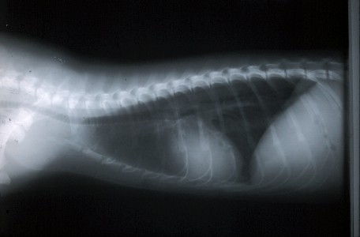
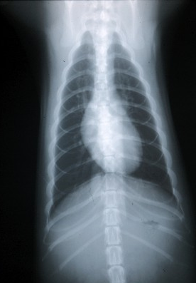
Thoracic Radiography
Bronchial Pattern

Slide 34
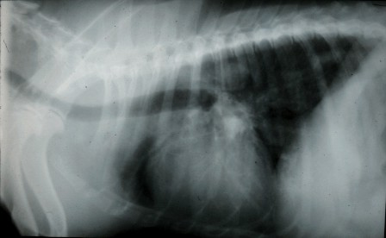
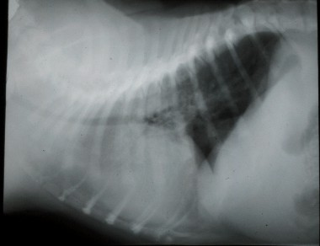
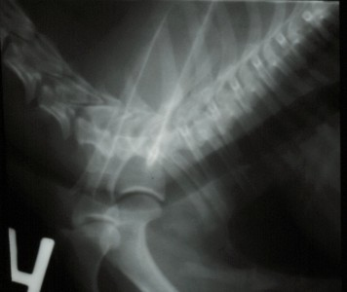
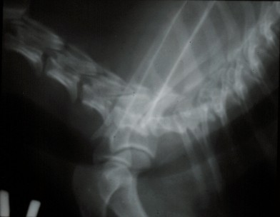
Thoracic Radiography
Inspiration
Expiration

Slide 35
Specific Procedures (Invasive -- Tracheal & Bronchial Disease)
Transtracheal aspirate or “wash”:
Minimal equipment:
- Percutaneous or via Endotracheal tube
- Cultures & Cytology
Endoscopy (Tracheoscopy-Bronchoscopy):
General anesthesia - Stabilize patient first !
Use rigid or flexible scope
Always plan to take samples -- Culture & Cytology; +/- Biopsies

Slide 36
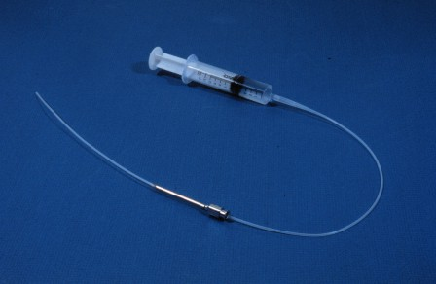
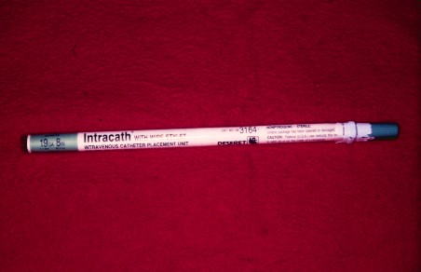
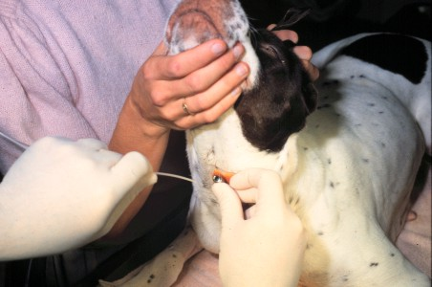
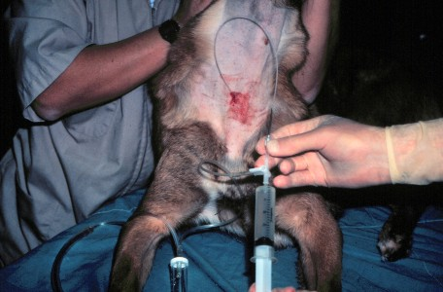
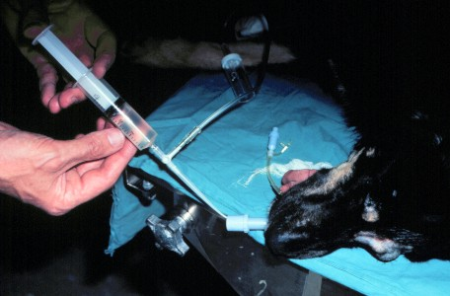
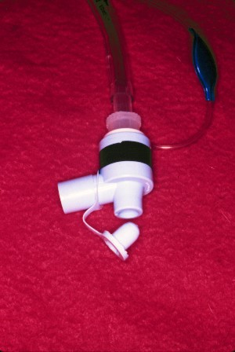
Transtracheal Wash

Slide 37
Cytology & Culture
Eosinophyllic Hypersensitivity

Slide 38
Bronchoscopy
Rigid
Flexible

Slide 39
Brush Cytology, Aspirates & Bronchial Alveolar Lavage

Slide 40
Bronchial Culture & Biopsies

Slide 41
DISEASES OF THE LUNGS

Slide 42
Disease of the Lungs
Clinical Signs
Most Common :
Cough :
If soft -- pulmonary edema
If harsh :
Airway involvement
Interstitial involvement
Dyspnea (variable) :
Obstructive pattern:
Inspiratory = “stiff lungs”
Expiratory = compressed airways
Restrictive pattern -- rapid & shallow
Fever :
Inflammatory disease
Systemic disease
Exercise intolerance

Slide 43
Disease of the Lungs
Clinical Signs (Cont)
May Be Present :
Cyanosis
Pale membranes
Anorexia & weight loss
Open mouth breathing
Halitosis

Slide 44
Initial Data Base
Disease of the Lungs
History
Clinical Pathology :
CBC -- inflammation :
Infectious
Hypersensitivity
Serum chemistries -- substantiate systemic disease
Blood Gases
Serology -- Heartworm,
viral & rickettsial
Parasitology
Physical examination :
Thoracic auscultation :
Lung sounds ;
Normal
Decreased -- emphysema
Increased -- congestion
Abnormal
Inspiration -- crackles
Heart murmurs
Organomegally !

Slide 45
Blood Gases
Arterial (Respiratory Function)
Value Mean Range
pH 7.40 7.37-7.42
PaO₂ (mm Hg) 100 80 -100
PaCO₂ (mm Hg) 40 35 - 45
[HCO₃] (mEq/L) 24 22 - 26
O₂ content (ml/dl) 20 18 - 22
O₂ saturation (%) 95 93 - 98

Slide 46
Specific Procedures (Non- invasive -- Lung Disease)
Radiography :
Usually essential -- Stabilize patient first !
Unanesthetised patient -- right +/- left lateral & VD thoracic views
Follow up radiographs !
Electrocardiogram?

Slide 47
Radiography
Right Lateral
Left Lateral
R
Ventral-Dorsal
Right Lateral
Pulmonary Mass
Interstitial & Aleveolar Pneumonia (Histoplasmosis)
R
Dorsal-Ventral

Slide 48
Specific Procedures (Invasive Procedures-- Lung Disease)
Transtracheal Wash:
Little value unless some airway involvement
Minimal risk (sedation)
Endoscopy (Bronchoscopy) :
Use flexible scope -- Less value unless some airway involvement
Bronchial Alveolar Lavage -- Best when there is extension of airway disease into alveoli
Pulmonary Aspirate
General anesthesia - Stabilize patient first !
Thoracotomy -- last resort; place chest drain

Slide 49
Pulmonary Aspirate

Slide 50
DISEASES OF THE MEDIASTINUM, PLEURAL SPACE & CHEST WALL

Slide 51
Disease of the Pleura & Mediastinum
Clinical Signs
Most Common:
Pleural disease :
Dyspnea :
Restrictive pattern
Orthopnea
Changes in chest wall
Exercise intolerance
Mediastinal disease :
Dyspnea :
Obstructive pattern
Tachypnea/Orthopnea
Dysphagia or regurgitation
Jugular distension

Slide 52
Disease of the Pleura & Mediastinum
Clinical Signs
May Be Present :
Exercise intolerance
Anorexia & weight loss
Fever
Changes in vocalization
Horner’s syndrome
Thoracic wall masses
Subcutaneous emphysema
Cyanosis or Pale membranes

Slide 53
Initial Data Base
Disease of the Pleura & Mediastinum
History
Clinical Pathology :
CBC -- inflammation
Serum chemistries -- substantiate systemic disease
Endocrine -- hyperthyroid cats
Serology -- FeLV cats
Blood Gases
Physical examination :
Ophthalmologic exam
Palpation of abdomen
Percussion of thorax
Thoracic auscultation :
Increased heart & decreased lung sounds = Effusions !
Decreased lung and cardiac sounds = Pneumothorax !
Heart murmurs
Intestinal sounds
Thoracocentesis !

Slide 54
Specific Procedures (Non-invasive -- Pleural & Mediastinal Disease)
Radiography :
Stabilize patient first ! -- thoracocentesis ?
Unanesthetised patient -- compromise in patient positioning !
Initial and after evacuation of thorax
Follow up radiographs !
Ultrasonogram -- pleural effusions
Electrocardiogram -- murmur or muffled heart sounds

Slide 55
Radiography
Diaphragmatic Hernia
Pneumothorax
Hydrothorax

Slide 56
Thoracic Ultrasound
Pleural Fluid Left Ventricle

Slide 57
Specific Procedures (Invasive -- Pleural & Mediastinal Disease)
Thoracocentesis -- place chest drain for effusions or pneumothorax
Minimal value :
Transtracheal aspirate or “wash”
Endoscopy (Bronchoscopy)
Pulmonary Aspirate
Percutaneous biopsy -- place chest drain
Thoracotomy -- last resort; place chest drain

Slide 58
Thoracocentesis
Transudate
Exudate
Serosanguinous

Slide 59
Thoracotomy
Chylothorax with Fibrinous Pleuritis

Slide 60
RESPIRATORY DISEASES
Clinical Cases

Slide 65
Cat ‘Flu (Feline Herpesvirus)

Slide 66
Cat ‘Flu (Feline Herpesvirus)

Slide 67
Cat ‘Flu (Feline Calicivirus)

Slide 68
Cat ‘Flu

Slide 69
Search e-book
Google ➔ Merck’s Veterinary Manual

Slide 70
Finish ???
Purrfect…

