Slide 1
Normalisasi Permeabilitas Relatif

Slide 2
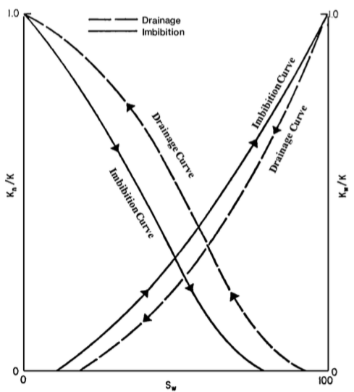

Slide 3
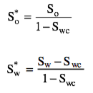
Two Phase Relative Permeability Correlations
Sebagian besar dari korelasi menggunakan parameter “effective phase saturation”

Slide 4
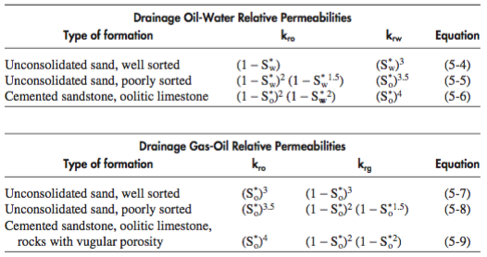
Wyllie and Gardner Correlation

Slide 5
Example
Generate the drainage relative permeability data for an unconsolodated well-sorted sand by using the wyllie and Gardner method. Assume the following critical saturation values:
Soc = 0.3
Swc = 0.25
Sgc = 0.05

Slide 6
Normalization and de-normalization Permeability Data

Slide 7
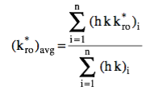
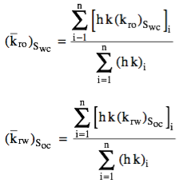
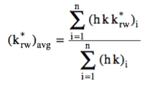
Normalization and de-normalization Permeability Data (2)

Slide 8
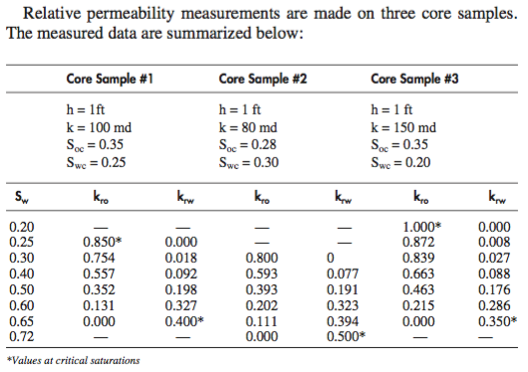
Example

