Slide 1
Compressibility
TKA 1401 Petrofisik

Slide 2
Porosity Review
Porosity is defined as the ratio of the void space in a rock to the bulk volume of that rock multiple by 100 to express in per cent
Primary porosity → intergranular (sandstone); intercrystalin (limestone)
Secondary porosity → fracture (shale); vugs (limestone)

Slide 3
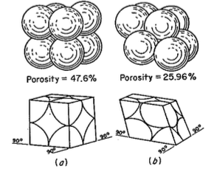
Porosity of Various Packing of Uniform spheres
Cubical packing (the least compact arrangement) → 47.6%
Rhombohedral packing (the most compact arrangement) → 25.96%

Slide 4
Affecting Factors of Porosity
Packing
Variety of particle size
Angularity
Distribution of particle size
Filled space with clay and cementing material

Slide 5
Compressibility
Porosity is a function of the degree of compaction of the rock.
Compacting force is a function of the maximum depth of burial of rock
Compacting force affect the grain arrangement

Slide 6
Compressibility (2)
Geerstma states that three kinds of compressibility must be distinguished in rocks:
Rock matrix compressibility
Rock bulk compressibility
Pore compressibility
Rocks buried at depth are subjected to internal stress exerted by fluids contained in the pores and to external stress which is in part exerted by overlying rocks

Slide 7
Formula

