Slide 1
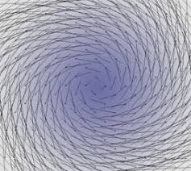
Ordinary Differential Equations Bernoulli Equation Abadi Universitas Negeri Surabaya

Slide 2
Bernoulli equation
Bernoulli equation is one of the well known nonlinear differential equations of first order. It is written as
$$y^{′}+a\left(x\right)y=b\left(x\right)y^{m}$$
Where $a(x)$ and $b(x)$ are continuous functions.
If $m=0$, the equation becomes a linear differential equation. In case of $m=1$ the equation becomes separable
In general case, when $m≠0, 1$, bernoulli equation can be converted to a linear differential equation using the change of variable $z=y^{1−m}$
The new differential equation for the function $z(x)$ has the form:
$$z^{′}+\left(1−m\right)a\left(x\right)z=\left(1−m\right)b(x)$$

Slide 3
Example
Find the general solution of the equation $y^{′}−y=y^{2}e^{x}$
Solution:
Set $m=2$ , so we use the substitution $z=y^{1−2}=\frac{1}{y}$
Differentiating both sides of the equation, we obtain:
$$z^{′}=−\frac{1}{y^{2}} y′$$
Divide both sides of the original differential equation by $y^{2}$:
$$\frac{1}{y^{2}}y^{′}−\frac{1}{y}=e^{x}$$
Subtituting $z$and $z’,$ we find:
$$−z^{′}−z=e^{x}$$

Slide 4
or we can write as:
$$z^{′}+z=−e^{x}$$
We get linear equation for the function $z(x)$. To solve it, we use the integrating factor
$$μ\left(x\right)=e^{∫\left(1 dx\right)}=e^{x}$$
The general solution of the linear equation is given by:
$$z\left(x\right)=\frac{1}{e^{x}}[∫\left(e^{x}\left(−e^{x}\right)dx\right]$$
$$z\left(x\right)=Ce^{−x}−\frac{1}{2}e^{x}$$
Returning to the function $y(x)$, we obtain the implicit expression:
$$\frac{1}{y}=Ce^{−x}−\frac{1}{2}e^{x}$$
Or
$$e^{x}=y(C−\frac{1}{2}e^{2x})$$

Slide 5
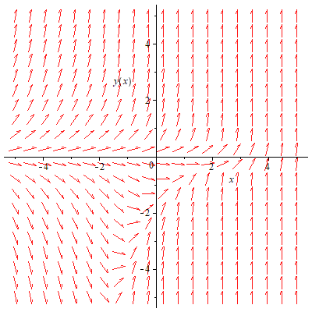
The direction fields of the that differential equation is:

Slide 6
exercises
Find the general solution of the equation:
$y^{′}+\frac{y}{x}=y^{2}$
$y^{′}+y\cot{x=y^{4}\sin{x}}$
$y^{′}+\frac{2y}{x}=2x\sqrt{y}$
$4xyy^{′}=y^{2}+x^{2}$ with $y\left(1\right)=1$

