Slide 1
FUTURE PLAN

Slide 2
I’m going to….
I plan to….
I hope to….
I would like to….
I would love to….

Slide 3
What are you going to do after graduating from a university?
I’m going to…..
Take a gap year
Find a job right away
Work for my family business
Study for my master’s degree

Slide 4
What kind of future do you hope to have?
I hope to have….
a nice family
a good job
some good friends
….

Slide 5
What other languages would you like to learn?
I’d like to learn…. because
Because….
……
It will be….
….

Slide 6
Would you like to stay in a dormitory or stay at home during university?
I’d like to …. because
because….
commute
freedom
independent
save cost
lonely

Slide 7
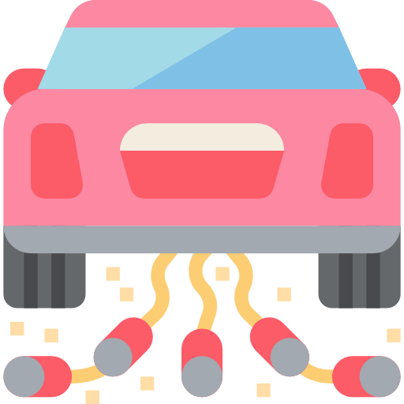
Do you want to get married in the future?
I ( don’t) want to…. because
tradition
The right person
Have kids
Stay together

Slide 8
If you could study abroad, where would you like to go?
I would like to go to… because…
Education system
The weather
Freedom of expression
curriculum

Slide 9
What kind of change do you hope to see in Indonesia?
I hope …
Technology
The economics
Education system
Law enforcement
Politics
The environment
Freedom of expression

Slide 10
What kind of change do you hope to see in the world?
I hope …
Education
Peace
Politics
Awareness
The environment

Slide 11
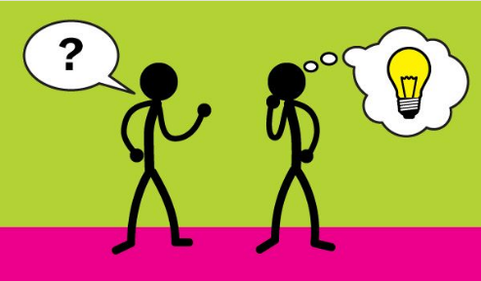
listening activity
Listen to Mary and answer the questions-
What is she doing tonight?
What is she doing on Wednesday?
What is she doing at the weekend?

Slide 12
fill in the gaps
Tonight I am going_____________. Tomorrow I am going to work. On Wednesday I am going ___ ____ _______. On Thursday I am visiting my sister. On Friday I am going to work. At the weekend I am going___ _______.

Slide 13
A) Simple future tense
Going to
Planned Future
Will
Negative: will not
Unplanned Future
USE: will
To talk about spontaneous decisions.
They will move to Ankara this winter.
Predictions about the future.
Because it’s getting hot in the house, I’ll turn on the air conditioner.
Dad’s late, I’ll call him.
FORM:
USE: going to
To talk about plans
I’m going to graduate at the end of this year. I passed all the exams.
To talk about predictions based on evidences.
Watch out! You’re going to hit the wall.
Subject + will / won’t + verb in infinitive
Subject + be going to + infinitive verb
Short form: will

Slide 14
B) Present Continuous in the future
Subject + verb to be (am / is / are) + verb -ing
Use: Present Continuous in the future:
To talk about a planned event in an exact place and time in the future.
Hayrettin is visiting his aunt this afternoon.
Fatma is having her hair dyed next weekend.
They’re having a listening quiz next Tuesday.
I’m seeing my dentist this Saturday.

