Slide 1
Desain Pengelolaan jaringan PPDIOO & McCabe Model
Rochmad M Thohir Yassin

Slide 2
PPDIOO Model

Slide 3
Prepare Phase
Pada tahapan ini meliputi mengidentifikasi dan mengukuhkan kebutuhan organisasi, mengembangkan strategi jaringan, membuat arsitektur konseptual dengan skala yang tinggi dan mengidentifikasi teknologi yang tepat untuk dapat mendukung arsitektur tersebut

Slide 4
Identifying Organizational Goal
What are you trying to accomplish with this project?
What business challenges are you currently facing?
What are the consequences of not resolving these issues?
How would you measure or quantify success if you could fix or correct the identified problems and issues?
What applications are most critical to your organization?
What is the major objective of this project?
What is driving the change?
Do you need to support any government or safety or legal mandates?
What are your main concerns with the implementation of a new solution?
What technologies or services are needed to support your objectives?
What other technology projects and business initiatives will affect your group in the next two to five years?
What skill sets does your technical staff currently have?
What is your goal for return on investment?

Slide 5
Contoh Organizational Goals

Slide 6
Plan Phase
Pada tahapan ini meliputi mengidentifikasi network requirements termasuk di dalamnya tujuan mengapa jaringan dibangun, dimana jaringan akan dipasang, siapa saja yang membutuhkan layanan jaringan tersebut, dan sebagainya

Slide 7
Design Phase
Pada fase ini, melakukan perancangan jaringan komputer secara menyeluruh dan detail yang sesuai dengan bisnis yang berjalan, kebutuhan teknis untuk mendukung availability, reliability, security, scalability, dan performance

Slide 8
Design Phase
Step 1 : Identify Customer Requirements
Step 2 : Characterize the existing network and sites
Step 3 : Design the network topology and solutions

Slide 9
Identify Customers Requirements
Pada tahap ini yaitu mengidentifikiasi kebutuhan pelanggan, tujuan dari suatu organisasi dan technical goal pada organisasi tersebut.
Pada tahap ini juga mendeskripsikan dan menentukan manakah aplikasi dan network yang sudah ada dan yang mana yang akan dirancang

Slide 10
Identify Customer Requirements (2)
Hal-hal yang perlu dipertimbangkan pada tahap ini :
Apakah proses perancangan ini untuk sebuah network yang baru atau modifikasi dari network yang sudah ada ?
Apakah perancangan ini untuk keseluruhan network, bagian dari sebuah network, atau hanya sebagian dari segment atau module ?
Apakah perancangan ini ditujukan untuk fungsi yang tunggal atau keseluruhan fungsionalitas ?

Slide 11
Contoh Design Assesment
Scope of Design | Comments
Entire Network | Backbone pada kantor pusat butuh redesign. Semua LAN pada kantor cabang butuh diupgrade ke teknologi FastEthernet
Network Layer | Perlunya perancangan baru terhadap IP Private. LAN-LAN harus disegmentasi. Routing harus redesign untuk mendukung perancangan baru IP Address dan untuk menyediakan ketersediaan dan redudansi
Datalink Layer | Office Backbone membutuhkan perangkat dan link yang mendukung redudansi. Selain itu juga memerlukan site survey untuk keperluan pengembangan mobile application

Slide 12
Identifying Required Information
Extracting Initial Requirements
Gathering Network Requirements

Slide 13
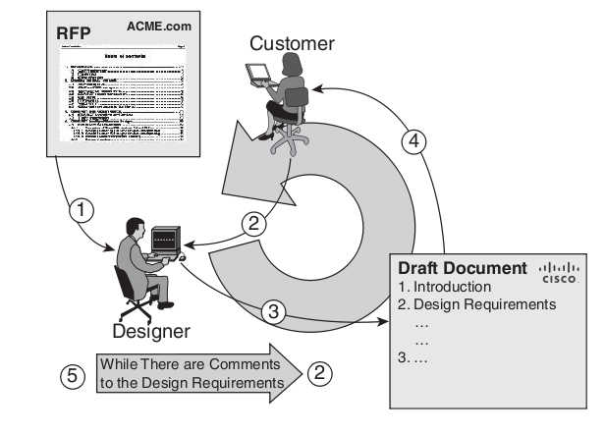
Extracting Initial Requirements

Slide 14
Extracting Initial Requirements
Step 1 Extract the initial customer requirements (from the RFP or RFI).
Step 2 Query the customer for a verbal description of the initial requirements.
Step 3 Produce a draft document that describes the design requirements.
Step 4 Verify the design requirements with the customer, and obtain customer approval.
Step 5 Revise the document as necessary to eliminate errors and omissions.

Slide 15
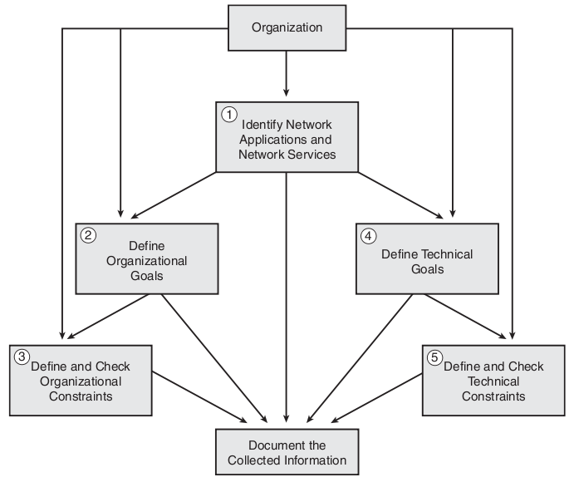
Gathering Network Requirements

Slide 16
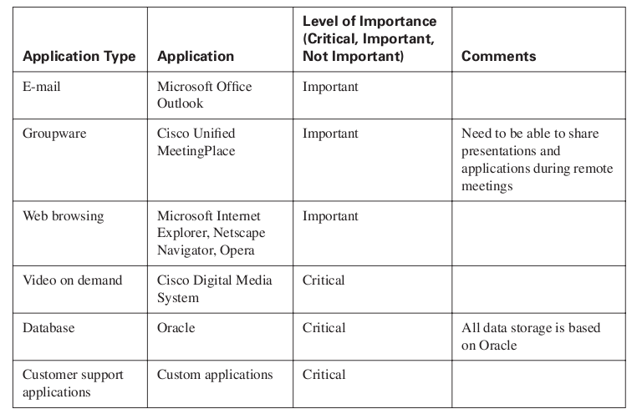
Planned Applications and Network Services

Slide 17
Characterize the existing network and sites
Step 1 : Customer Input
Step 2 : Network Audit
Step 3 : Traffic Analysis

Slide 18
Customer Input
Terkait dengan semua dokumentasi network
Hal-hal yang perlu diidentifikasi :
Locations and types of servers, including a list of network applications supported
Locations and types of network devices
Cabling that is currently in place, including network interface connection tables and worksheets
Wiring closet locations
Environmental controls, including heating, ventilation, and air conditioning requirements, and filtration
Locations of telephone service demarcation points
WAN speeds and locations of the WAN connection feeds
Locations of power receptacles, and availability of additional receptacles and power sources

Slide 19
Customer Input (2)
Contoh dokumentasi network :
Identitas Pemilik ? | Nama : Alamat : No.Telp : No.HP : Email :
Apakah network ini dimaintenance oleh pemiliknya sendiri ? | Ya / Tidak
Berapa jam network ini beroperasi sehari ? | __ Jam
Apakah ada prosedur untuk mengakses ruangan network ? Bagaimana prosedurnya ?
Apakah ada standar prosedur keamanan ? Bagaimana standarnya ?
Sebutkan secara detail perangkat network !

Slide 20
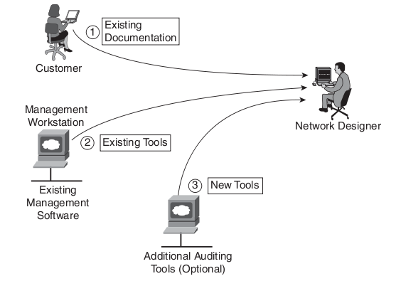
Network Audit

Slide 21
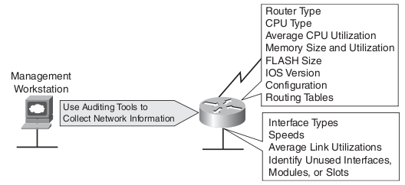
Network Audit (2)

Slide 22
Contoh Network Audit

Slide 23
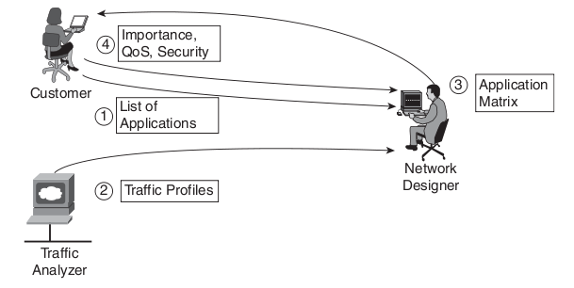
Traffic Analysis

Slide 24
Tools untuk Traffic Analysis
Cisco IOS Network-Based Application Recognation (NBAR)
Ciso IOS NetFlow Technology
Cacti (http://www.cacti.net)
Solarwinds Network Traffic Analysis (https://www.solarwinds.com/netflow-traffic-analyzer/use-cases/network-traffic-analysis)
Wireshark (http://www.wireshark.org)

Slide 25
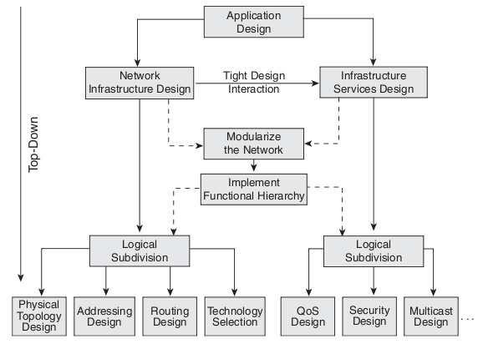
Design the network topology and solutions
Top-Down Approach :

Slide 26
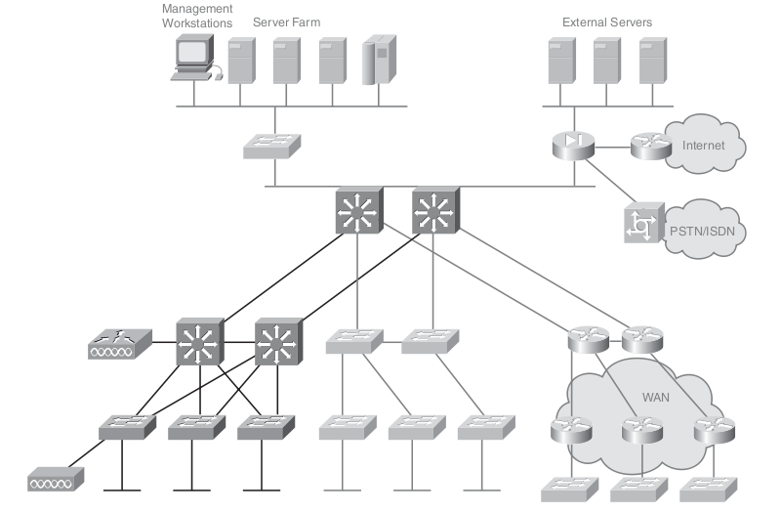
Prototype

Slide 27
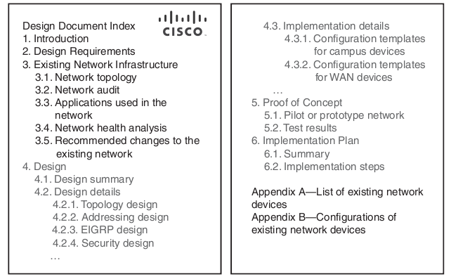
Documenting Design

Slide 28
Implementation Phase
Fase implementasi baru dapat diimplementasikan, jika fase perancangan telah disetujui

Slide 29
Implementation Phase (2)
Step 1 : Plan the Implementation
Step 2 : Implement and verify the design
Step 3 : Monitor and Optionally redisgn

Slide 30
Operate Phase
Fase ini termasuk dalam fase implementasi, namun lebih kepada bagaimana memelihara berjalannya jaringan komputer dengan baik, termasuk di dalamnya fault detection, correction, dan performance monitoring

Slide 31
Optimize Phase
Tujuan dari fase ini adalah untuk mengidentifikasi dan mencari solusi sebelum terjadinya kerusakan pada jaringan. Fase ini sifatnya proaktif.

Slide 32
Keuntungan PPDIOO
Lowering the total cost of network ownership
Increasing network availability
Improving business agility
Accelerating access to applications and services

Slide 33
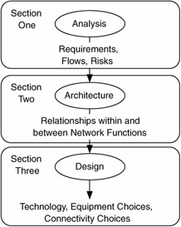
McCabe Model
Designing a network is typically broken into three sections:
Determine requirements
Define the overall architecture
Choose technology and specific devices

Slide 34
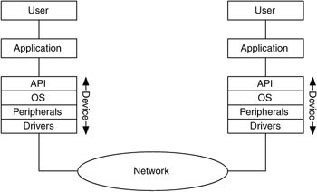
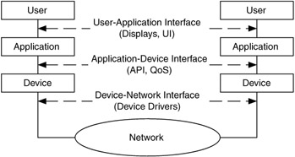
Requirements
Consider how devices communicate

Slide 35
Requirement Analysis
Given these concepts, how do we describe requirements for a network?
Need a process to filter or classify requirements
Network requirements (often have high, medium, low priorities)
Future requirements (planned upgrades)
Rejected requirements (remember for future ref.)
Informational requirements (ideas, not required)

Slide 36
Requirement Analysis (2)
Requirements can come from many aspects of the network system
User Requirements
Application Requirements
Device Requirements
Network Requirements
Other Requirements

Slide 37
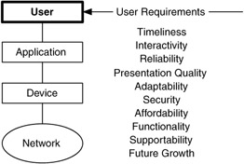
User Requirement
User requirements are often qualitative and very high level
What is ‘fast enough’ for download? System response (RTT)?
How good does video need to be?
What’s my budget?

Slide 38
Application Requirement
What types of apps are we using?
Mission-critical
Rate-critical
Real-time and/or interactive
How sensitive are apps to RMA (reliability, maintainability, availability)?
What capacity is needed?
What delay time is acceptable?

Slide 39
Device Requirement
What kinds of devices are on your network?
Generic computing devices include normal PCs, Macs, laptops, handheld computers, workstations
Servers include all flavors of server – file, print, app/computation, and backup
Specialized devices include extreme servers (supercomputers, massively parallel servers), data collection systems (POS terminals), industry-specific devices, networked devices (cameras, tools), stoplights, ATMs, etc.

Slide 40
Network Requirement
Issues with network integration include
Scaling dependencies – how will the size of the existing network affect the new one?
Will the existing network change structure, or just add on a new wing?
Location dependencies – interaction between old and new networks could change the location of key components
Performance constraints – existing network could limit performance of the new one

Slide 41
Other Requirement
Requirements can come from other outside sources – your customer, legal requirements, larger scale organization (enterprise) requirements, etc.
Additional requirements can include
Operational suitability – how well can the customer configure and monitor the system?
Supportability – how well can the customer maintain the system?

Slide 42
Network Architecture
Now that we FINALLY have requirements and flows defined, we can consider how all this will affect the architecture of our network
The architecture of a house needs many views to understand not only the exterior appearance, but also where the wires run, where the pipes are, ductwork for heating and cooling, etc.
Similarly, we need several views of a network

Slide 43
Contoh Network Architecture

Slide 44
Selecting Technology
After the types of mechanisms in the reference architecture have been selected, we can start choosing more specific design technologies for our network
This is where most people start ‘network design’
Technologies need to be consistent with the goals of the network
What is most important – cost, capacity, QoS, security, manageability…?

Slide 45
Selecting Technology (2)
The goals may be different in different parts of the network
Consider having a primary goal and one or more secondary goals
Consider graphs to show tradeoffs
Based on the flow requirements, how do you evaluate candidate technologies?
RMA, capacity, cost, performance, supportability, etc. can be your basis for judging technologies

