Slide 1
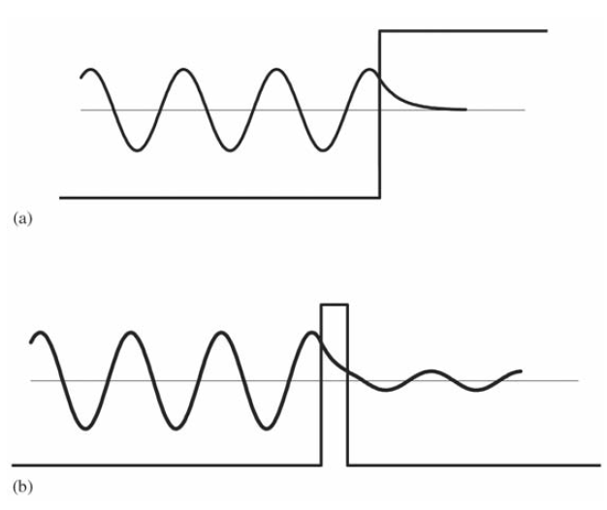
Aplikasi Persamaan Schrodinger

Slide 2
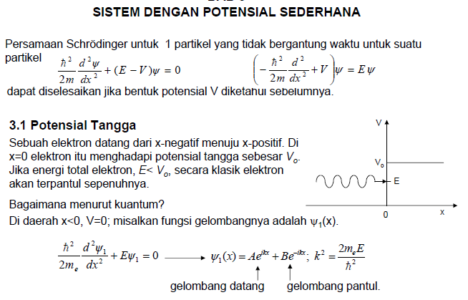

Slide 3
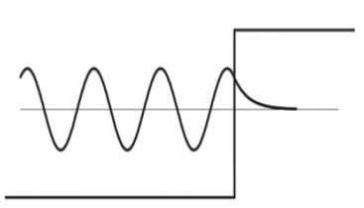
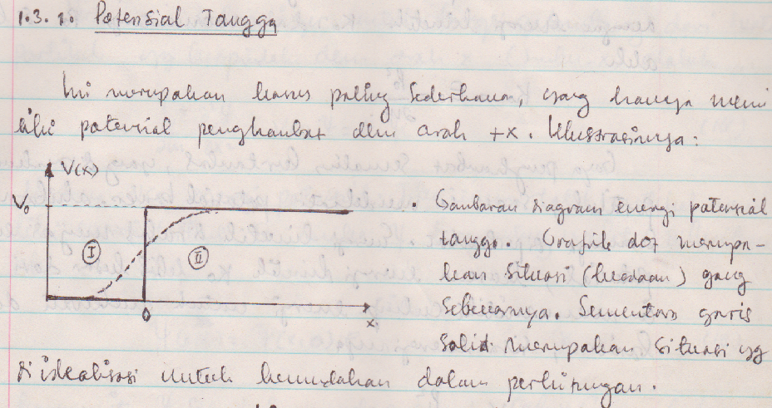
Potensial Tangga (Step Potential)

Slide 4
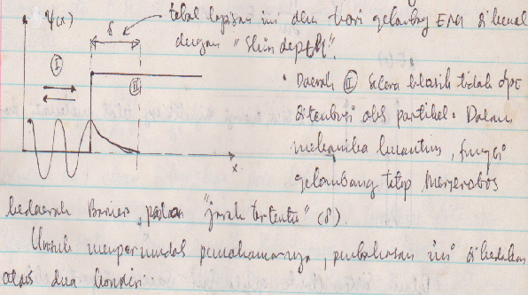
Potensial Tangga (Step Potential)

Slide 5
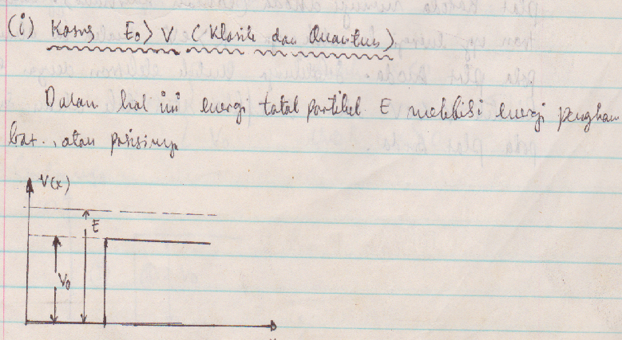
Potensial Tangga (Step Potential)

Slide 6
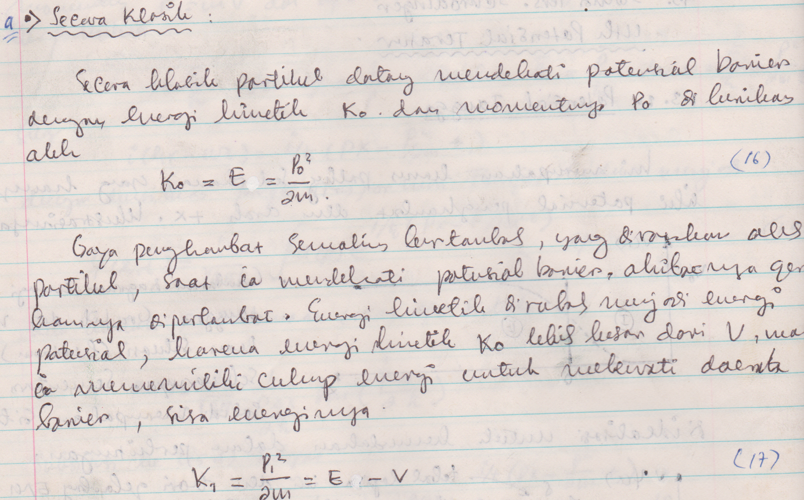
Potensial Tangga (Step Potential)

Slide 7
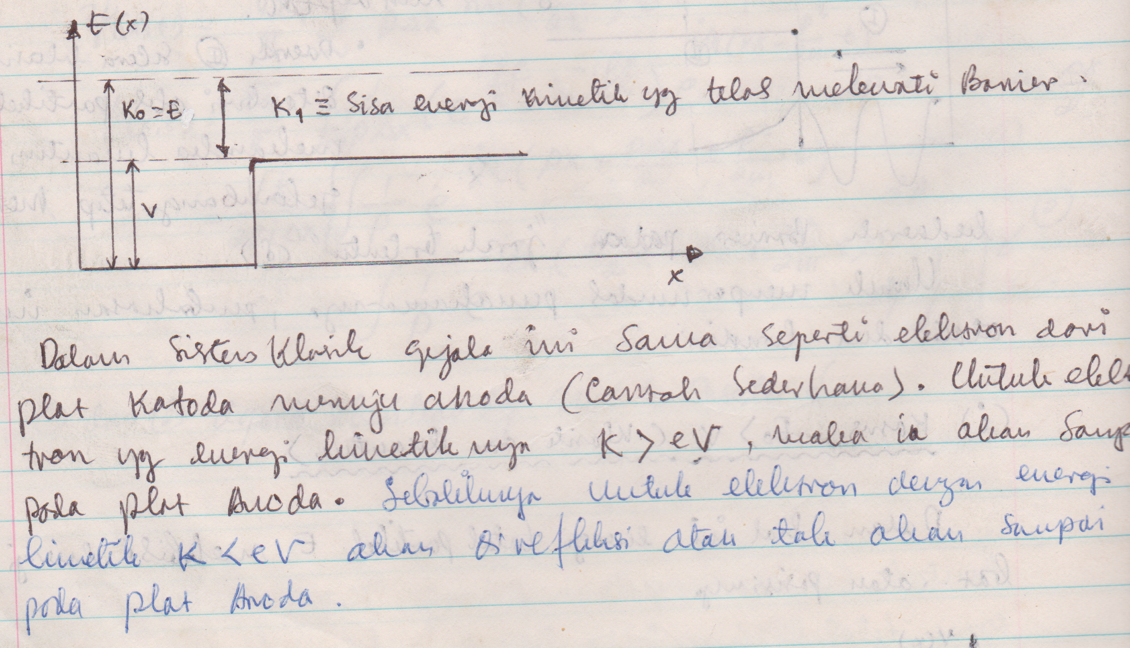
Potensial Tangga (Step Potential)

Slide 8
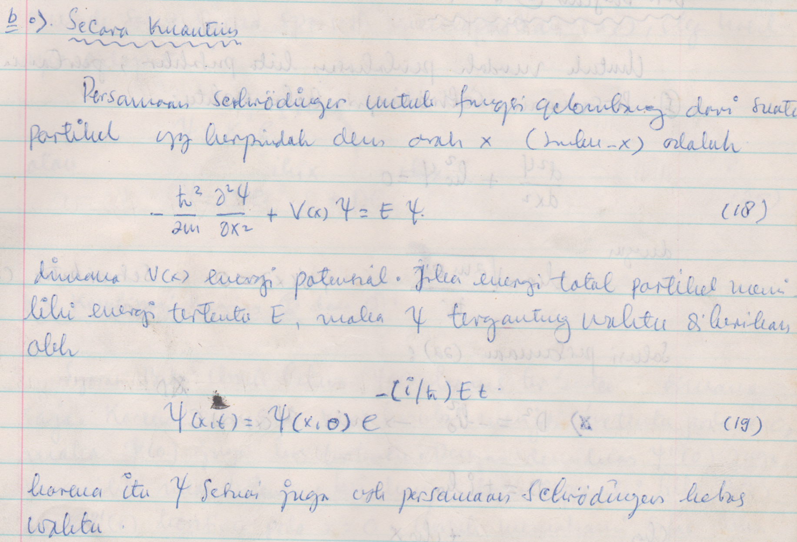
Potensial Tangga (Step Potential)

Slide 9
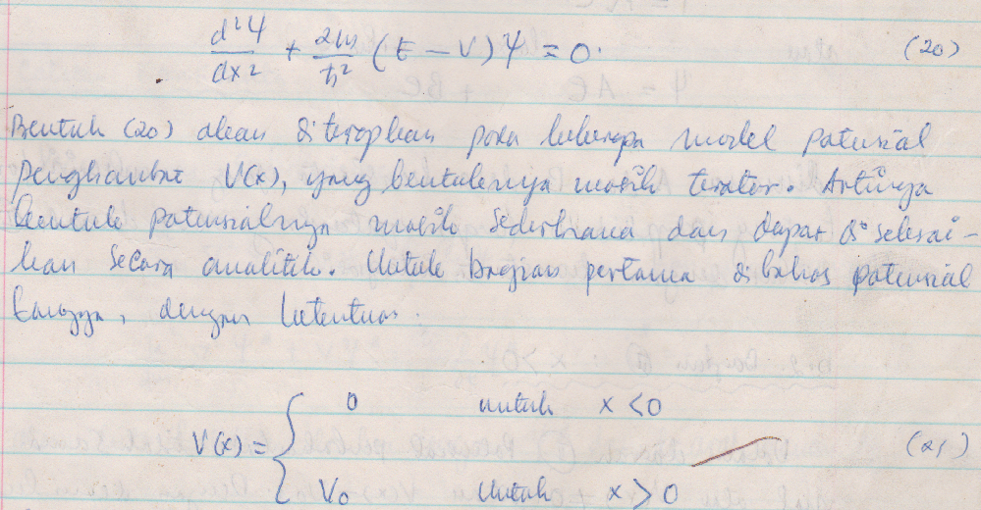
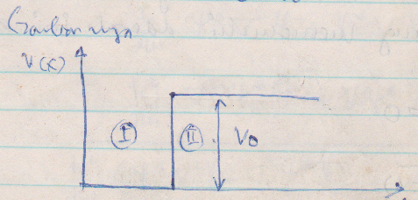
Potensial Tangga (Step Potential)

Slide 10
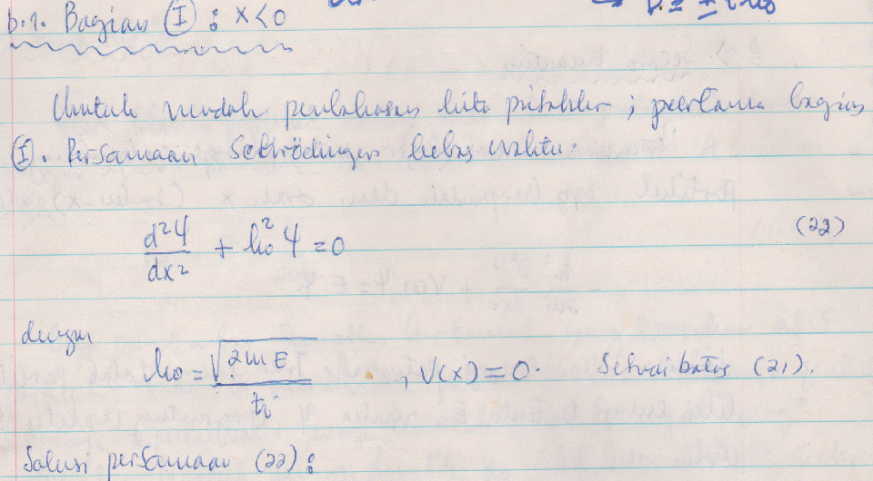
Potensial Tangga (Step Potential)

Slide 11
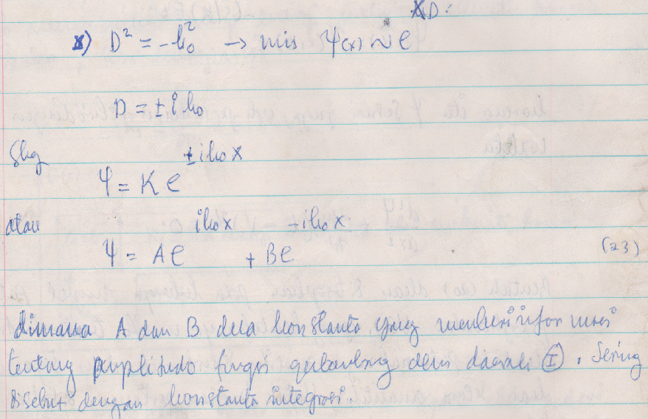
Potensial Tangga (Step Potential)

Slide 12
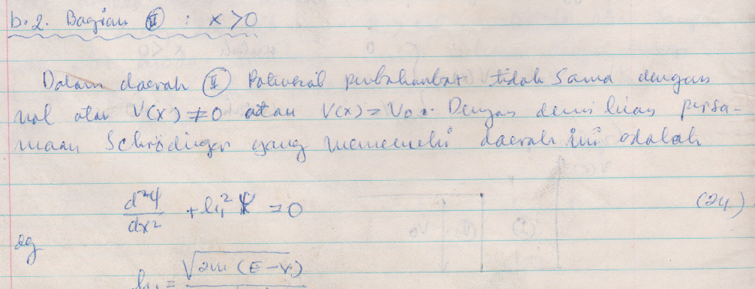
Potensial Tangga (Step Potential)

Slide 13
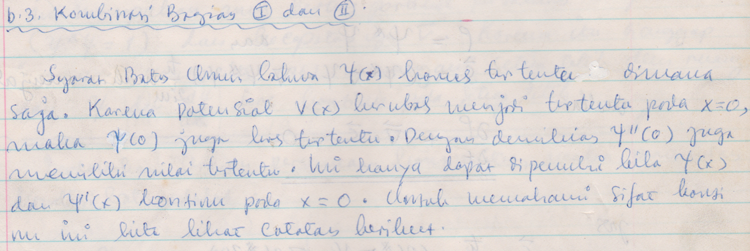
Potensial Tangga (Step Potential)

Slide 14
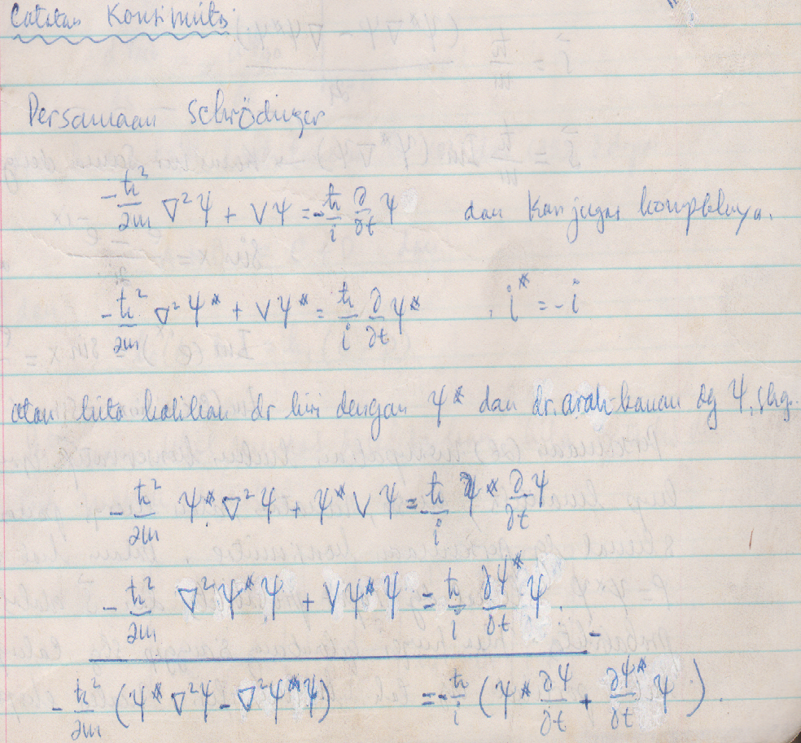
Potensial Tangga (Step Potential)

Slide 15
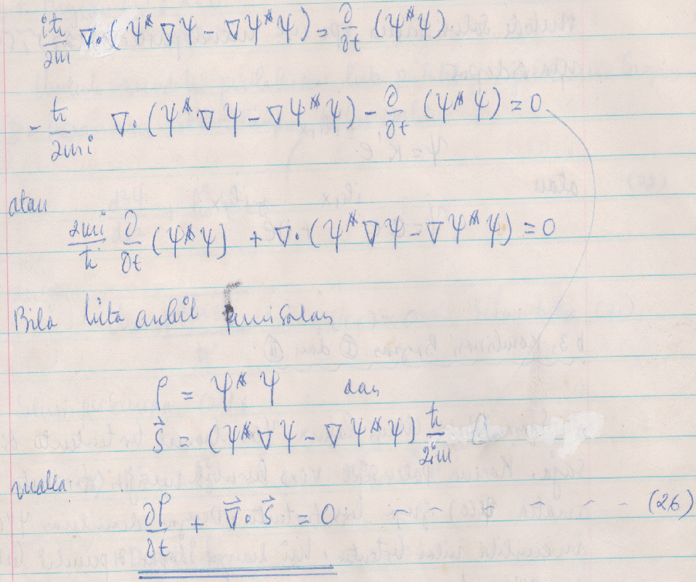
Potensial Tangga (Step Potential)

Slide 16
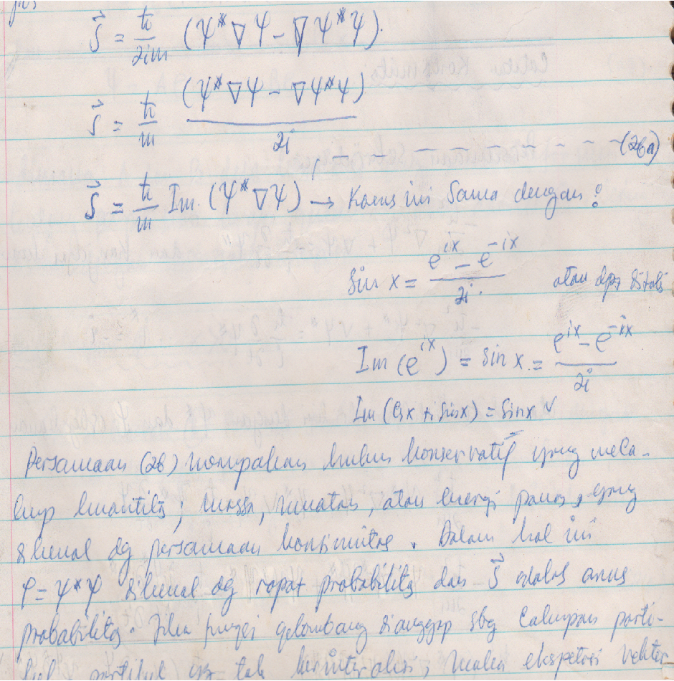
Potensial Tangga (Step Potential)

Slide 17
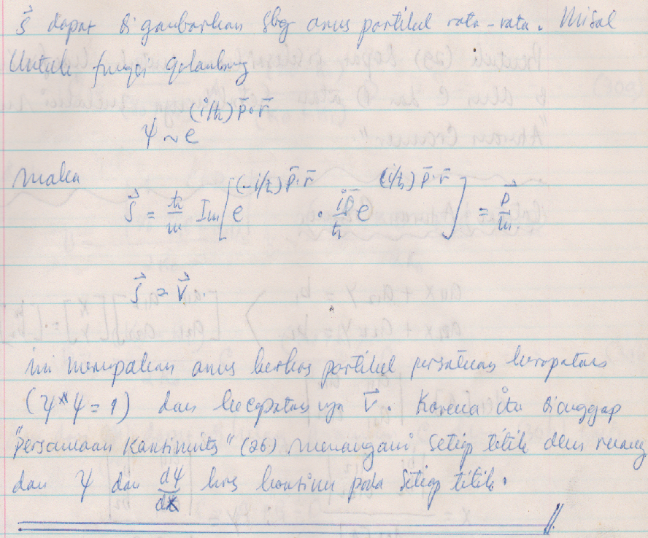
Potensial Tangga (Step Potential)

Slide 18
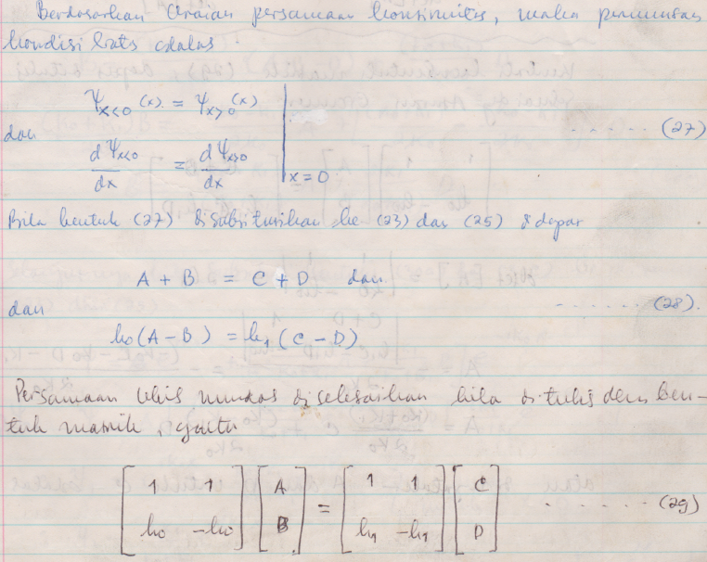
Potensial Tangga (Step Potential)

Slide 19
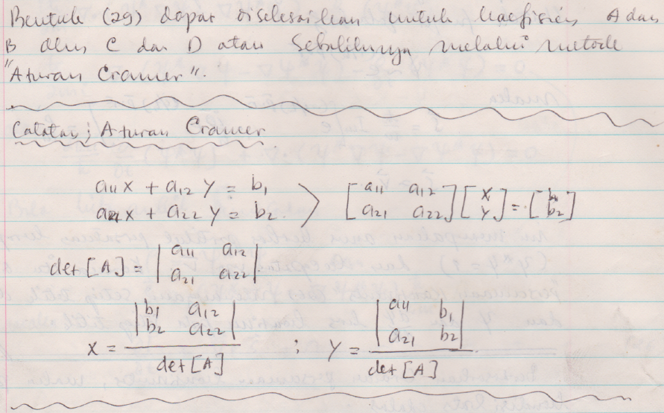
Potensial Tangga (Step Potential)

Slide 20
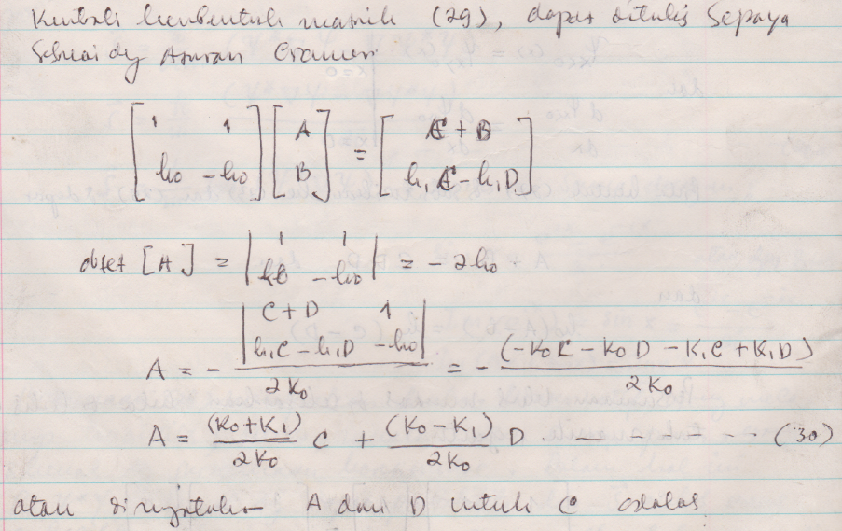
Potensial Tangga (Step Potential)

Slide 21
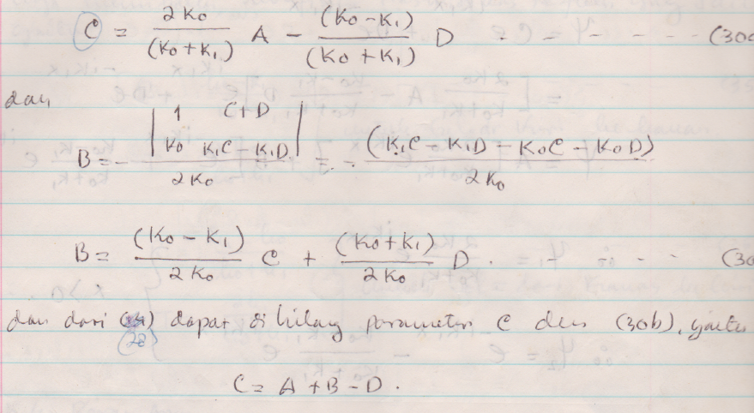
Potensial Tangga (Step Potential)

Slide 22
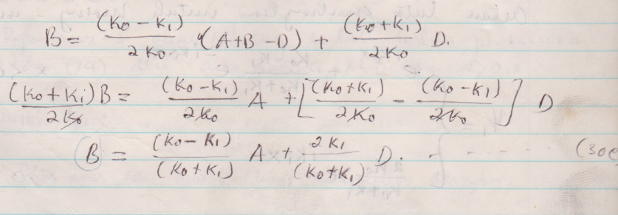
Potensial Tangga (Step Potential)

Slide 23
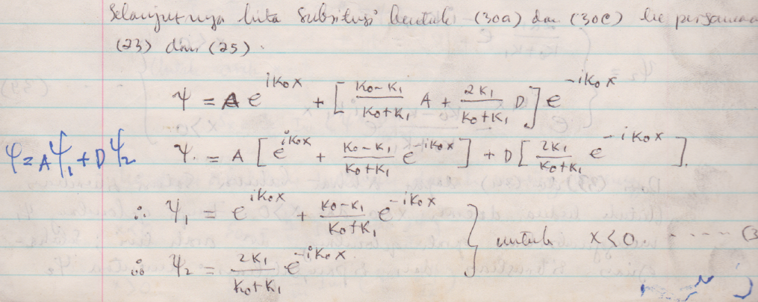
Potensial Tangga (Step Potential)

Slide 24
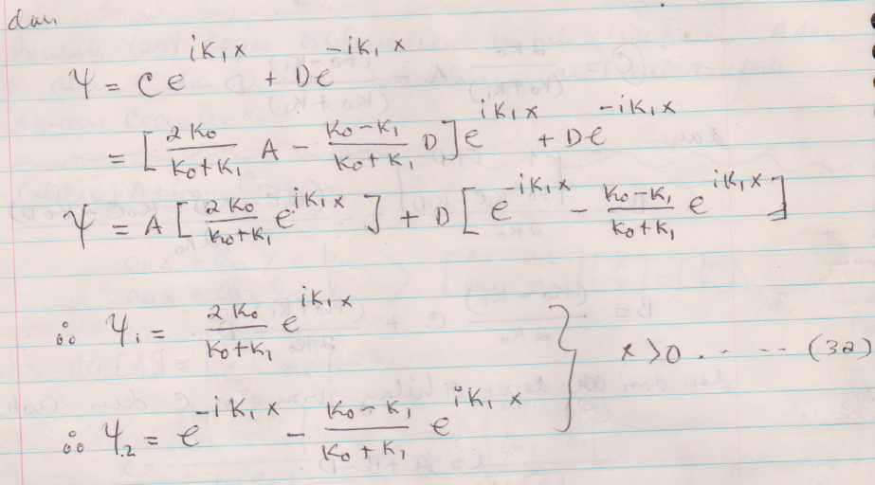
Potensial Tangga (Step Potential)

Slide 25
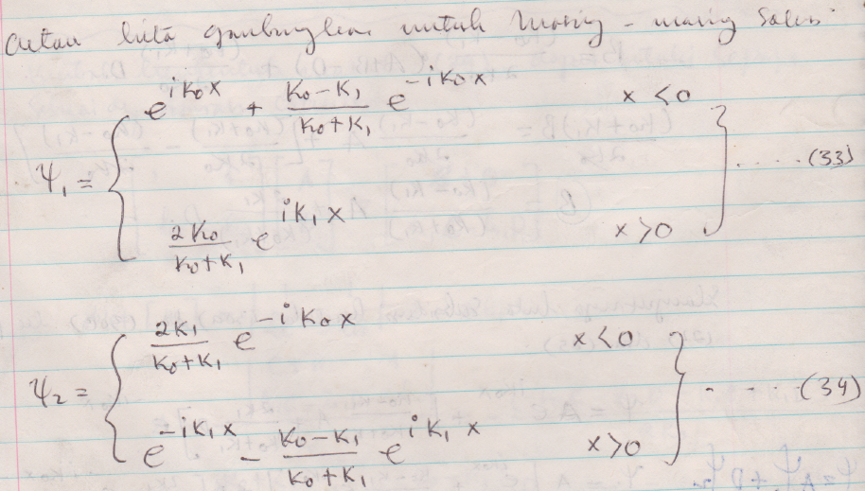
Potensial Tangga (Step Potential)

Slide 26
Potensial Tangga (Step Potential)

Slide 27
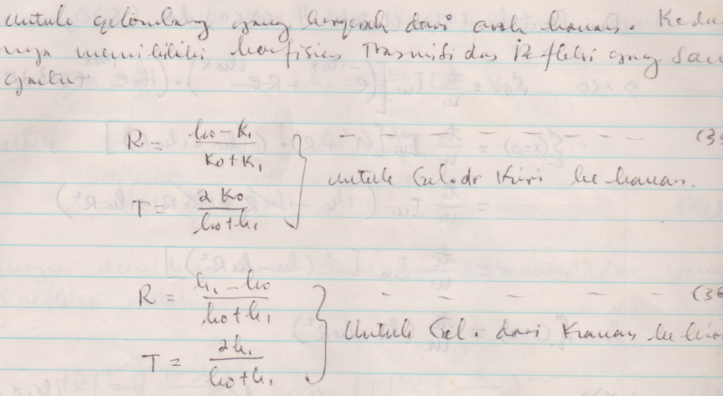
Potensial Tangga (Step Potential)

Slide 28
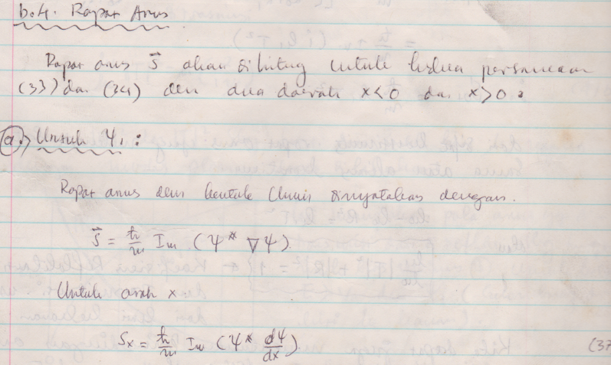
Potensial Tangga (Step Potential)

Slide 29
Potensial Tangga (Step Potential)

Slide 30
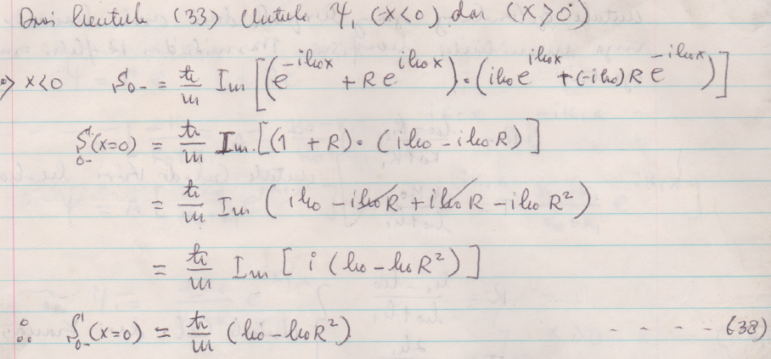
Potensial Tangga (Step Potential)

Slide 31
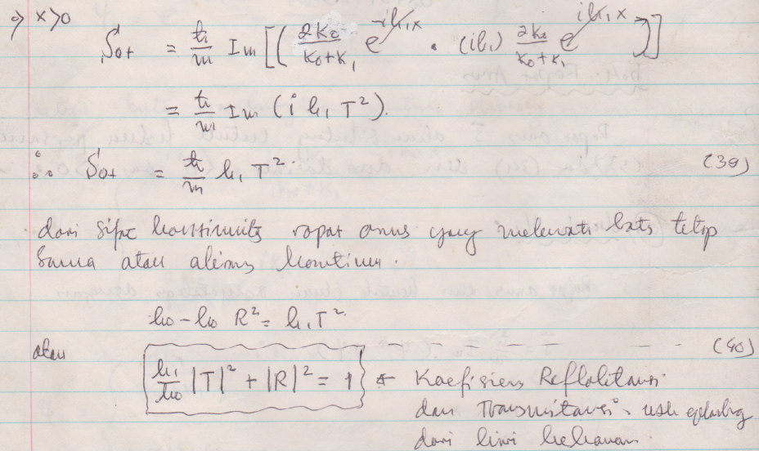
Potensial Tangga (Step Potential)

Slide 32
Potensial Tangga (Step Potential)

Slide 33
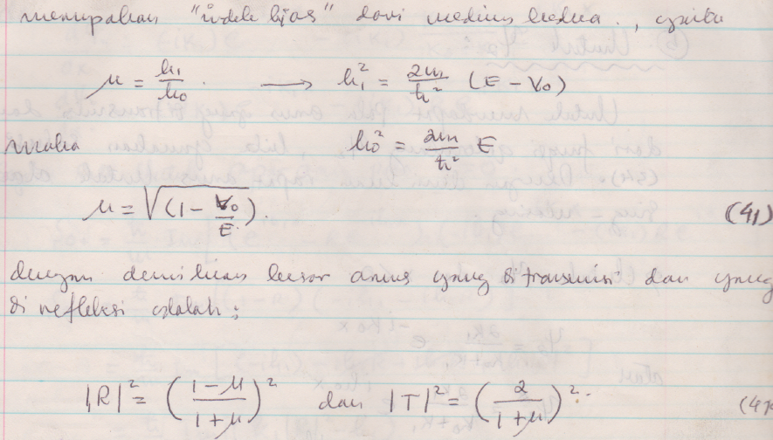
Potensial Tangga (Step Potential)

Slide 34
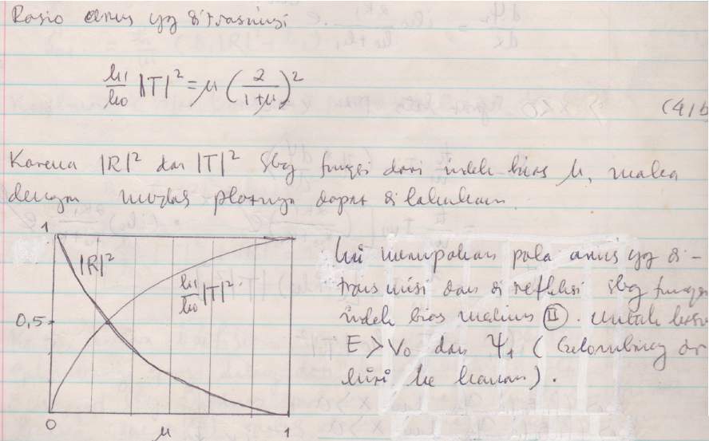
Potensial Tangga (Step Potential)

Slide 35
Potensial Tangga (Step Potential)

Slide 36
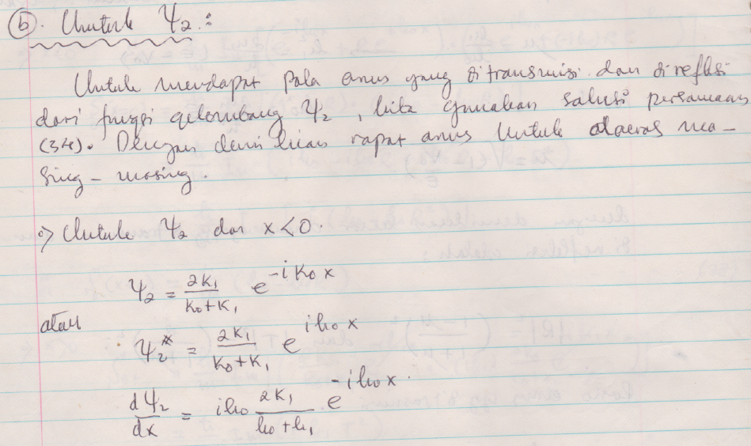
Potensial Tangga (Step Potential)

Slide 37
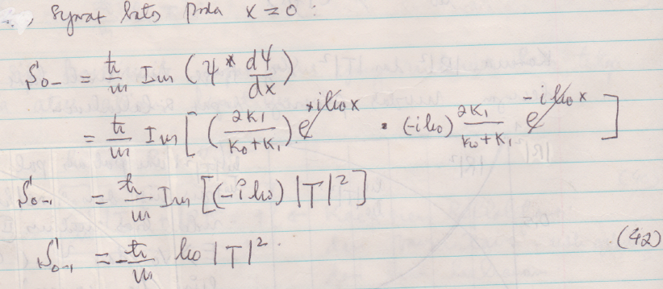
Potensial Tangga (Step Potential)

Slide 38
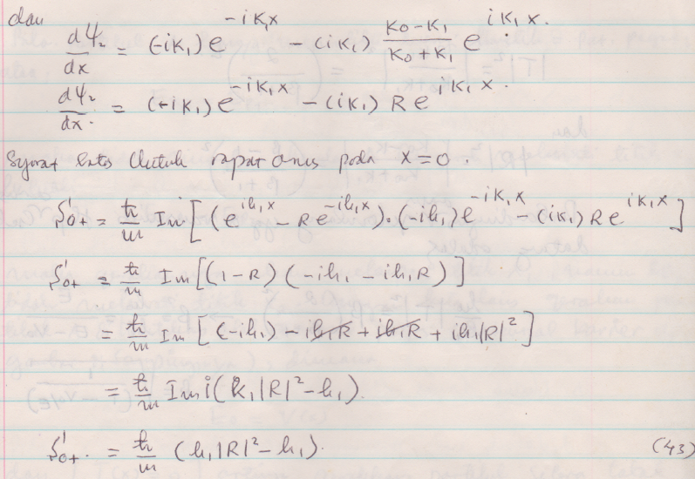
Potensial Tangga (Step Potential)

Slide 39
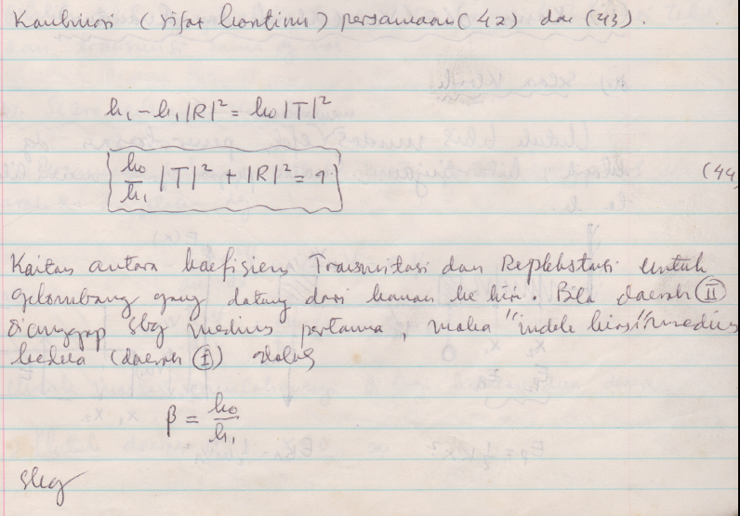
Potensial Tangga (Step Potential)

Slide 40
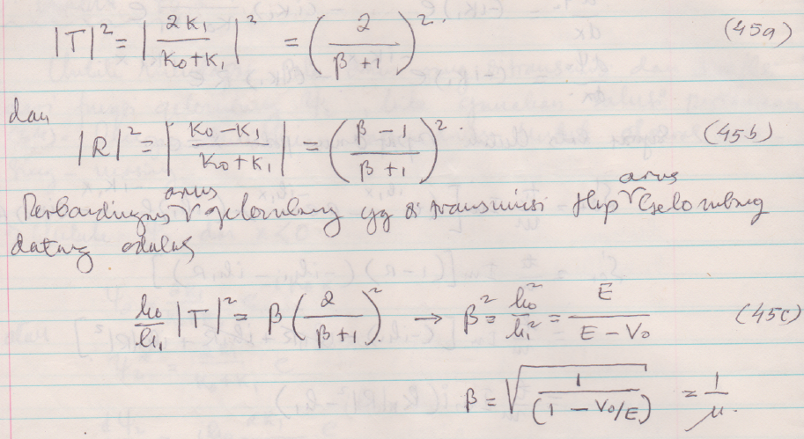
Potensial Tangga (Step Potential)

Slide 41
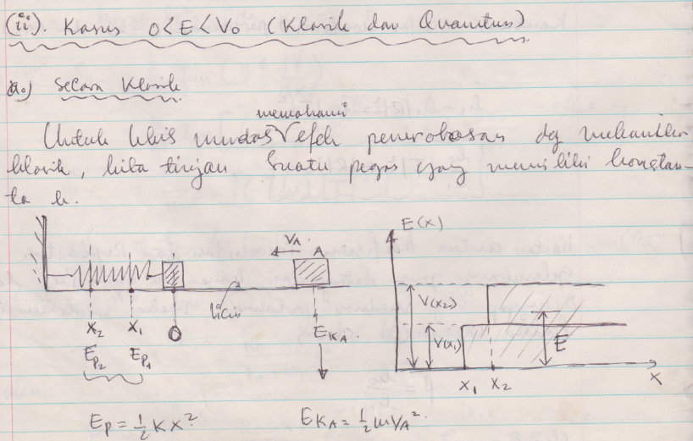
Potensial Tangga (Step Potential)

Slide 42
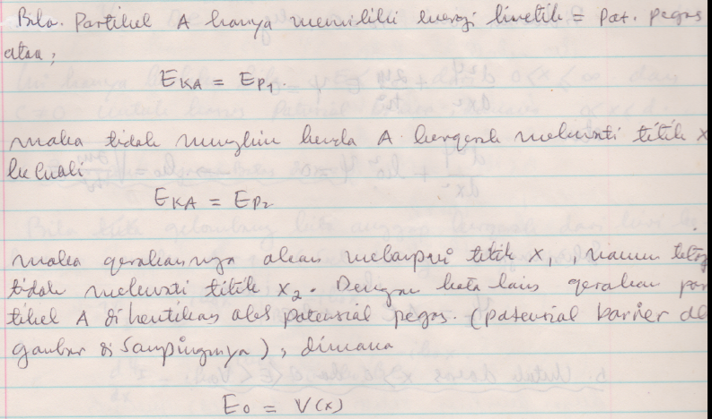
Potensial Tangga (Step Potential)

Slide 43
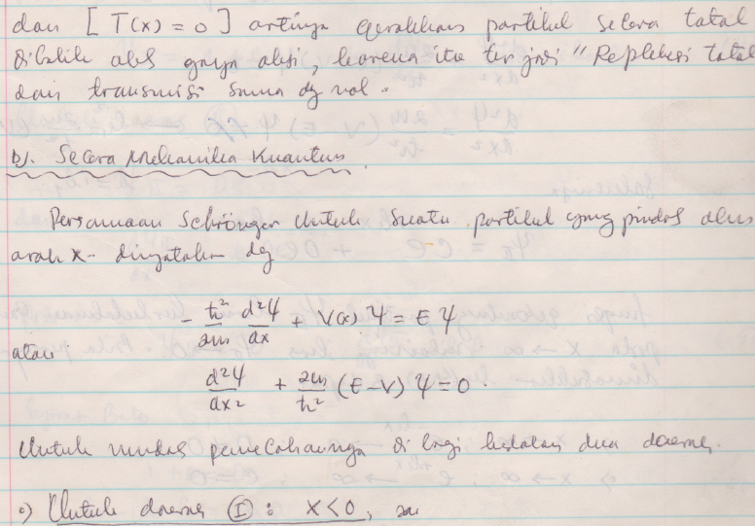
Potensial Tangga (Step Potential)

Slide 44
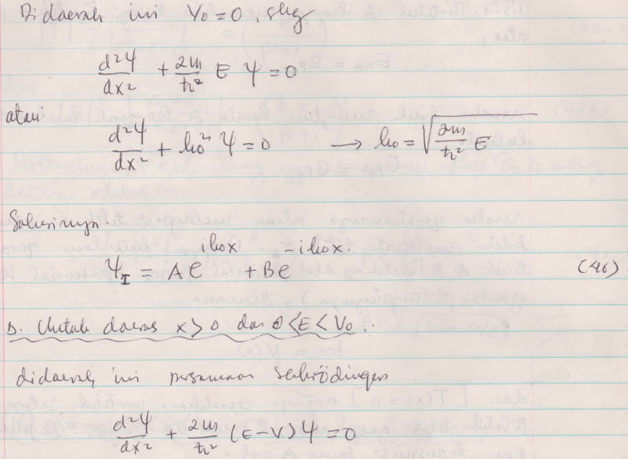
Potensial Tangga (Step Potential)

Slide 45
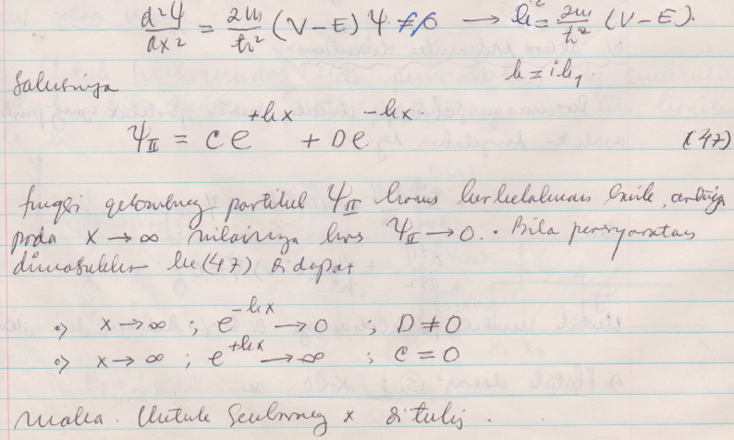
Potensial Tangga (Step Potential)

Slide 46
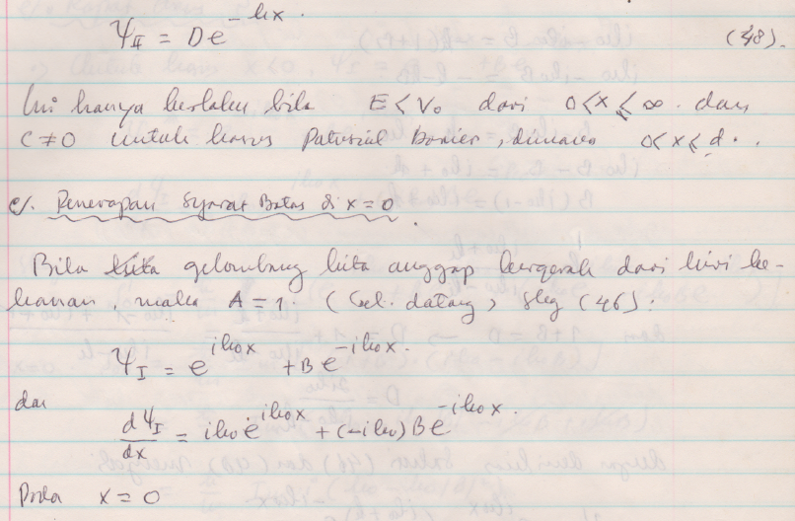
Potensial Tangga (Step Potential)

Slide 47
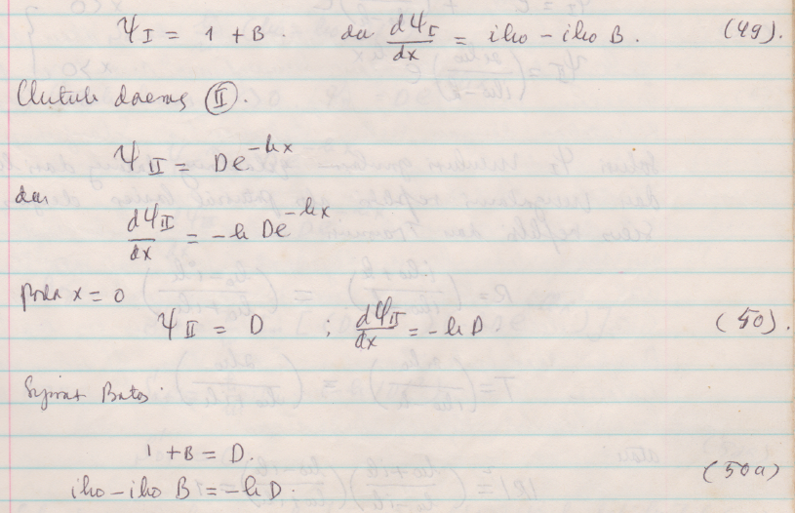
Potensial Tangga (Step Potential)

Slide 48
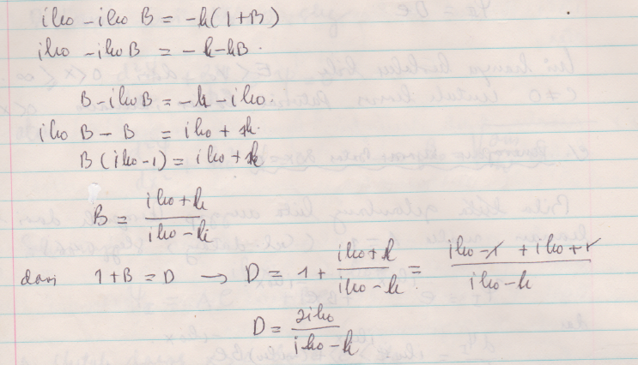
Potensial Tangga (Step Potential)

Slide 49
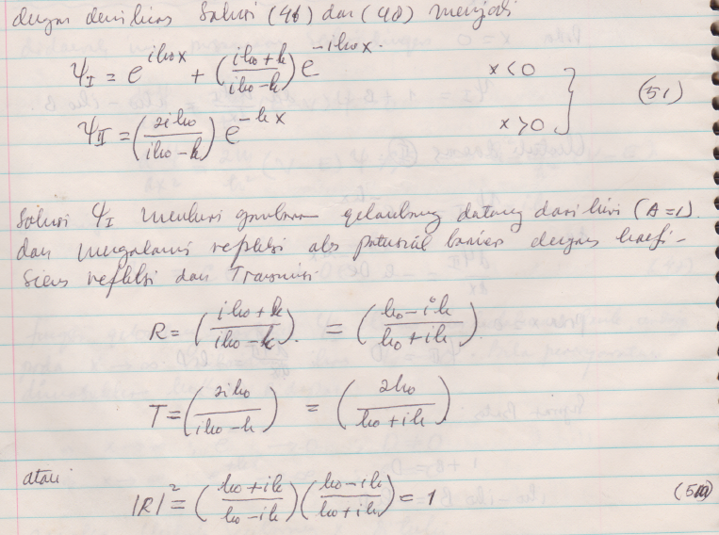
Potensial Tangga (Step Potential)

