Slide 1
Sistem Transmisi Tenaga Listrik
Dimas Fajar Uman Putra

Slide 2
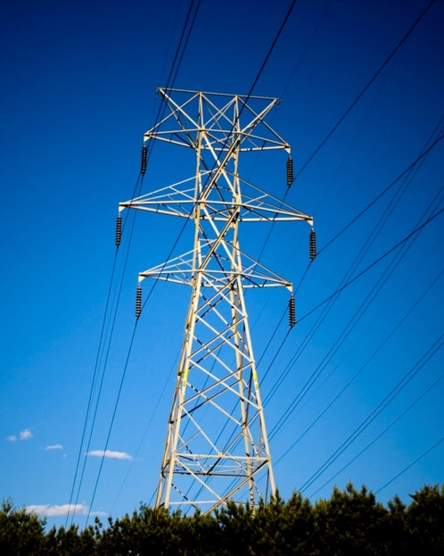
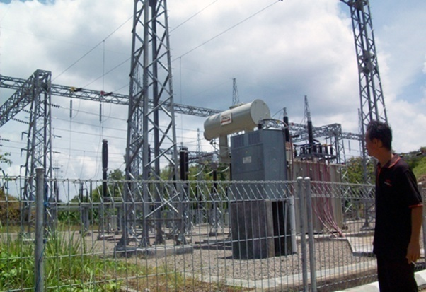
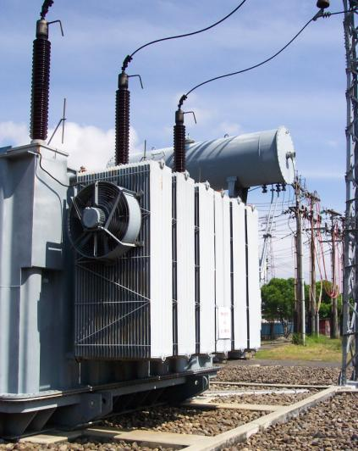
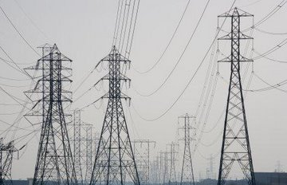
Pengertian penyaluran energi listrik :
Proses dan cara menyalurkan energi listrik pada jarak yang berjauhan dari satu tempat ke tempat lainnya (dari pembangkit listrik ke gardu induk dan dari satu gardu induk ke gardu induk lainnya), yang terdiri dari konduktor yang direntangkan antara tiang-tiang (tower), melalui isolator-isolator, dengan sistem tegangan tinggi/ekstra tinggi.
Ruang lingkupnya dimulai dari Gardu Induk di Pembangkitan sampai dengan Gardu Induk (sisi primer) yang ada pusat-pusat beban.
22

Slide 3
BESARAN TEGANGAN DAN JENIS PENYALURAN (TRANSMISI)
Besaran tegangan : 66 KV, 70 KV, 132 KV, 150 KV, 245 KV, 275 KV, 350 KV, 500 KV, 1.000 KV dan lain-lain
Jenis arus : arus searah (DC) dan arus bolak-balik (AC).
Jenis dan ruang lingkup penyaluran :
Saluran udara (Overhead Line).
Saluran bawah tanah (Underground Cable).
Saluran kabel bawah laut (Sub Marine Cable).
Gardu Induk Tegangan Ultra Tinggi.
Gardu Induk Tegangan Ekstra Tinggi.
Gardu Induk.
Gardu Hubung.
Pusat Pengatur Beban.
Unit Pengatur Beban.
23

Slide 4
SISTEM PENYALURAN (TRANSMISI) DI INDONESIA
Besaran tegangan : 70 KV, 150 KV, 275 KV dan 500 KV.
Jenis arus : arus bolak-balik (AC).
Jenis dan ruang lingkup penyaluran :
Saluran Udara Tegangan Tinggi (SUTT).
Saluran Kabel Tanah Tegangan Tinggi (SKTT).
Saluran Kabel Bawah Laut Tegangan Tinggi (Sub Marine Cable).
Saluran Udara Tegangan Ekstra Tinggi (SUTET).
Gardu Induk (GI).
Gardu Induk Tegangan Ekstra Tinggi (GITET).
Pusat Pengatur Beban (UPB).
Unit Pengatur Beban.
Sistem interkoneksi (Interconnection System) :
Telah terpasang di Pulau Jawa-Madura-Bali (Jamali) dan Pulau Sumatera.
Sebagian daerah di Sumatera masih terjadi bottle neck.
24

Slide 5
Tingkat pengembangan sistem (menuju ke interkoneksi) :
Sistem penyaluran dari parsial menuju ke interkoneksi.
Terpasang di Pulau Kalimantan dan Pulau Sulawesi.
Tingkat perintisan :
Pada umumnya di daerah-daerah yang ratio elektrifikasinya rendah (NTT, Maluku, Maluku Utara, Papua dan lain-lain).
Penyediaan listrik bersifat parsial.
Saluran udara (Overhead Line) dipasang di daerah-daerah yang keadaan ROW-nya memungkinkan, pada umumnya di daerah pinggiran kota dan di luar kota.
Saluran kabel bawah tanah (Underground cable) dipasang di daerah yang ROW-nya tidak memungkinkan, pada umumnya di daerah tengah kota, kota-kota besar yang padat pemukiman dan beban listriknya besar.
25

Slide 6
Gardu Induk :
Untuk daerah-daerah yang masih memungkinkan mendapatkan lahan/space tanah yang luas, dipasang Gardu Induk Konvesional, pada umumnya di pinggiran kota atau di kota-kota kecil.
Untuk daerah-daerah perkotaan (Kota Besar) yang padat pemukiman, dipasang Gas Insulated Switchgear SF6 (GIS SF6).
Pusat Pengatur Beban (P2B) dan Unit Pengatur Beban (UPB) :
Dipasang di daerah-daerah yang jaringannya telah terinterkoneksi, area pelayanan luas dan beban yang dilayani besar, contoh : P3B & UPB yang ada di Sistem Jawa-Madura-Bali (Jamali).
Tujuannya adalah untuk pengaturan beban maupun melakukan manuver beban jika terjadi masalah di sistem, misal : jika terjadi gangguan di sistem pembangkit atau di sistem transmisi.
26

Slide 7
PEMBANGUNAN DAN PENGEMBANGAN PENYALURAN (TRANSMISI)
Secara teknis, pembangunan dan pengembangan sistem penyaluran tenaga listrik, tidak ada masalah dan tidak ada kesulitan.
Masalah-masalah yang sering timbul dalam pembangunan sistem penyaluran (transmisi) adalah masalah non teknis, antara lain :
Kesulitan mendapatkan lahan untuk tapak tower.
Harga tanah yang sangat (terlalu) mahal.
Proses perijinan yang sulit dan berbelit.
Reaksi dari masyarakat yang tidak mau dilalui jalur transmisi.
Beberapa waktu terakhir ini, muncul fenomena baru, masyarakat minta kompensasi (ganti rugi) di sepanjang ROW jalur transmisi.
Biaya ganti rugi kerusakan bangunan, tanaman dan lain-lain yang mahal, bahkan terkadang jauh melampaui harga standar.
Koordinasi dengan berbagai pihak / instansi terkait, yang merupakan kesulitan tersendiri dan tak jarang membutuhkan biaya besar.
Isu lingkungan hidup.
Dan berbagai hambatan/kendala lainnya.
27

Slide 8
Berbagai permasalahan tersebut mengakibatkan proses pembangunan dan pengembangan sistem penyaluran menjadi terhambat, bahkan ada pembangunan transmisi yang terhenti/tertunda bertahun-tahun.
Mengingat dari waktu ke waktu beban akan terus berkembang (mengalami pertumbuhan), sedangkan di sisi lain untuk membangun transmisi dan gardu induk banyak menghadapi masalah, perlu dipikirkan dan dicarikan solusi dalam pengembangan sistem penyaluran di Indonesia.
Harus dicermati bahwa penambahan pembangkit tanpa diimbangi penambahan sistem transmisi akan timbul masalah tersendiri.
28

Slide 9
UP-RATING SISTEM PENYALURAN (TRANSMISI)
Up-rating berarti menaikkan rate/menaikkan kemampuan/menaikkan kapasitas.
Up-rating sistem penyaluran, berarti menaikkan rate/menaikkan kemampuan/menaikkan kapasitas penyaluran, antara lain :
Dari SUTT 70 KV menjadi 150 KV.
SUTT 150 KV yang ditingkatkan kemampuannya dalam menyalurkan energi listrik.
SUTT single circuit ditingkatkan menjadi double circuit.
Gardu induk yang berkapasitas 10 MVA dinaikkan menjadi 30 MVA, dari 1 trafo menjadi 2 trafo, dari 30 MVA menjadi 60 MVA atau 100 MVA.
Dan lain sebagainya.
Up-rating bisa dilakukan dengan cara :
Membangun SUTT baru, membangun (memperluas) Gardu Induk Eksisting.
Mengganti konduktor (re-conductoring) SUTT eksisting, mengganti trafo pada Gardu Induk Eksisting, dari kapasitas kecil diganti dengan kapasitas yang lebih besar.
Menambah jumlah sirkit SUTT eksisting, menambah jumlah trafo dan peralatan pada Gardu Induk eksisting.
29

Slide 10
Sistem distribusi tenaga listrik

Slide 11
Perbedaan Transmisi dengan Distribusi
BASIS | TRANSMISSION LINE | DISTRIBUTION LINE
Usage | Transmission Line helps in the movement of electricity from power plant to the substations. | The Distribution line carries electricity from the substation to the consumer’s end.
Phase | It is carried out electricity in three phase supply system. | It requires a single phase supply system for carrying electricity.
Current conduction level | They conduct current at 69 kV or more. | They conduct less than 69 kV
Thickness | Transmission lines are thick lines. | Distribution line are thin as compared to the transmission line.

Slide 12
Perbedaan Trafo pada sistem Transmisi dengan Distribusi
BASIS OF DIFFERENCE | POWER TRANSFORMER | DISTRIBUTION TRANSFORMER
Type of network | It is used in transmission network of higher voltages | It is used in the distribution network for lower voltages.
Availability of ratings | 400 kV, 200 kV, 110 kV , 66 kV, 33 kV. | 11 Kv, 6.6 Kv, 3.3 Kv, 440 V,230 V
Maximum rating of usage | Power transformers are used for rating above 200 MVA | Distribution transformers are used for rating less than 200 MVA
Size | Larger in size as compared of distribution transformers | Smaller in size
Designed Efficiency | Designed for maximum efficiency of 100% | Designed for 50-70% efficiency
Efficiency formula | Efficiency is measured as the ratio of output to the input power | Here All Day Efficiency is considered. It is the ratio of output in kilowatt hour (kWh) or watt hour (Wh) to the input in kWh or Wh of a transformer over 24 hours.
Application | Used in generating stations and transmission substations | Used in distribution stations, also for industrial and domestic purposes
Losses | Copper and iron losses take place throughout the day | Iron losses take place for 24 hours and copper losses are based on load cycle
Load fluctuation | In power transformer the load fluctuations are very less | Load fluctuations are very high
Operating condition | Always operated at full load | Operated at load less than full load as load cycle fluctuates
Considering time | It is independent of time | It is time dependent
Flux density | In power transformer flux density is higher | As compared to power transformer the flux density is lower in distribution transformer
Designing of the core | Designed to utilize the core for maximum and will operate near to the saturation point of the B-H curve, which helps to bring down the mass of core | As compared to power transformer the flux density is lower in distribution transformer
Usage | Used to step up and step down voltages | Used as an end user connectivity

Slide 13
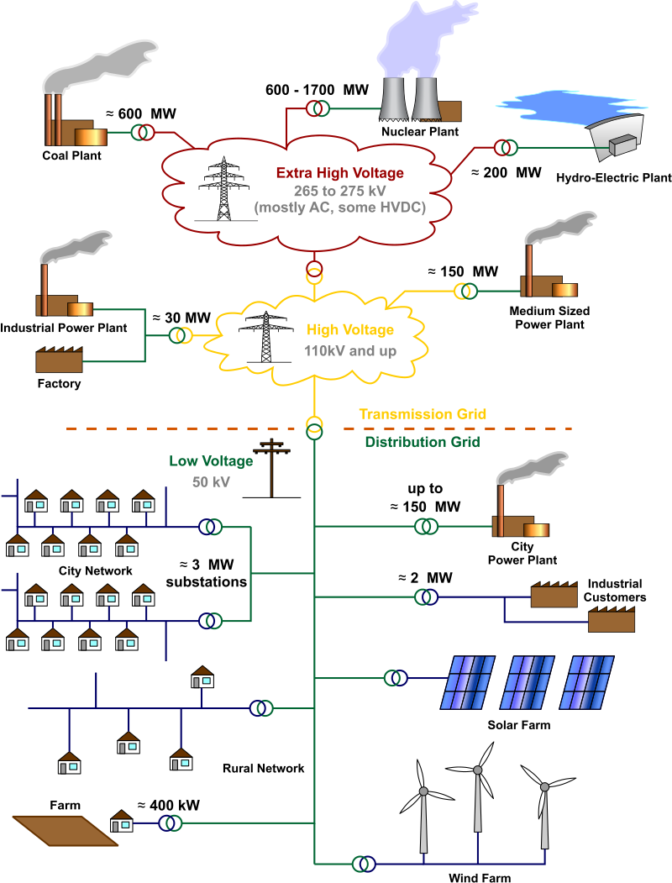
Perubahan sistem distribusi tenaga listrik

Slide 14
Sistem Distribusi Tenaga Listrik (New)
Masuknya Renewable energy dan DG (aktif distribution system)
Muncul Microgrid (isolated distribution system), sensor menjadi bertambah
SCADA memiliki peran yang lebih besar
Integrasi SCADA dengan GIS

Slide 15
Characteristics | Traditional Power grid | Smart Grid
Technology | Electromechanical: | Digital:
 | Traditional energy infrastructure is electromechanical. This means that it is of, relating to, or denoting a mechanical device that is electrically operated. The technology of this manner is typically considered to be “dumb” as it has no means of communication between devices and little internal regulation. | The smart grid employs digital technology allowing for increased communication between devices and facilitating remote control and self-regulation.
Distribution | One-Way Distribution: | Two-Way Distribution:
 | Power can only be distributed from the main plant using traditional energy infrastructure. | While power is still distributed from the primary power plant, in a smart grid system, power can also go back up the lines to the main plant from a secondary provider. An individual with access to alternative energy sources, such as solar panels, can actually put energy back on to the grid.
Generation | Centralized: | Distributed:
 | With traditional energy infrastructure, all power must be generated from a central location. This eliminates the possibility of easily incorporating alternative energy sources into the grid. | Using smart grid infrastructure, power can be distributed from multiple plants and substations to aid in balancing the load, decrease peak time strains, and limit the number of power outages.
Sensors | Few Sensors: | Sensors Throughout:
 | The infrastructure is not equipped to handle many sensors on the lines. This makes it difficult to pinpoint the location of a problem and can result in longer downtimes. | In a smart grid infrastructure system, there are multiple sensors placed on the lines. This helps to pinpoint the location of a problem and can help reroute power to where it is needed while limiting the areas affected by the downtime.
Monitoring | Manual: | Self:
 | Due to limitations in traditional infrastructure, energy distribution must be monitored manually. | The smart grid can monitor itself using digital technology. This allows it to balance power loads, troubleshoot outages, and manage distribution without the need for direct intervention from a technician.
Restoration | Manual: | Self-Healing:
 | In order to make repairs on traditional energy infrastructure, technicians have to physically go to the location of the failure to make repairs. The need for this can extend the amount of time that outages occur. | Sensors can detect problems on the line and work to do simple troubleshooting and repairs without intervention. For problems related to infrastructure damage, the smart grid can immediately report to technicians at the monitoring center to begin the necessary repairs.
Equipment | Failure & Blackout: | Adaptive & Islanding:
 | As a result of aging and limitations, traditional energy infrastructure is prone to failures. Failure of infrastructure can lead to blackouts, a condition where the end customer is receiving no power to their unit causing downtime. | Using a smart grid system, power can be rerouted to go around any problem areas. This limits the area impacted by power outages and can do it on a per residence level.
Control | Limited: | Pervasive:
 | Using traditional power infrastructure, energy is very difficult to control. After leaving the power plant or substation, companies have no control over the energy distribution. | With the increased amount of sensors and other smart infrastructure, energy companies have more control than ever over power distribution. Energy and energy consumption can be monitored all the way down the line; from the moment it leaves the power plant, all the way to the consumer.
Customer Choices | Fewer: | Many:
 | The traditional power grid system infrastructure is not properly equipped to give customers a choice in the way they receive their electricity. Alternative energy sources, for example, have to be separated from power plants and traditional grid infrastructure. This is also part of the reasoning behind the establishment of electric companies as a public utility. | Using smart technologies, infrastructure can be shared. This allows more companies and forms of alternative energy to come on to the grid allowing consumers to have more choice in how they receive energy.

Slide 16
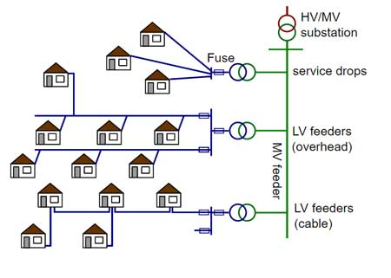
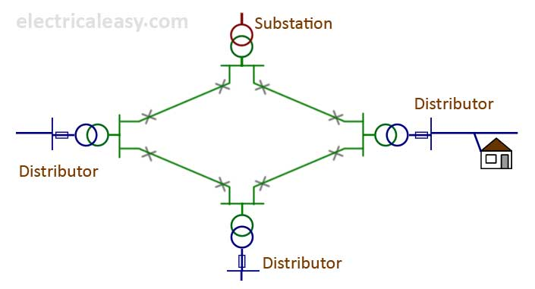
Topology di Dalam Sistem Distribusi
Radial
Parallel
Loop/Ring
Spindle

Slide 17
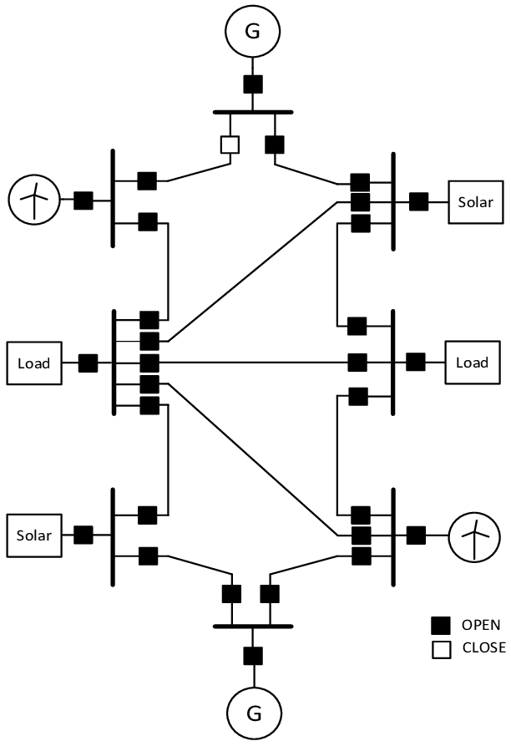
Topology di Dalam Sistem Distribusi
Weakly Mesh
Mesh
Spindle
Spindle

Slide 18
Berdasarkan Level Tegangan
Sistem Distribusi Primer
Sistem Distribusi Sekunder

Slide 19
Gardu Induk

