Slide 1
FAKULTAS TEKNOLOGI INFORMASI
PENAMBANGAN DATA
[KP368 – 3 SKS – FAKULTAS TEKNOLOGI INFORMASI]

Slide 2
PENGANTAR PENAMBANGAN DATA
Pertemuan 01

Slide 3
Tujuan Pembelajaran
Mahasiswa memahami proses, peran utama dan metode dalam penambangan data
Mahasiswa mengetahui penerapan penambangan data dalam kehidupan sehari-hari

Slide 4
Dunia vs Data
Dunia sedang tenggelam dalam data

Slide 5
Berapa populasi penduduk di dunia?
*Sumber: https://www.worldometers.info/world-population/

Slide 6
Data bertambah seiring pertambahan penduduk
Manusia memproduksi beragam data yang jumlah dan ukurannya sangat besar
Bisnis
Kedokteran
Ekonomi
Olahraga
Cuaca
Finansial
Media Sosial
dll
*Sumber: https://www.worldometers.info/world-population/

Slide 7
Sebagai gambaran banyaknya data…

Slide 8
Sebagai gambaran banyaknya data…
Setiap hari kita menghasilkan 2,5 Quintilion Bytes setiap hari.
Pada Tahun 2022, jumlah data seluruh dunia diperkirakan mencapai ~97 zettabyte.
Sumber: https://www.statista.com/statistics/871513/worldwide-data-created

Slide 9
Berapakah ukuran 1 ZettaByte?

Slide 10
Dalam satu detik…
10.217 Tweet terkirim
1.195 Foto Instagram terunggah
2.180 Posting Tumblr terkirim
7.384 Panggilan Skype
165.118 GB lalu lintas data di Internet
106.462 Pencarian di Google
97.970 Video YouTube dilihat
3.193.745 Email terkirim (~67% spam)
Sumber: https://www.internetlivestats.com

Slide 11
Faktanya…
Data melimpah, tapi sedikit pengetahuan

Slide 12
Apa itu Data Mining?
Disiplin ilmu yang mempelajari metode untuk mengekstrak pengetahuan atau menemukan pola dari suatu data yang besar
Ekstraksi dari data ke pengetahuan:
Data: fakta yang terekam dan tidak membawa arti
Pengetahuan: pola, rumus, aturan atau model yang muncul dari data
Nama lain data mining:
Knowledge Discovery in Database (KDD)
Knowledge extraction
Pattern analysis
Information harvesting
Business intelligence
Penambangan Data

Slide 13
Apa itu Data Mining?
Data
Metode Data Mining
Pengetahuan

Slide 14
Definisi Data Mining
Melakukan ekstraksi untuk mendapatkan informasi penting yang sifatnya implisit dan sebelumnya tidak diketahui, dari suatu data (Witten et al., 2011)
Kegiatan yang meliputi pengumpulan, pemakaian data historis untuk menemukan keteraturan, pola dan hubungan dalam set data berukuran besar (Santosa, 2007)
Ekstraksi pola atau pengetahuan yang menarik (penting, implisit, sebelumnya tidak diketahui dan berpotensi bermanfaat) dari data berukuran besar (Han et al., 2011)

Slide 15
Data – Informasi – Pengetahuan
Data Kehadiran Pegawai
NIP | TGL | DATANG | PULANG
1103 | 02/12/2004 | 07:20 | 15:40
1142 | 02/12/2004 | 07:45 | 15:33
1156 | 02/12/2004 | 07:51 | 16:00
1173 | 02/12/2004 | 08:00 | 15:15
1180 | 02/12/2004 | 07:01 | 16:31
1183 | 02/12/2004 | 07:49 | 17:00

Slide 16
Data – Informasi – Pengetahuan
Informasi Akumulasi Bulanan Kehadiran Pegawai
NIP | Masuk | Alpa | Cuti | Sakit | Telat
1103 | 22
1142 | 18 | 2 |  | 2
1156 | 10 | 1 | 11
1173 | 12 | 5 |  |  | 5
1180 | 10 |  |  | 12

Slide 17
Data - Informasi – Pengetahuan
Pola Kebiasaan Kehadiran Mingguan Pegawai
 | Senin | Selasa | Rabu | Kamis | Jumat
Terlambat | 7 | 0 | 1 | 0 | 5
Pulang Cepat | 0 | 1 | 1 | 1 | 8
Izin | 3 | 0 | 0 | 1 | 4
Alpa | 1 | 0 | 2 | 0 | 2

Slide 18
Data – Informasi – Pengetahuan – Kebijakan
Kebijakan penataan jam kerja karyawan khusus untuk hari senin dan jumat
Peraturan jam kerja:
Hari Senin dimulai jam 10:00
Hari Jumat diakhiri jam 14:00
Sisa jam kerja dikompensasi ke hari lain

Slide 19
Data Mining pada Business Intelligence
Increasing potential
to support business decisions
End User
Decision Making
Data Presentation
Business Analyst
Visualization Techniques
Data Mining
Data Analyst
Information Discovery
Data Exploration
Statistical Summary, Querying, and Reporting
Data Preprocessing/Integration, Data Warehouses
DBA
Data Sources
Paper, Files, Web documents, Scientific experiments, Database Systems

Slide 20
Hubungan dengan Berbagai Bidang
Data Mining melibatkan berbagai bidang ilmu:
Matematika (Statistika)
Kecerdasan Buatan
Machine Learning
Visualisasi
Manajemen Database
Datawarehouse
Manajemen Sains
dll

Slide 21
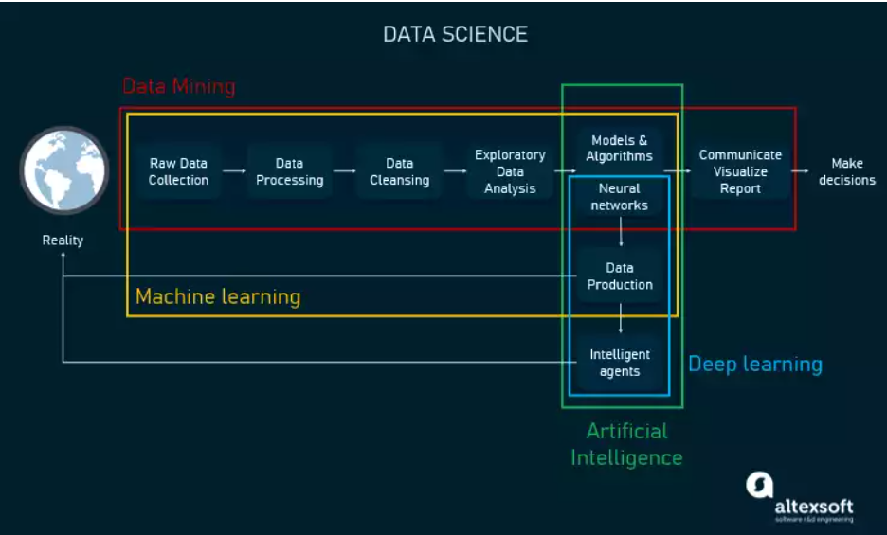
Hubungan dengan Berbagai Bidang

Slide 22
Tujuan Data Mining
Descriptive analytics fokus untuk mendapatkan dan mendeskripsikan data dalam bentuk laporan, grafik, visualisasi, klasterisasi, dll untuk memahami suatu permasalahan
Descriptive Analytics
Predictive Analytics
Predictive analytics melakukan analisis sejumlah data lampau yang berasal dari berbagai sumber untuk memprediksikan kejadian di masa mendatang.
Prescriptive Analytics
Prescriptive analytics memberikan saran aksi / langkah terbaik untuk menghadapi suatu situasi / kondisi tertentu.

Slide 23
Fungsi Utama Data Mining

Slide 24
Supervised vs Unsupervised Learning
SUPERVISED LEARNING
Kita “melatih model”, lalu dengan pengetahuan tersebut, si model dapat memprediksikan data yang baru atau belum diketahui
Notes:
https://towardsdatascience.com/supervised-vs-unsupervised-learning-in-2-minutes-72dad148f242

Slide 25
Supervised vs Unsupervised Learning
UNSUPERVISED LEARNING
Model / algoritma berusaha untuk menemukan pengetahuan (pola, informasi, dll) dari sekumpulan data
Notes:
https://towardsdatascience.com/supervised-vs-unsupervised-learning-in-2-minutes-72dad148f242

Slide 26
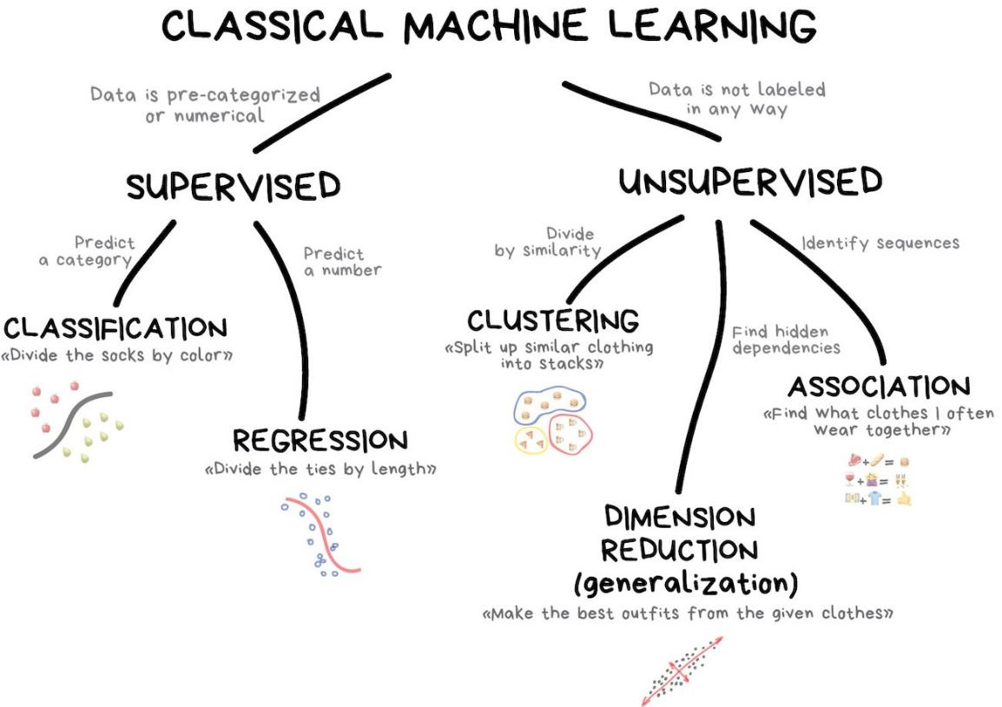
Supervised vs Unsupervised Learning
Supervised
Classification
Regression
Unsupervised
Clustering
Association
Dimension Reduction
Notes:
https://github.com/iammiori/data_analysis_python/issues/1

Slide 27
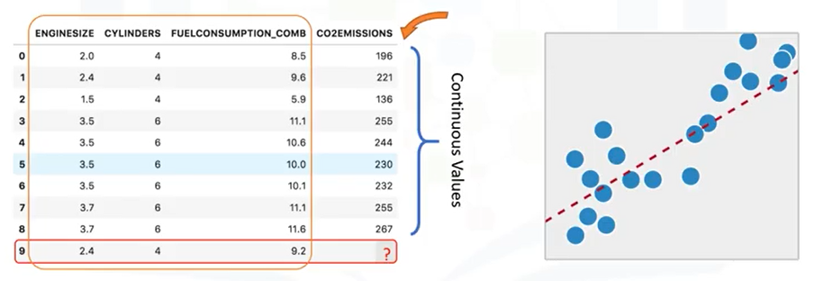
Classification vs Regression
Klasifikasi berusaha memprediksi label atau kelas yang bersifat diskret / kategorikal
Regresi berusaha memprediksi label atau kelas yang bersifat kontinu / numerik
Notes:
http://cognitiveclass.ai

Slide 28
TOP FREE DATA MINING TOOLS

Slide 29
BIDANG DATA MINING
Tren dan Ide Riset
Dr. Achmad Solichin, M.T.I | Universitas Budi Luhur

Slide 30
TREN DAN IDE RISET DATA MINING
Educational Data Mining
Social Media Data Mining
Healthcare Data Mining
Multimedia Data Mining
Geographic Data Mining

Slide 31
#1. EDUCATIONAL DATA MINING
Predicting performance and characteristics
Detecting undesirable student behaviour
Profiling and Grouping students
Social Network Analysis
Providing reports
Creating alerts for stakeholders
Planning and scheduling
Constructing courseware
Developing Concept Maps
Generating recommendation
Evaluation
Adaptive systems
Scientific inquiry
Notes:
Sumber: Bakhshinategh, B., Zaiane, O.R., ElAtia, S. et al. Educational data mining applications and tasks: A survey of the last 10 years. Educ Inf Technol 23, 537–553 (2018) doi: https://doi.org/10.1007/s10639-017-9616-z

Slide 32
#1. EDUCATIONAL DATA MINING
TOPIK | CONTOH PENELITIAN
Prediksi performa dan karakteristik siswa/mahasiswa | Prediksi Tingkat Kelulusan Mahasiswa Tepat Waktu Menggunakan Naive Bayes: Studi Kasus UIN Syarif Hidayatullah Jakarta (Salmu & Solichin, 2017) - http://achmatim.net/download/70 Prediksi Mahasiswa Drop Out Menggunakan Metode Support Vector Machine (Nurhayati, Kusrini & Luthfi, 2015) - http://dx.doi.org/10.30700/jst.v5i1.25
Prediksi gaya belajar siswa/mahasiswa | Detecting Learning Styles in Learning Management Systems Using Data Mining (Liyanage, Gunawardena & Hirakawa, 2016) - https://doi.org/10.2197/ipsjjip.24.740 VARK Learning Style Classification Using Decision Tree with Physiological Signals (Dutsinma & Temdee, 2020) - https://doi.org/10.1007/s11277-020-07196-3
Penjurusan siswa/mahasiswa | Penerapan Metode Naïve Bayes Classifier Untuk Penjurusan Siswa Pada Madrasah Aliyah Al-Falah Jakarta (Mafakhir & Solichin, 2020) - http://dx.doi.org/10.21111/fij.v5i1.4007 Integrasi Metode Naive Bayes dengan K-Means dan K-Means-Smote untuk Klasifikasi Jurusan SMAN 3 Mataram (Hairani, Hansyah & Mardedi, 2020) - https://doi.org/10.30864/jsi.v15i1.317

Slide 33
#1. EDUCATIONAL DATA MINING
TOPIK | CONTOH PENELITIAN
Rekomendasi pengambilan matakuliah | Rekomendasi Pengambilan Mata Kuliah Pilihan Untuk Mahasiswa Sistem Informasi Menggunakan Algoritme Decision Tree (Iswara dkk, 2019) - http://dx.doi.org/10.25126/jtiik.201963892 Penerapan Naïve Bayes Classifier Untuk Pemilihan Konsentrasi Mata Kuliah (Fadillah & Hardiyana, 2018) - https://doi.org/10.34010/jati.v8i2.1039
Adaptive systems | Case Based Reasoning Adaptive E-Learning System Based On Visual-Auditory-Kinesthetic Learning Styles (Rahman & Budiyanto, 2019) - https://ieeexplore.ieee.org/document/8976921 An Adaptive Educational Data Mining Technique for Mining Educational Data Models in Elearning Systems (Murugananthan & ShivaKumar, 2016) – http://10.17485/ijst/2016/v9i3/86392
Gamification | The use of gamification in education: a bibliometric and text mining analysis (Martí‐Parreño, Méndez‐Ibáñez & Alonso‐Arroyo, 2016)- https://doi.org/10.1111/jcal.12161

Slide 34
#2. SOCIAL MEDIA DATA MINING
Notes:
Sumber: The Essential of Sentiment Analysis and Opinion Mining in Social Media : Introduction and Survey of the Recent Approaches and Techniques - https://ieeexplore.ieee.org/document/8743799

Slide 35
#2. SOCIAL MEDIA DATA MINING
TOPIK | CONTOH PENELITIAN
Analisis Sentimen | Rofiqoh, U., Perdana, R.S. and Fauzi, M.A., 2017. Analisis sentimen tingkat kepuasan pengguna penyedia layanan telekomunikasi seluler indonesia pada twitter dengan metode Support Vector Machine dan Lexicon Based Features. Jurnal Pengembangan Teknologi Informasi dan Ilmu Komputer e-ISSN, 2548, p.964X. Giovani, A.P., Ardiansyah, A., Haryanti, T., Kurniawati, L. and Gata, W., 2020. Analisis Sentimen Aplikasi Ruang Guru Di Twitter Menggunakan Algoritma Klasifikasi. Jurnal Teknoinfo, 14(2), pp.115-123.
Analisis Emosi | Ranganathana & Tzacheva, 2019. Emotion Mining in Social Media Data. Procedia Computer Science Volume 159, 2019, Pages 58-66 Krebs dkk, 2017. Social Emotion Mining Techniques for Facebook Posts Reaction Prediction. Code: https://github.com/jerryspan/FacebookR
Fake news / hoax detection | Hoax News Detection on Social Media: A Survey (Assiroj dkk, 2018) - https://doi.org/10.1109/INAPR.2018.8627053 Bharadwaj, Pranav and Shao, Zongru, Fake News Detection with Semantic Features and Text Mining. International Journal on Natural Language Computing (IJNLC) Vol.8, No.3, June 2019, Available at SSRN: https://ssrn.com/abstract=3425828

Slide 36
#3. HEALTHCARE DATA MINING
TOPIK / DATA | CONTOH PENELITIAN
Deteksi / diagnosis penyakit | Penerapan Algoritma J48 Untuk Deteksi Penyakit Tiroid (Agustiani dkk, 2020) - https://doi.org/10.31294/p.v22i2.8174 Preliminary Diagnosis of Pulmonary Tuberculosis Using Ensemble Method (Winarko, Rusdah & Wardoyo, 2015) - https://doi.org/10.1109/ICODSE.2015.7436993
Pemberian Obat | Hypertension Drug Suitability Evaluation Based On Patient Condition with Improved Profile Matching (Soetanto, dkk, 2018) - http://doi.org/10.11591/ijeecs.v11.i2.pp453-461 Mining Adverse Drug Side-Effects from Online Medical Forums (Sampathkumar, Luo & Chen, 2012) -https://doi.org/10.1109/HISB.2012.75
Hospital Management | E-Referral System Modeling Using Fuzzy Multiple-Criteria Decision Making (Triyono dkk, 2018) - http://doi.org/10.11591/ijeecs.v11.i2.pp475-486 Mining medical data to identify frequent diseases using Apriori algorithm (Ilayaraja & Meyyappan, 2013) - https://doi.org/10.1109/ICPRIME.2013.6496471
Notes:
Sumber: Patel, S. and Patel, H., 2016. Survey of data mining techniques used in healthcare domain. International Journal of Information, 6(1/2), pp.53-60.

Slide 37
#3. HEALTHCARE DATA MINING
Klasterisasi Persebaran Virus Corona (Covid-19) Di DKI Jakarta Menggunakan Metode K-Means (Solichin & Khairunnisa, 2020) - http://dx.doi.org/10.21111/fij.v5i2.4905
Application of Needleman-Wunch Algorithm to identify mutation in DNA sequences of Corona virus - https://iopscience.iop.org/article/10.1088/1742-6596/1218/1/012031
Analisis Sentimen Pandemi Covid-19 pada Streaming Twitter dengan Text Mining Python - https://p3m.sinus.ac.id/jurnal/index.php/e-jurnal_SINUS/article/view/491/pdf
Study on COVID-19 in the World and Indonesia Using Regression Model of SVM, Bayesian Ridge and Gaussian - https://ejournal.unsrat.ac.id/index.php/JIS/article/view/28256
COVID-19 Spread Pattern Using Support Vector Regression - https://doi.org/10.33558/piksel.v8i1.2024

Slide 38
#4. MULTIMEDIA DATA MINING
Notes:
Sumber: Bhatt, C.A., Kankanhalli, M.S. Multimedia data mining: state of the art and challenges. Multimed Tools Appl 51, 35–76 (2011). https://doi.org/10.1007/s11042-010-0645-5

Slide 39
#4. MULTIMEDIA DATA MINING
Notes:
Sumber: Bhatt, C.A., Kankanhalli, M.S. Multimedia data mining: state of the art and challenges. Multimed Tools Appl 51, 35–76 (2011). https://doi.org/10.1007/s11042-010-0645-5

Slide 40
#4. MULTIMEDIA DATA MINING
Notes:
Sumber: Bhatt, C.A., Kankanhalli, M.S. Multimedia data mining: state of the art and challenges. Multimed Tools Appl 51, 35–76 (2011). https://doi.org/10.1007/s11042-010-0645-5

Slide 41
#5. GEOGRAPHIC/SPATIAL DATA MINING
Bruce K. Wylie, Neal J. Pastick, Joshua J. Picotte & Carol A. Deering (2019) Geospatial data mining for digital raster mapping, GIScience & Remote Sensing, 56:3, 406-429, DOI: http://10.1080/15481603.2018.1517445
Choi, H. Geospatial Data Approach for Demand-Oriented Policies of Land Administration. Land 2020, 9, 31. DOI: https://doi.org/10.3390/land9010031
M. S. Suchithra and M. L. Pai, "Data Mining based Geospatial Clustering for Suitable Recommendation system," 2020 International Conference on Inventive Computation Technologies (ICICT), Coimbatore, India, 2020, pp. 132-139, doi: https://10.1109/ICICT48043.2020.9112562.
Analysis of land cover changes after the eruption of mount Sinabung using satellite imagery - https://doi.org/10.1088/1742-6596/1402/2/022108

Slide 42
REFERENSI
Jiawei Han and Micheline Kamber, Data Mining: Concepts and Techniques Third Edition, Elsevier, 2012.
Ian H. Witten, Frank Eibe, Mark A. Hall, Data mining: Practical Machine Learning Tools and Techniques 3rd Edition, Elsevier, 2011
Markus Hofmann and Ralf Klinkenberg, RapidMiner: Data Mining Use Cases and Business Analytics Applications, CRC Press Taylor & Francis Group, 2014
Daniel T. Larose, Discovering Knowledge in Data: an Introduction to Data Mining, John Wiley & Sons, 2005
Ethem Alpaydin, Introduction to Machine Learning, 3rd ed., MIT Press, 2014
Florin Gorunescu, Data Mining: Concepts, Models and Techniques, Springer, 2011
Oded Maimon and Lior Rokach, Data Mining and Knowledge Discovery Handbook Second Edition, Springer, 2010
Warren Liao and Evangelos Triantaphyllou (eds.), Recent Advances in Data Mining of Enterprise Data: Algorithms and Applications, World Scientific, 2007
Florin Gorunescu, Data Mining: Concepts, Models and Techniques, Springer, 2011
Bakhshinategh, B., Zaiane, O.R., ElAtia, S. et al. Educational data mining applications and tasks: A survey of the last 10 years. Educ Inf Technol 23, 537–553 (2018) doi: https://doi.org/10.1007/s10639-017-9616-z
H. Soong, N. B. A. Jalil, R. Kumar Ayyasamy and R. Akbar, "The Essential of Sentiment Analysis and Opinion Mining in Social Media : Introduction and Survey of the Recent Approaches and Techniques," 2019 IEEE 9th Symposium on Computer Applications & Industrial Electronics (ISCAIE), Malaysia, 2019, pp. 272-277, doi: https://10.1109/ISCAIE.2019.8743799.
Bhatt, C.A., Kankanhalli, M.S. Multimedia data mining: state of the art and challenges. Multimed Tools Appl 51, 35–76 (2011). https://doi.org/10.1007/s11042-010-0645-5

Slide 43
Rekomendasi Channel Youtube
https://www.youtube.com/playlist?list=PLoCJK3XDWIQtpZTgzLZX4Ed_36vIFC7F9

Slide 44
Kesimpulan
TERIMA KASIH

Slide 45
Kontributor Materi
Dr. Achmad Solichin (achmad.solichin@budiluhur.ac.id)
….

