Slide 1
Otentikasi Aplikasi Web
Eri Haryanto, S.Kom., M.Kom., CEH, CHFI

Slide 2
What is web authentication?
Website authentication is the security process that allows users to verify their identities in order to gain access to their personal accounts on a website.

Slide 3
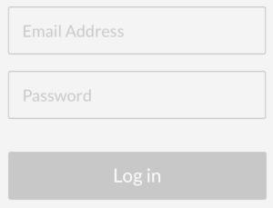
Login FORM

Slide 4
CAPTCHA
This Photo by Unknown Author is licensed under CC BY-SA

Slide 5
ONE TIME PASSWORD (OTP)

Slide 6
Secure Protocol (HTTPS) Dengan sertifikat ssl

Slide 8
BIOMETRIC (FINGERPRINT)

Slide 9
password

Slide 10
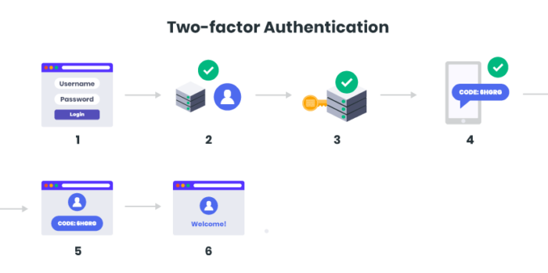

Slide 11
Single sign on (SSO)

