Slide 1
CORONARY ARTERY DISEASE & CARDIAC ARREST MANAGEMENT
Ns. Zulmah Astuti., M.Kep

Slide 2
Introduction
Coronary artery disease is a condition in which there is an inadequate supply of blood and oxygen to the myocardium. It results from occlusion of the coronary arteries and results in a demand-supply mismatch of oxygen. It typically involves the formation of plaques in the lumen of coronary arteries that impede blood flow.

Slide 3
Etiology
Coronary artery disease is a multifactorial phenomenon. Etiologic factors can be broadly categorized into non-modifiable and modifiable factors.
Non-modifiable factors include gender, age, family history, and genetics.
Modifiable risk factors include smoking, obesity, lipid levels, and psychosocial variables.

Slide 4
Pathophysiology
The hallmark of the pathophysiology of CAD is the development of atherosclerotic plaque. Plaque is a build-up of fatty material that narrows the vessel lumen and impedes the blood flow. The first step in the process is the formation of a "fatty streak." Fatty streak is formed by subendothelial deposition of lipid-laden macrophages, also called foam cells. When a vascular insult occurs, the intima layer breaks, and monocytes migrate into the subendothelial space where they become macrophages. These macrophages take up oxidized low-density lipoprotein (LDL) particles, and foam cells are formed. T cells get activated, which releases cytokines only to aid in the pathologic process. Growth factors released activate smooth muscles, which also take up oxidized LDL particles and collagen and deposit along with activated macrophages and increase the population of foam cells. This process leads to the formation of subendothelial plaque.

Slide 5
Classification
Stable ischemic heart disease (SIHD)
Acute coronary syndrome (ACS)
ST-elevation MI (STEMI)
Non-ST elevation MI (NSTEMI)
Unstable angina

Slide 6
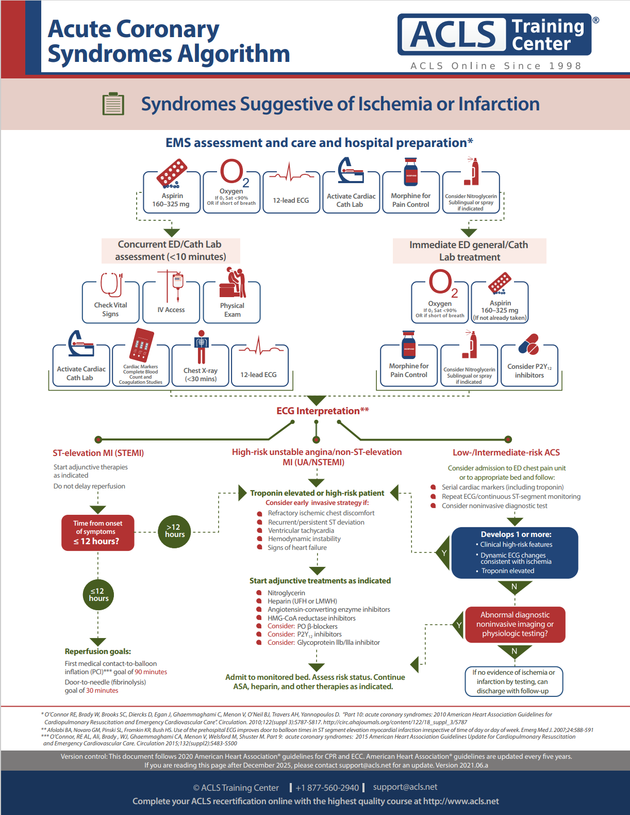
INTERVENTION FOR ACS

Slide 7
CARDIAC ARREST
Hilangnya fungsi jantung secara tiba-tiba dan mendadak, bisa terjadi pada seseorang yang memang didiagnosa dengan penyakit jantung ataupun tidak.
Waktu kejadiannya tidak bisa diperkirakan, terjadi dengan sangat cepat begitu gejala dan tanda tampak (American Heart Association,2010).

Slide 8
PENYEBAB

Slide 9
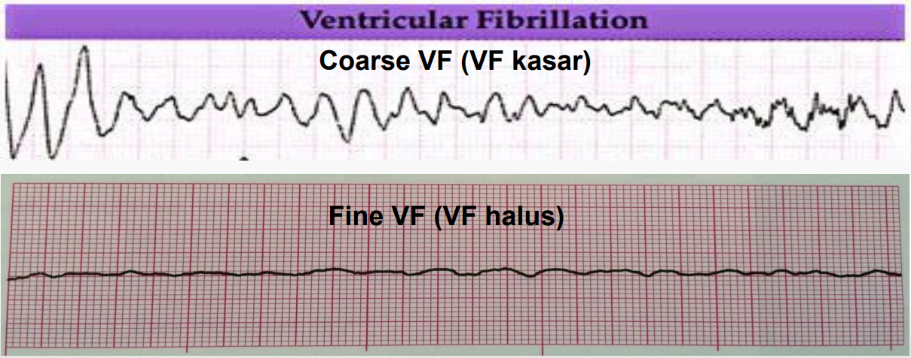
PATOFISIOLOGY
VENTRICULAR FIBRILLATION
Fibrilasi ventrikel (ventricular fibrillation/VF) adalah keadaan mengancam nyawa dimana aktivitas listrik jantung terlalu cepat dan sangat ireguler. VF ditandai oleh gelombang elektrokardiografi yang bervariasi dengan laju ventrikel > 300 per menit dan panjang tiap siklus < 200 ms

Slide 10
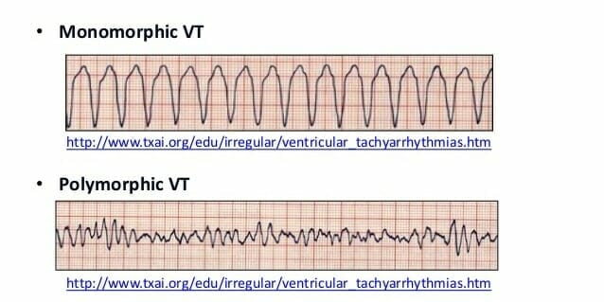
PATOFISIOLOGY
VENTRICULAR TACHYCARDIA
Takikardi Ventrikel adalah takikardi dengan kompleks QRS yang lebar yang berasal dari ventrikel, disebabkan oleh re-entry, triggered activity, atau automaticity. Pada takikardi ventrikel terdapat tiga atau lebih Prematur Ventricular Contraction (PVC) atau Ventrikular Extrasystoles (VES) dengan laju lebih dari 120 kali per menit.
Gambaran EKG takikardia ventrikel menunjukkan disosiasi atrioventrikular, kompleks QRS yang lebar (> 0,16 detik), perubahan aksis, kompleks QRS 90-180 kali/menit, capture beat, dan fusion beat, dengan morfologi: monomorfik atau polimorfik

Slide 11
PATOFISIOLOGY
ASYSTOLE
Asistole adalah cardiac arrest rhythm dengan tidak ada aktivitas listrik jantung dan pasti tidak ada aktivitas pompa jantung
Flat line protocol
Periksa electrode dan power
Periksa lead lain (I, II, III)
Naikan Amplitudo (rule out the fine VF)

Slide 12
PATOFISIOLOGY
PULSELESS ELECTRICAL ACTIVITY
PEA meliputi beberapa irama tetapi tidak ada pulsasi nadi. Aktivitas listrik jantung ada namun tetapi kemampuan mekanisme jantung untuk berkontraksi tidak dapat berfungsi

Slide 13
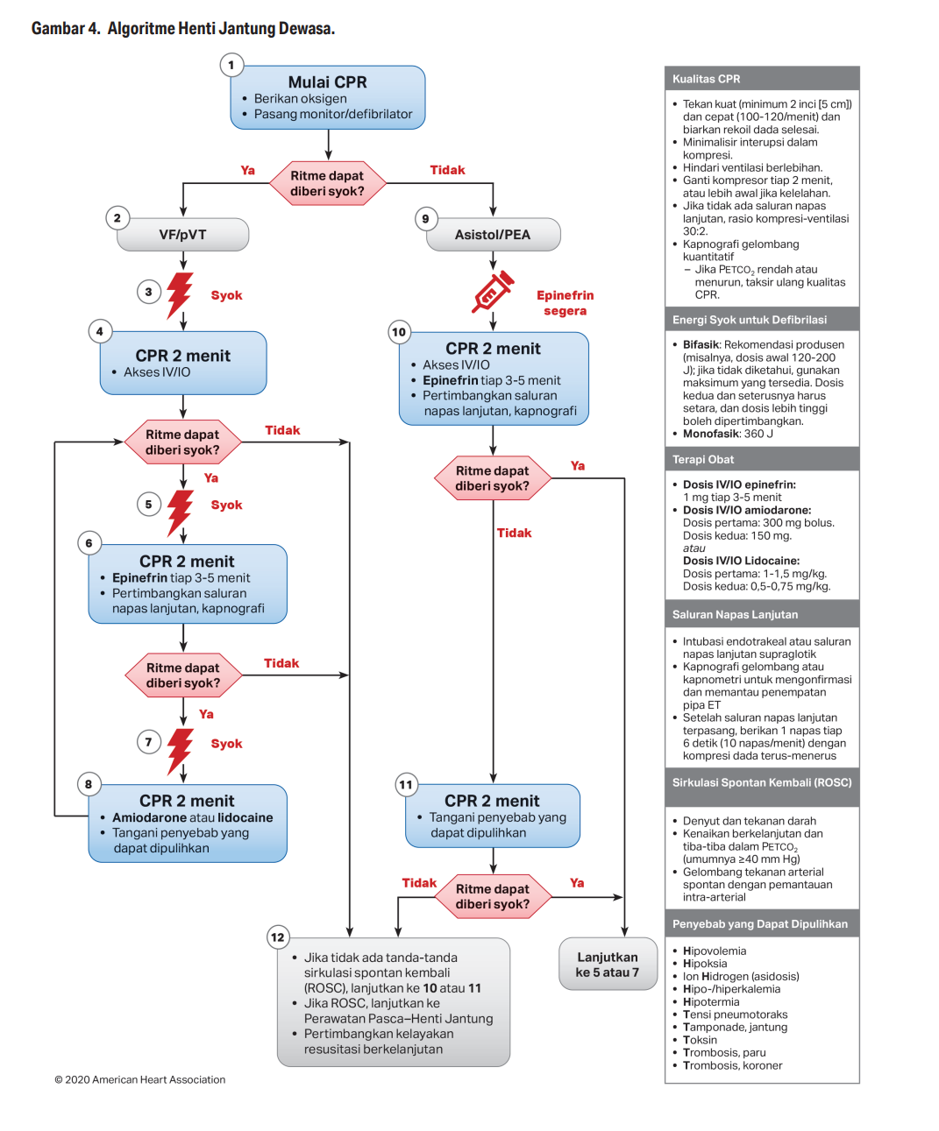
CARDIAC ARREST MANAGEMENT

Slide 14
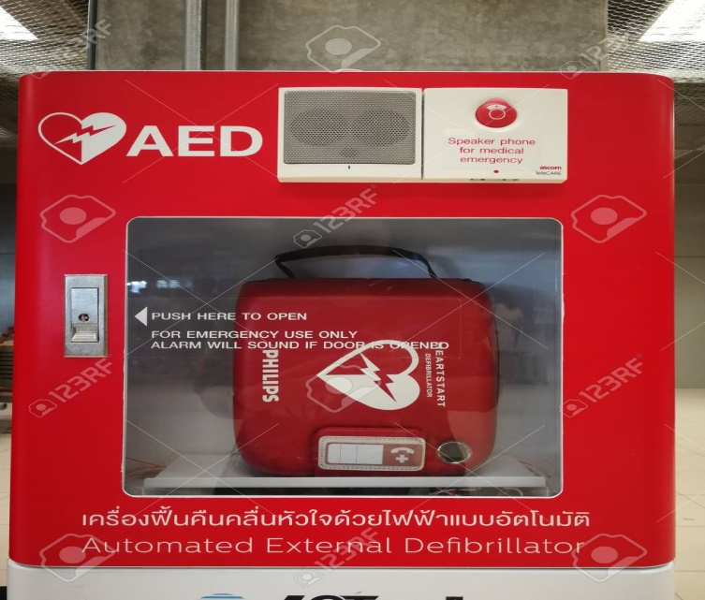
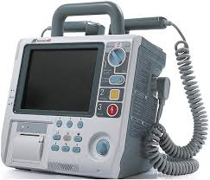
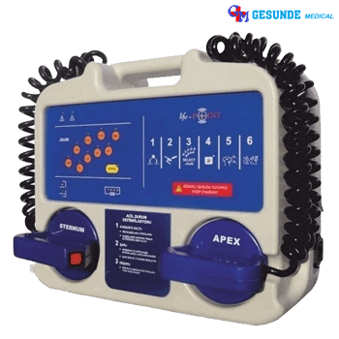
DC SHOCK

Slide 15
FUNCTION DC SHOCK https://youtu.be/8HkJCQHLbhI

Slide 16
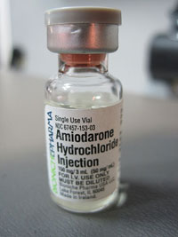
OBAT-OBATAN CARDIAC ARREST
For cardiac arrest, amiodarone is used after the third shock for ventricular fibrillation and ventricular tachycardia that is unresponsive to shock delivery, CPR, and vasopressors. For tachycardia with a pulse, amiodarone may be considered, and expert consultation should be obtained prior to its use.
Within the VT/VF pulseless arrest algorithm, the dosing is as follows: 300mg IV/IO push → (if no conversion) 150 mg IV/IO push

Slide 17
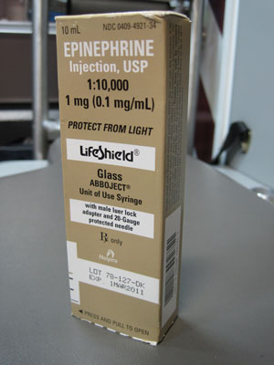
OBAT-OBATAN CARDIAC ARREST
Epinephrine is the primary drug used in the cardiac arrest algorithm. It is used for its potent vasoconstrictive effects and also for its ability to increase cardiac output. Epinephrine is considered a vasopressor.
Routes : During ACLS, epinephrine can be given 3 ways: intravenous; intraosseous, and endotracheal tube
Dosing : Intravenous Push/IO: 1mg epinephrine IV is given every 3-5 minutes.

