Slide 1
Ordinary Differential Equations Linear Equations Abadi Universitas Negeri Surabaya

Slide 2
Linear Equations; Method of Integrating Factors
A linear first order ODE has the general form
where f is linear in y. Examples include equations with constant coefficients, such as those in Chapter 1,
or equations with variable coefficients:

Slide 3
Constant Coefficient Case
For a first order linear equation with constant coefficients,
recall that we can use methods of calculus to solve:

Slide 4
Variable Coefficient Case: Method of Integrating Factors
We next consider linear first order ODEs with variable coefficients:
The method of integrating factors involves multiplying this equation by a function μ(t), chosen so that the resulting equation is easily integrated.

Slide 5
Example 1: Integrating Factor (1 of 2)
Consider the following equation:
Multiplying both sides by μ(t), we obtain
We will choose μ(t) so that left side is derivative of known quantity. Consider the following, and recall product rule:
Choose μ(t) so that

Slide 6
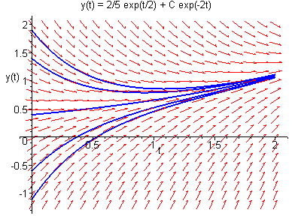
Example 1: General Solution (2 of 2)
With μ(t) = e^{2t}, we solve the original equation as follows:

Slide 7
Method of Integrating Factors: Variable Right Side
In general, for variable right side g(t), the solution can be found as follows:

Slide 8
Example 2: General Solution (1 of 2)
We can solve the following equation
using the formula derived on the previous slide:
Integrating by parts,
Thus

Slide 9
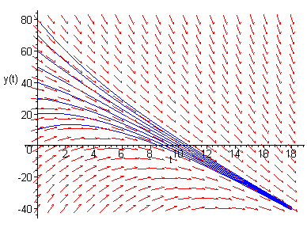
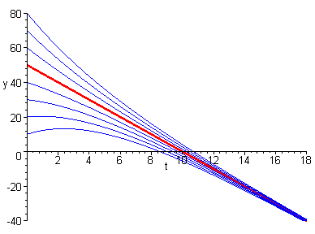
Example 2: Graphs of Solutions (2 of 2)
The graph on left shows direction field along with several integral curves.
The graph on right shows several solutions, and a particular solution (in red) whose graph contains the point (0,50).

Slide 10
Example 3: General Solution (1 of 2)
We can solve the following equation
using the formula derived on previous slide:
Integrating by parts,
Thus

Slide 11
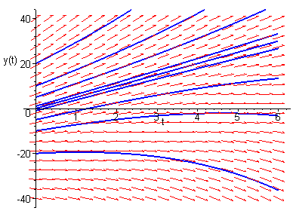
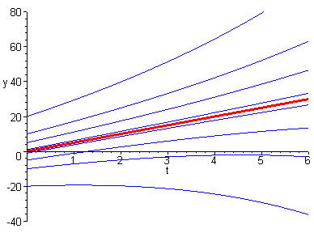
Example 3: Graphs of Solutions (2 of 2)
The graph on left shows direction field along with several integral curves.
The graph on right shows several integral curves, and a particular solution (in red) whose initial point on y-axis separates solutions that grow large positively from those that grow large negatively as t → ∞.

Slide 12
Method of Integrating Factors for General First Order Linear Equation
Next, we consider the general first order linear equation
Multiplying both sides by μ(t), we obtain
Next, we want μ(t) such that μ'(t) = p(t)μ(t), from which it will follow that

Slide 13
Integrating Factor for General First Order Linear Equation
Thus we want to choose μ(t) such that μ'(t) = p(t)μ(t).
Assuming μ(t) > 0, it follows that
Choosing k = 0, we then have
and note μ(t) > 0 as desired.

Slide 14
Solution for General First Order Linear Equation
Thus we have the following:
Then

Slide 15
Example 4: General Solution (1 of 3)
To solve the initial value problem
first put into standard form:
Then
and hence

Slide 16
Example 4: Particular Solution (2 of 3)
Using the initial condition y(1) = 2 and general solution
it follows that
or equivalently,

Slide 17
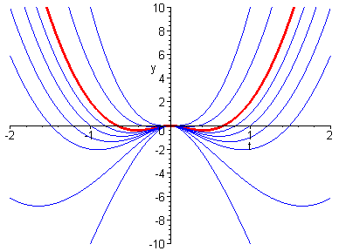
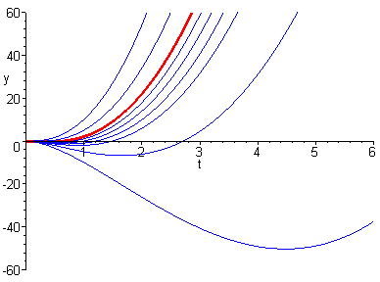
Example 4: Graphs of Solution (3 of 3)
The graphs below show several integral curves for the differential equation, and a particular solution (in red) whose graph contains the initial point (1,2).

Slide 18
Exercise
Find the general solution of the given equation
$y^{′}+y=te^{−1}+1$
$y^{′}−2y=3e^{t}$
Find the solution of the initial value Problems
$y^{′}−y=2te^{2t}, y\left(0\right)=1$
$ty^{′}+2y=t^{2}−t+1, y\left(1\right)=\frac{1}{2}, t>0$

