Slide 1
Ordinary Differential Equations Second Order Linear ODE Abadi Universitas Negeri Surabaya

Slide 2
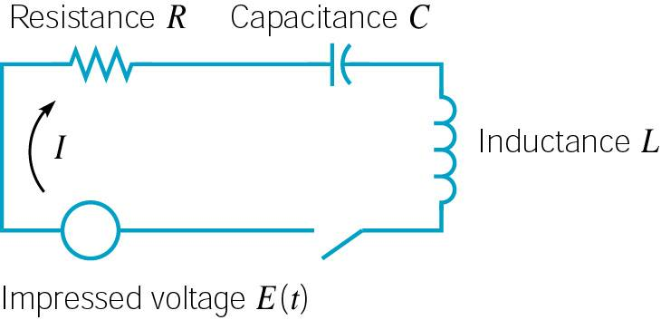
Mechanical & Electrical Vibrations
Two important areas of application for second order linear equations with constant coefficients are in modeling mechanical and electrical oscillations.
We will study the motion of a mass on a spring in detail.
An understanding of the behavior of this simple system is the first step in investigation of more complex vibrating systems.

Slide 3
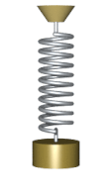
Videos

Slide 4
Spring – Mass System
Suppose a mass m hangs from vertical spring of original length l. The mass causes an elongation L of the spring.
The force F_{G} of gravity pulls mass down. This force has magnitude mg, where g is acceleration due to gravity.
The force F_{S} of spring stiffness pulls mass up. For small elongations L, this force is proportional to L.
That is, F_{s} = kL (Hooke’s Law).
Since mass is in equilibrium, the forces balance each other:

Slide 5
Spring Model
We will study motion of mass when it is acted on by an external force (forcing function) or is initially displaced.
Let u(t) denote the displacement of the mass from its equilibrium position at time t, measured downward.
Let f be the net force acting on mass. Newton’s 2nd Law:
In determining f, there are four separate forces to consider:
Weight: w = mg (downward force)
Spring force: F_{s} = - k(L+ u) (up or down force, see next slide)
Damping force: F_{d}(t) = - γ u′ (t) (up or down, see following slide)
External force: F (t) (up or down force, see text)

Slide 6
Spring Model: Spring Force Details
The spring force F_{s} acts to restore spring to natural position, and is proportional to L + u. If L + u > 0, then spring is extended and the spring force acts upward. In this case
$$F_{s}=−k(L+u)$$
If L + u < 0, then spring is compressed a distance of |L + u|, and the spring force acts downward. In this case
$$F_{s}=k\left|L+u\right|=k\left[−\left(L+u\right)\right]=−k(L+u)$$
In either case,
$$F_{s}=−k(L+u)$$

Slide 7
Spring Model: Damping Force Details
The damping or resistive force F_{d} acts in opposite direction as motion of mass. Can be complicated to model.
F_{d} may be due to air resistance, internal energy dissipation due to action of spring, friction between mass and guides, or a mechanical device (dashpot) imparting resistive force to mass.
We keep it simple and assume F_{d} is proportional to velocity.
In particular, we find that
If u′ > 0, then u is increasing, so mass is moving downward. Thus F_{d} acts upward and hence F_{d} = - γ u′, where γ > 0.
If u′ < 0, then u is decreasing, so mass is moving upward. Thus F_{d} acts downward and hence F_{d} = - γ u′ , γ > 0.
In either case, $F_{d}\left(t\right)=−γu^{′}\left(t\right), γ>0.$

Slide 8
Spring Model: Differential Equation
Taking into account these forces, Newton’s Law becomes:
Recalling that mg = kL, this equation reduces to
where the constants m, γ, and k are positive.
We can prescribe initial conditions also:
It follows from Theorem 3.2.1 that there is a unique solution to this initial value problem. Physically, if mass is set in motion with a given initial displacement and velocity, then its position is uniquely determined at all future times.
Second order ordinary differential equation

Slide 9
Second Order Linear Homogeneous ODE with Constant Coefficients
A second order ordinary differential equation has the general form
where f is some given function.
This equation is said to be linear if f is linear in y and y':
Otherwise the equation is said to be nonlinear.
A second order linear equation often appears as
If G(t) = 0 for all t, then the equation is called homogeneous. Otherwise the equation is nonhomogeneous.

Slide 10
Homogeneous Equations, Initial Values
The focus of this chapter is thus on homogeneous equations; and in particular, those with constant coefficients:
Initial conditions typically take the form
Thus solution passes through (t₀, y₀), and slope of solution at (t₀, y₀) is equal to y₀'.

Slide 11
Example 1: Infinitely Many Solutions (1 of 3)
Consider the second order linear differential equation
Two solutions of this equation are
Other solutions include
Based on these observations, we see that there are infinitely many solutions of the form
It will be shown in Section 3.2 that all solutions of the differential equation above can be expressed in this form.

Slide 12
Example 1: Initial Conditions (2 of 3)
Now consider the following initial value problem for our equation:
We have found a general solution of the form
Using the initial equations,
Thus

Slide 13
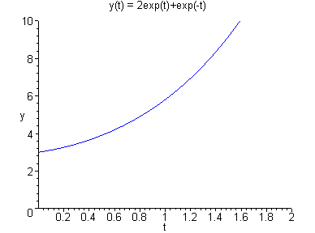
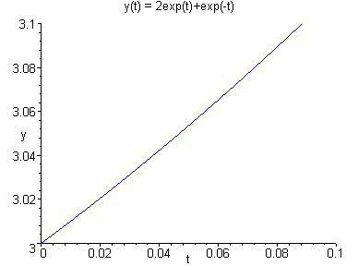
Example 1: Solution Graphs (3 of 3)
Our initial value problem and solution are
Graphs of this solution are given below. The graph on the right suggests that both initial conditions are satisfied.

Slide 14
Characteristic Equation
To solve the 2nd order equation with constant coefficients,
we begin by assuming a solution of the form y = e^{rt}.
Substituting this into the differential equation, we obtain
Simplifying,
and hence
This last equation is called the characteristic equation of the differential equation.
We then solve for r by factoring or using quadratic formula.

Slide 15
General Solution
Using the quadratic formula on the characteristic equation
we obtain two solutions, r₁ and r₂.
There are three possible results:
The roots r₁, r₂ are real and r₁ ≠ r₂.
The roots r₁, r₂ are real and r₁ = r₂.
The roots r₁, r₂ are complex.
In this section, we will assume r₁, r₂ are real and r₁ ≠ r₂.
In this case, the general solution has the form

Slide 16
Distinct Roots of Characteristic Equation
For the initial value problem
we use the general solution
together with the initial conditions to find c₁ and c₂. That is,
Since we are assuming r₁ ≠ r₂, it follows that a solution of the form y = e^{rt} to the above initial value problem will always exist, for any set of initial conditions.

Slide 17
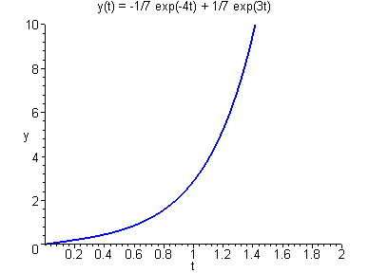
Example 2
Consider the initial value problem
Assuming exponential soln leads to characteristic equation:
Factoring yields two solutions, r₁ = -4 and r₂ = 3
The general solution has the form
Using the initial conditions:
Thus

Slide 18
EXERCISE
Consider the initial value problem below, find the solution of IVP
1.
2.

