Slide 1
Scalars and Vectors

Slide 2
Scalar
A scalar is any positive or negative physical quantity that can be completely specified by its magnitude.
Examples: length, mass and time

Slide 3
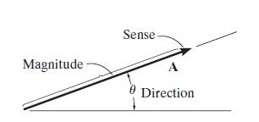
Vector
A vector is any physical quantity that requires both a magnitude and a direction for its complete description.
Examples: force, position, and moment.
A vector is shown graphically by an arrow
The length of the arrow represents the
magnitude of the vector
The angle between the vector and a fixed
axis defines the direction of its line of action
The head or tip of the arrow
indicates the sense of direction of the vector

Slide 4
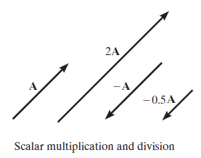
Vector Operations
Multiplication and Division of a Vector by a Scalar
If a vector is multiplied by a positive scalar, its magnitude is increased by that amount
When multiplied by a negative scalar it will also change the directional sense of the vector

Slide 5
Vector Addition
All vector quantities obey the parallelogram law of addition

Slide 6
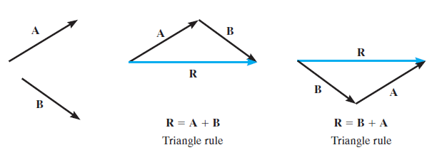
Vector Addition (continued)
Triangle rule of addition

Slide 7
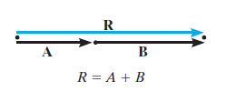
Vector Addition (continued)
Collinear vectors addition

Slide 8
Vector Subtraction
The resultant of the difference between two vectors A and B of the same type may be expressed as

Slide 9
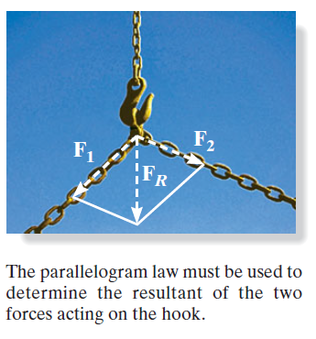
Vector Addition of Forces
The two component forces F₁ and F₂ acting on the pin can be added together to form the resultant force
F_{R} = F₁ + F₂

Slide 10
Components of a Force
Sometimes it is necessary to resolve a force into two components in order to study its pulling or pushing effect in two specific directions.
F is to be resolved into two components along the two
members, defined by the u and v axes.

Slide 11
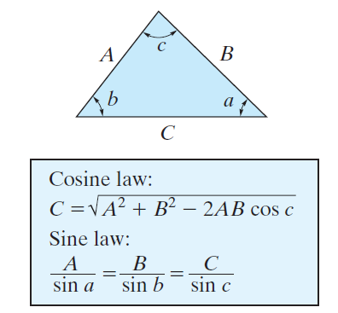
Important Math

Slide 12
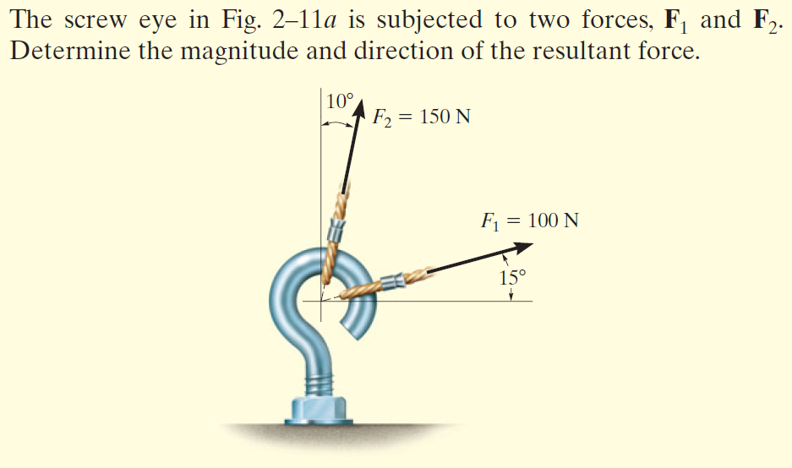
Examples

Slide 13
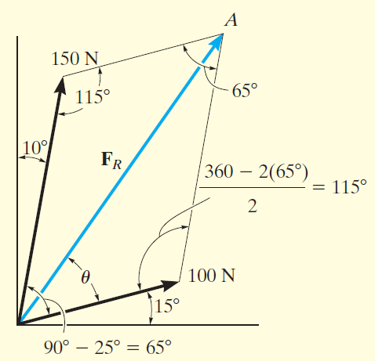
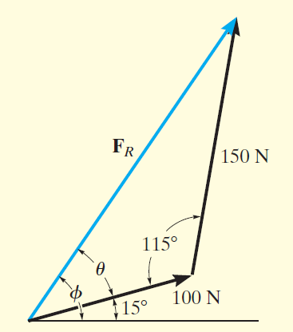
Solution

Slide 14
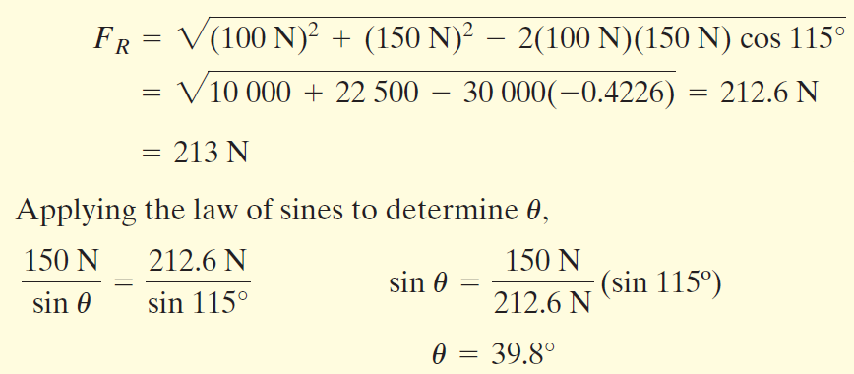

Slide 15
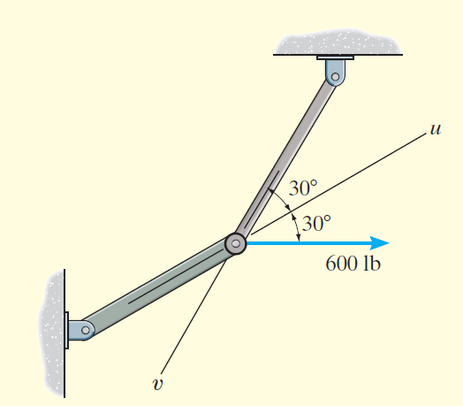
Another Example

Slide 16
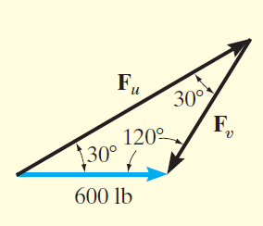
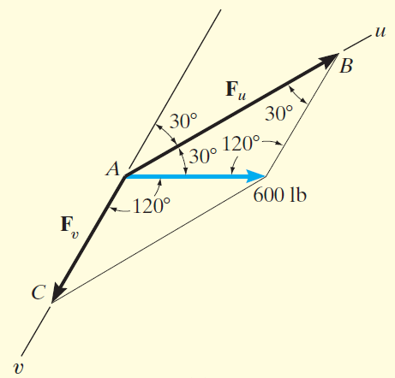
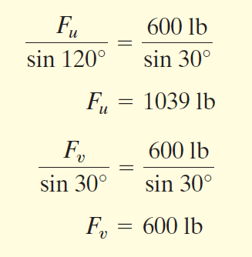
Solution

Slide 17
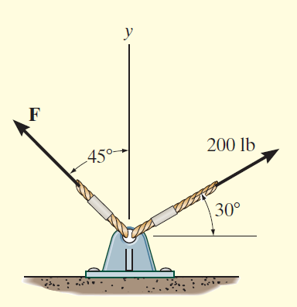
Still Another Example

Slide 18
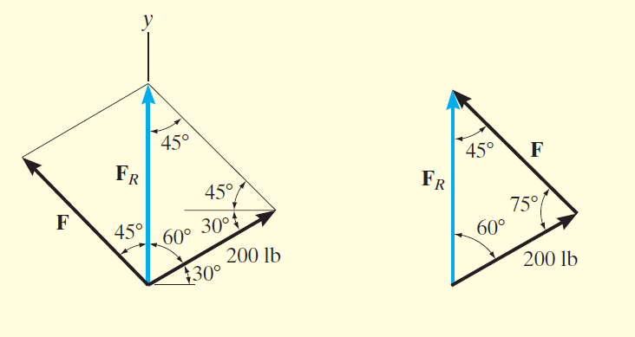
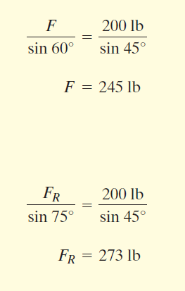
Solution

Slide 19
“The most effective way of learning the principles of engineering mechanics
is to solve problems”
(R.C. Hibbeler)

Slide 20
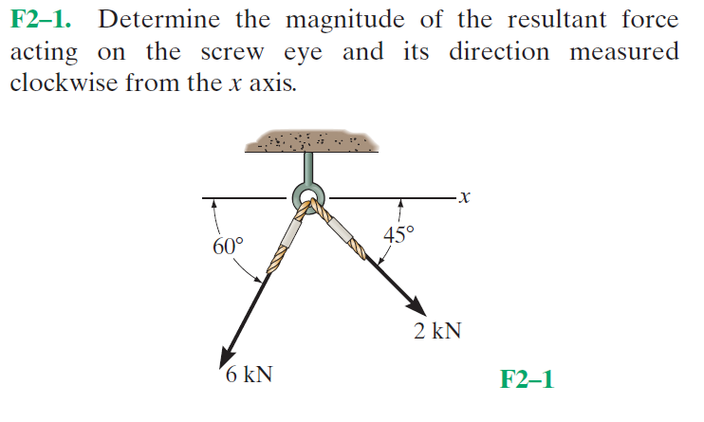
Fundamental Problems

Slide 21
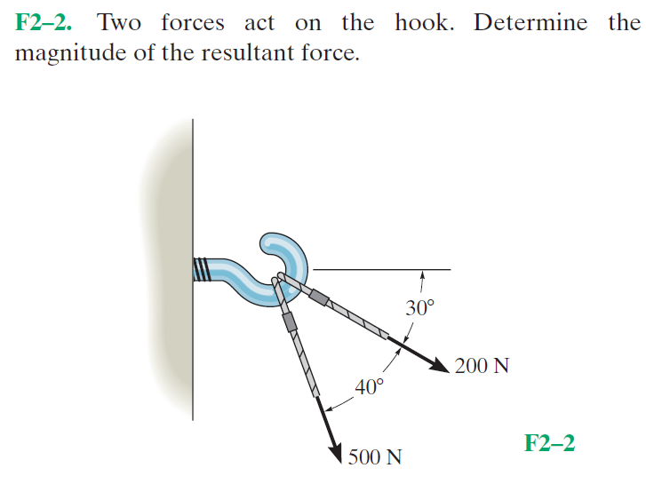
Fundamental Problems

Slide 22
Fundamental Problems

Slide 23
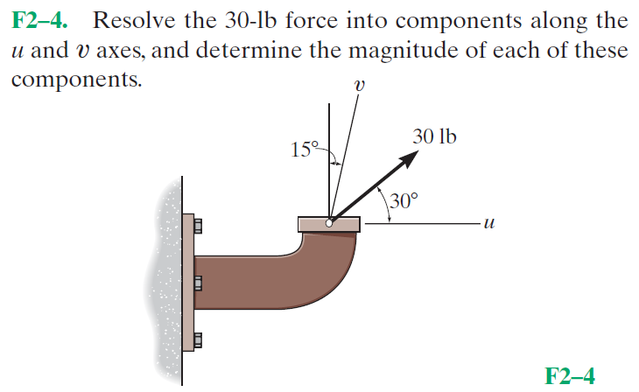
Fundamental Problems

Slide 24
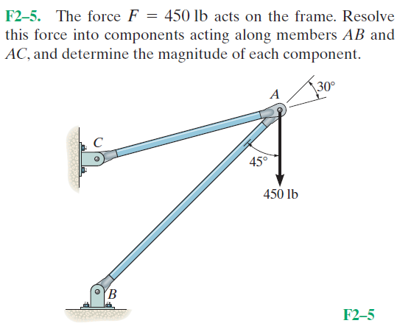
Fundamental Problems

Slide 25
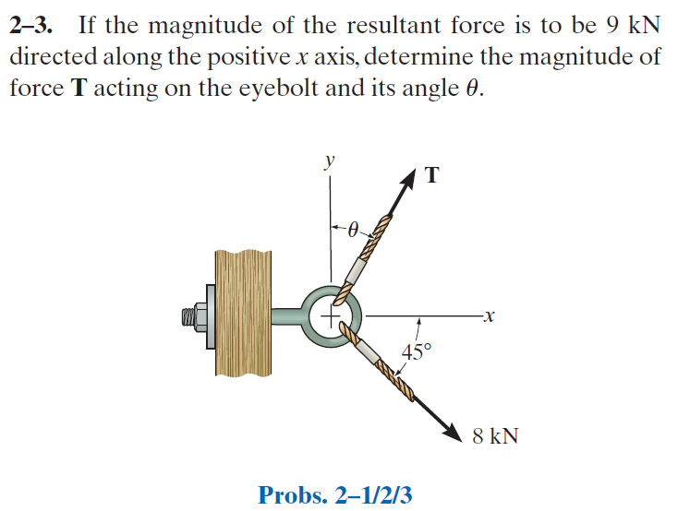
Advanced Problems

Slide 26
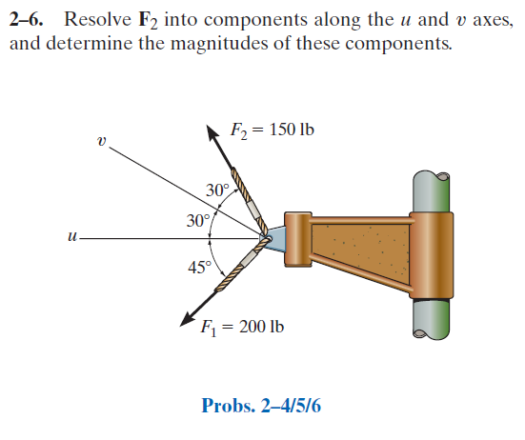
Advanced Problems

Slide 27
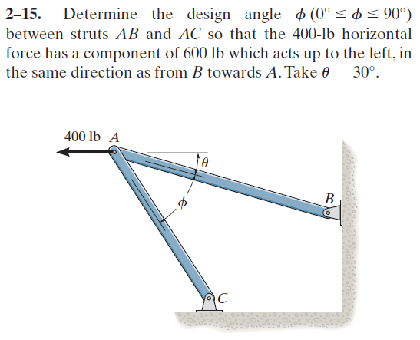
Advanced Problems

Slide 28
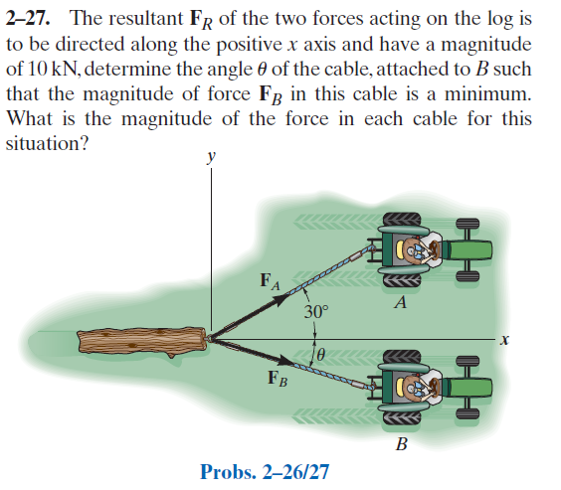
Advanced Problems

