Slide 1
POISONING, SNAKE BITES, BEE STINGS, DRUG OVERDOSE
Emergency and Critical Care

Slide 2
Objectives
Describe the management of the patient with Steven Johnson’s syndrome.
Describe sign and symptoms of Drug Overdose, Poisoning, Bee stings, snake bites
Discuss management of Drug Overdose, Poisoning, Bee stings, snake bites

Slide 3
Steven Johnson Syndrome
Read Cooper, K.L. (2012). Drug Reaction, Skin Care, Skin Loss. Critical Care Nurse 32: 52-59.
Define Steven Johnson Syndrome
List Priorities of nursing care
Notes:
Pertama-tama kita akan lihat mengenai syndrome Steven Johnson
Bacalah artikel Drug reaction, skin care, skin loss
Definisikan sindrom Steven Johnson
Buat lah prioritas asuhan keperawatanya
Selanjutnya kita akan melanjutkan video ini

Slide 4
Steven-Johnson Syndrome
Necrosis of epidermal cells from a drug reaction
Skin
GI tract
Eye
GU system
Tracheobronchial tree
Easy to misdiagnose
Diagnostic testing
Allergy patch
Skin biopsy
Common medications
Allopurinal
Antibiotics
Anticonvulsants
Antiviral
Carvedilol
Cimetidine
Clofibrate
Mefloquine
NSAID’s
Notes:
Sindrom Steven Johnson menyebabkan nekrosis pada sel epidermal akibat dari reaksi obat
Sel-sel ini ada pada kulit, saluran pencernaan, mata, system GU, tracheobronchial tree
Sindrom Steven Johnson sangat mudah untuk salah diagnose
Testing diagnose pada Sindrome Steven Johnson dilakukan dengan; allergy patch dan biopsy kulit
Sangat penting juga agar kita mengetahu obat-obatan yang sering menyebabkan Steven Johnson antara lain: allopurinol, antibiotic, antikonvulsan, antiviral, carvedilol, cimetidine, clofibrate, mefloquine dan golongan NSAID. Namun bisa saja dari obat lain

Slide 5
Steven-Johnson Syndrome
Potentially fatal
Treatment
Discontinue causative medications
Supportive treatment
Maintain ABC
Prevent infection and sepsis
Ensure nutrition to promote wound healing
Replace fluid and electrolytes
Control environment
Wound care
Pain management
Notes:
Walaupun Sindrome Steven Johnson sulit untuk didiagnosa tetapi dapat fatal kemungkinan
Sangat penting juga bagi perawat untuk melihat kemungkinan pengobatan bagi sindrom Steven Johnson
Hal yang paling penting dalam penanganan adalah menghentikan obat-obatan yang menjadi penyebabnya
Penting juga untuk perawat mengetahui penanganan yg mendukung seperti: menjaga jalan napas, pernapasan dan sirkulasinya; mencegah terjadinya infeksi dan sepsis; memastikan nutrisi untuk mempercepat proses penyembuhan luka; mengganti cairan dan elektrolit yang telah hilang; menjaga lingkungan pasien; perawatan luka; dan manajemen nyeri

Slide 6
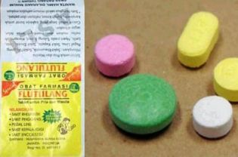
Local Event
The Malay woman, after taking Flutulang, developed a rash on her neck and thighs, which progressed to toxic epidermal necrolysis — a life-threatening skin reaction characterized by widespread blistering or peeling of the skin due to separation of the skin's top layer from its lower layers.
http://jakartaglobe.beritasatu.com/archive/singaporean-woman-dies-after-taking-herbal-drug-from-indonesia/
Notes:
Kliklah pda bagian link yang ada pada slid ini atau yang ada pada moodle, yg terjadi beberapa tahun lalu
Seorang wanita Melayu, setelah makan obat Flutulang di Indonesia, muncul ruam di leher dan paha, yang berlanjut ke nekrolisis epidermal toksik - reaksi kulit yang mengancam jiwa ditandai dengan kulit yg melepuh dan meluas atau pengelupasan kulit akibat pemisahan lapisan atas kulit dari lapisan kulit lebih rendah. Dan wanita ini pun meninggal. Itulah pentingnya agar kita melihat tanda dan gejala dari sindrom Steven Johnson

Slide 7
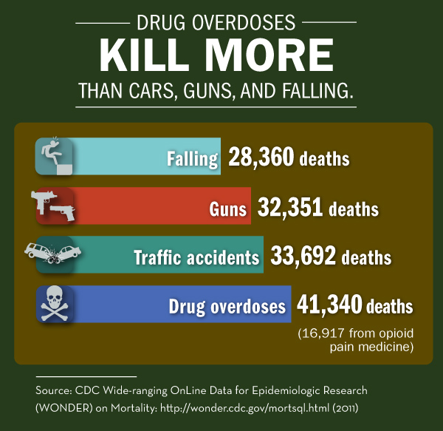
Drug Overdose
Sign and Symptoms:
Dizziness, diarrhea, nausea vomiting, hallucination, sort of breath, pinpoint pupils (opioid overdose), coma
Reasons for overdose:
accidental
intentional misuse
Notes:
accidental – a person takes the wrong drug or combination of drugs, in the wrong amount or at the wrong time without knowing that it could cause them harm
intentional misuse – a person takes an overdose to get ‘high’ or to inflict self-harm (which may be a cry for help or a suicide attempt).

Slide 8
Drug Overdose
Assessment:
ABC’s
Primary and secondary survey
History taking : SAMPLE/KOMPAK
Diagnostic: Blood test, toxicity level
Nursing problem: ABC’s, based on symptoms
Nursing Management:
Collaboration -> Oxygen, gastric lavage, HD, Naloxone
Notes:
KOMPAK : Keluhan, obat, makanan, alergi, penyakit sebelumnya, kejadian

Slide 9
Poisoning
Causes:
Gas: Carbon monoxide gas (from furnaces, gas engines, fires, space heaters)-> find more information in the document in moodle
Foods
Chemicals : Paints, other liquid
Drugs
Household cleaning products, toxic plants
Insecticides/pesticides

Slide 10
Poisoning Sign and symptoms
Headache, Fever, seizures, unconsciousness
Find more about poisoning sign and symptoms in http://www.umm.edu/health/medical/ency/articles/poisoning-first-aid
Notes:
Pain: Abdominal, chest
Bluish lips
Confusion
Cough
Diarrhea
Difficulty breathing
Dizziness
Double vision
Drowsiness
Fever
Headache
Heart palpitations
Irritability
Loss of appetite
Loss of bladder control
Muscle twitching
Nausea and vomiting
Numbness or tingling
Seizures
Shortness of breath
Skin rash or burns
Stupor
Unconsciousness
Unusual breath odor
Weakness

Slide 11
Poisoning Management
ABC’s
Absorbed: Eyes, skin : Irrigate for at least 15 to 20 minutes. Rinse with running water
Inhaled : move to fresh air immediately. Stay away from all toxic fumes and gases.
Swallowed: Check the chemical agent, Drink a small amount of water or milk immediately, consider activated charcoal if early onset
Obstruction: Heimlich maneuver use FBAO: foreign body airway obstruction method

Slide 12
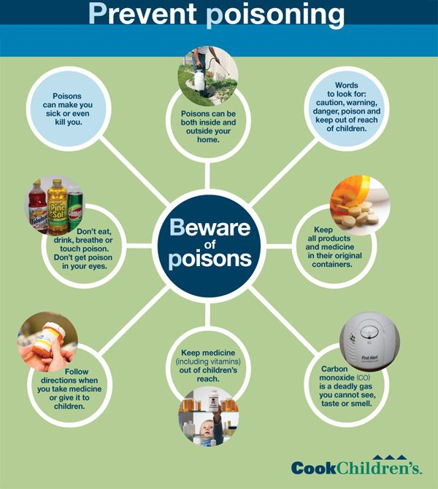
Poisoning preventions
Notes:
Only use chemicals and detergents in well-ventilated areas and wear protective clothing, such as gloves and a face mask.
Keep medications in their original containers.
Make sure they are kept out of children's reach.
Read the product information carefully.
Use only as directed.
Be aware of the possible side effects and any possible interactions with other medications you are taking.
Ask your health care provider or pharmacist if you have any questions.
Never use another person's prescribed medications or medications that have expired.

Slide 13
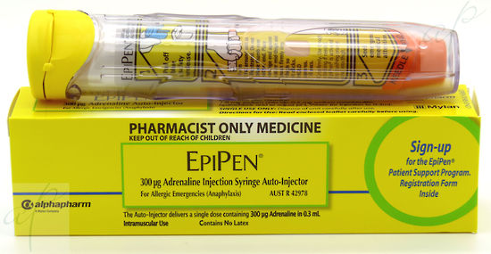
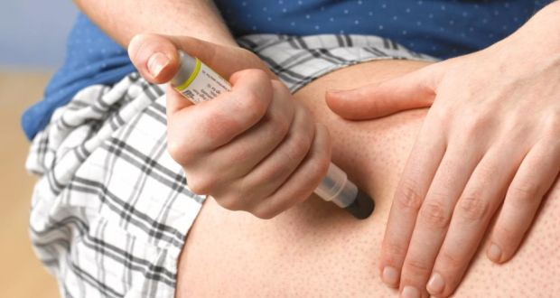
Epi pen

Slide 14
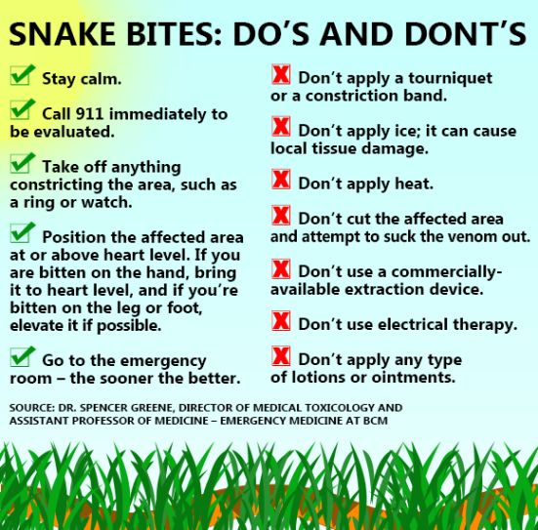
Snake bites Do’s and Don'ts
Notes:
DON'T panic. Snakebites can be treated, and bites generally are less dangerous than many people assume.
DON'T risk another bite by trying to capture or kill the snake. If you can take a picture or describe the snake, that's good but not essential.
DON'T use old first aid remedies: no tourniquet, no ice, no electric shocks, no cutting the wound and sucking out the venom. None of these "treatments" help and most of them make things worse.
DO keep the person quiet and still.
DO keep the arm or leg (usual sites for snakebite) at the level of the heart.
DO remove any jewelry, watches, and tight clothing from the area of the bite.
DO wash the area gently with soap and water.

Slide 15
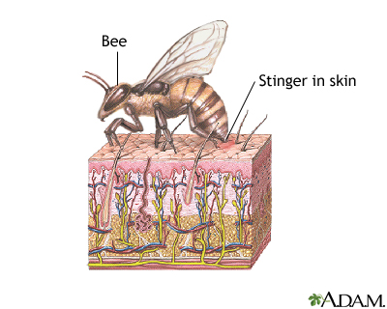
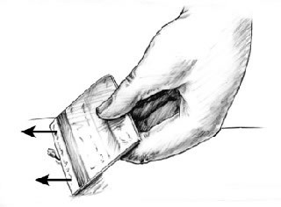
Bee stings
Sign and symptoms:
pain, swelling, redness, and itching
Have chest tightness and a feeling of tightness in the throat -> DANGER!
If there is a stinger in the skin,
remove it gently.
Notes:
person who has multiple stings might also need emergency care. In this case, it's not an allergic reaction. But, the quantity of venom injected all at once could cause nausea, dizziness, faintness, and even seizures.
All symptoms of an "ordinary" sting are at the sting site itself. Expected effects are pain, swelling, redness, and itching. All effects are at that specific spot. Even if the area is still red, swollen, itchy, and painful the next day – it's an expected reaction, not an allergic reaction. Treatment is in two parts:
If there is a stinger in the skin, remove it gently. Scrape it out with something that's not sharp: a finger nail, the edge of a credit card, or the dull side of a knife. Do not use tweezers or fingers to grab the stinger and pull it out; that pushes more venom into the skin.

Slide 16
Bee stings
Management:
Wash the area with water (and soap)
Apply ice to help relieve itching, swelling, and pain
Cortisone cream, antihistamine cream
Watch ABC’s!
Notes:
Wash the area well with soap and water. Apply ice to help relieve itching, swelling, and pain. There's no one treatment that works all the time. You can apply a cortisone cream, an antihistamine cream, or a paste of baking soda and water. Treat severe itching with an antihistamine. Diphenhydramine (Benadryl®) and chlorpheniramine might help. Be sure to follow label instructions for dose and precautions; these drugs can cause sleepiness. Try an over-the-counter pain reliever for pain.
In all cases, try to avoid scratching. (That's easy to say…) Scratching the bite site could cause an infection. Covering the sting site might help.
Has the victim had a tetanus booster in the last five years? If not, or you don't know, call the doctor to see if a booster would be a good idea.
If your local reaction is very large - several inches across - give your doctor a call. Some people with this type of reaction go on to develop severe allergies or anaphylaxis.
The victim could have chest tightness and a feeling of tightness in the throat. The person could feel faint. Hives (red, itchy bumps on the skin) pop up away from the bite. This is a true medical emergency.

Slide 17
Conclusion
Assessment
ABC’s -> Anaphylactic shock!
What is the substance : Swallowed, Absorbed, inhaled
Time
How much/how many
Management
ABC’s management
IV Fluid
Gastric Lavage
Hemodialysis
Medication: Antidote, antivenin, kalmethasone, epinephrine,
Wound Care

Slide 18
References
American red cross. (2017). Poisoning Safety & First Aid retrieved from http://www.redcross.org/get-help/how-to-prepare-for-emergencies/types-of-emergencies/poisoning
Perez, E. (2013). Poisoning first aid. Retrieved from http://www.umm.edu/health/medical/ency/articles/poisoning-first-aid
http://www.who.int/ipcs/publications/training_poisons/guidelines_poison_control/en/index3.html
http://www.poison.org/first-aid
https://www.betterhealth.vic.gov.au/health/healthyliving/drug-overdose

