Slide 1
Introduction: Why Project Management? Session 1-2
MGMT6196 - Manajemen Proyek

Slide 2
Chapter 1 Learning Objectives
After completing this chapter, you should be able to:
Understand why project management is becoming such a powerful and popular practice in business.
Recognize the basic properties of projects, including their definition.
Understand why effective project management is such a challenge.
Differentiate between project management practices and more traditional, process-oriented business functions.
Recognize the key motivators that are pushing companies to adopt project management practices.
Copyright ©2019 Pearson Education, Ltd.

Slide 3
Chapter 1 Learning Objectives
Understand and explain the project life cycle, its stages, and the activities that typically occur at each stage in the project.
Understand the concept of project “success,” including various definitions of success, as well as the alternative models of success.
Understand the purpose of project management maturity models and the process of benchmarking in organizations.
Identify the relevant maturity stages that organizations go through to become proficient in their use of project management techniques.
Copyright ©2019 Pearson Education, Ltd.

Slide 4
OUTLINE
Definisi proyek
Tujuan proyek
Siklus proyek
Faktor penentu keberhasilan proyek
Unsur-unsur proyek
Copyright ©2019 Pearson Education, Ltd.

Slide 5
Definisi proyek

Slide 6
What is a Project?
Projects are complex, one-time processes.
Projects are limited by budget, schedule, and resources.
Projects are developed to resolve a clear goal or set of goals.
Projects are customer-focused.
A project is a temporary endeavor undertaken to create a unique product, service, or result.
PMBoK 5th edition
Copyright ©2019 Pearson Education, Ltd.

Slide 7
General project characteristics
Projects are ad hoc endeavors with a clear life cycle.
Projects are building blocks in the design and execution of organizational strategies.
Projects are responsible for the newest and most improved products, services, and organizational processes.
Projects provide a philosophy and strategy for the management of change.
Project management entails crossing functional and organizational boundaries.
Copyright ©2019 Pearson Education, Ltd.

Slide 8
General project characteristics
Traditional management functions of planning, organizing, motivation, directing, and control apply to project management.
Principal outcomes of a project are the satisfaction of customer requirements within the constraints of technical, cost, and schedule objectives.
Projects are terminated upon successful completion of performance objectives.
Copyright ©2019 Pearson Education, Ltd.

Slide 9
Process & Project Management (Table 1.1)
PROCESS
Repeat process or product
Several objectives
Ongoing
People are homogenous
Well-established systems
Greater certainty
Part line organization
Established practices
Supports status quo
PROJECT
New process or product
One objective
One-shot-limited life
More heterogeneous
Integrated system efforts
Greater uncertainty
Outside of line organization
Violates established practice
Upsets status quo
Copyright ©2019 Pearson Education, Ltd.

Slide 10
Tujuan proyek

Slide 11
Project Success Rates
Software & hardware projects fail at a 65% rate.
Over half of all IT projects become runaways.
Only 30% of technology-based projects and programs are a success.
Ten major government contracts have over $16 billion in cost overruns and are a combined 38 years behind schedule.
Only 2.5% of global businesses achieve 100% project success and over 50% of global business projects fail.
More than $8 billion of $53 billion the Pentagon spent on Iraqi reconstruction projects was lost due to fraud, waste, and abuse.
Copyright ©2019 Pearson Education, Ltd.

Slide 12
Why are projects important?
Shortened product life cycles
Narrow product launch windows
Increasingly complex and technical products
Emergence of global markets
An economic period marked by low inflation
Copyright ©2019 Pearson Education, Ltd.

Slide 13
Siklus proyek

Slide 14
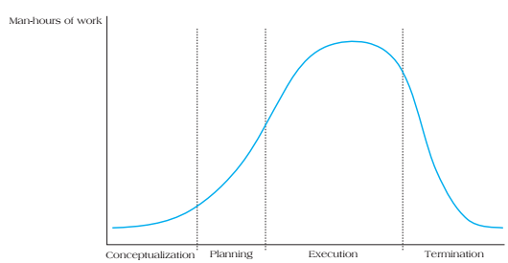
PROJECT LIFE CYCLES (FIGURE 1.1)
Copyright ©2019 Pearson Education, Ltd.

Slide 15
Project Life Cycles
A project life cycle refers to the stages in a project’s development and are divided into four distinct phases:
Conceptualization – development of the initial goal and technical specifications of the project. Key stakeholders are identified and signed on at this phase.
Planning – all detailed specifications, schedules, schematics, and plans are developed.
Execution – the actual “work” of the project is performed.
Termination – project is transferred to the customer, resources reassigned, project is closed out.
Copyright ©2019 Pearson Education, Ltd.

Slide 16
Change during project life cycle
Client
Interest
Project
Stake
Resources
Creativity
Uncertainty
Copyright ©2019 Pearson Education, Ltd.

Slide 17
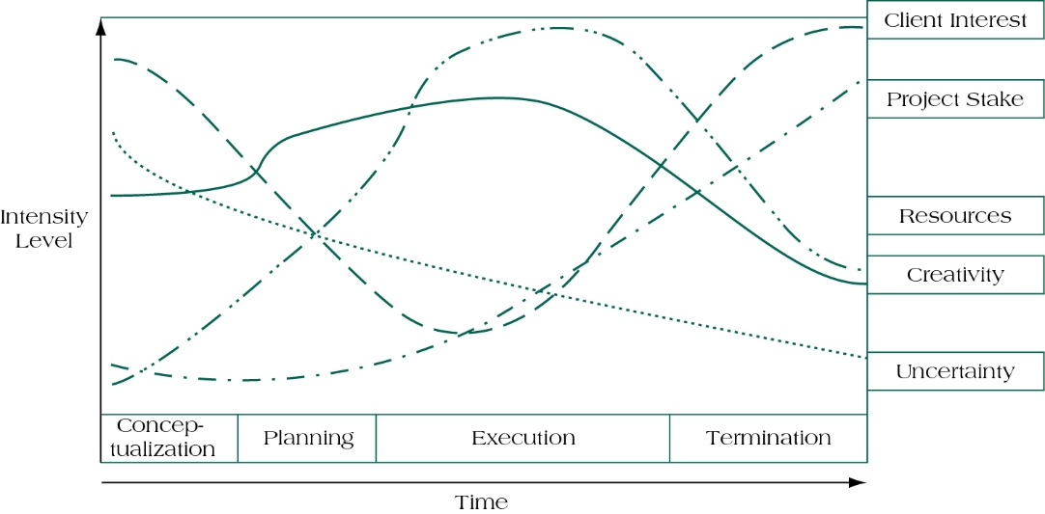
Project life cycle and their effects (Figure 1.2)
Copyright ©2019 Pearson Education, Ltd.

Slide 18
Faktor penentu keberhasilan proyek

Slide 19
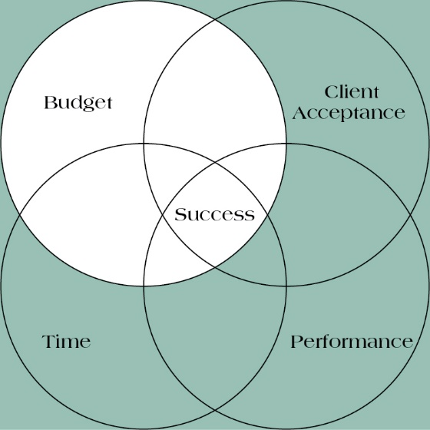
Quadruple constraint of project success (Figure 1.3)

Slide 20
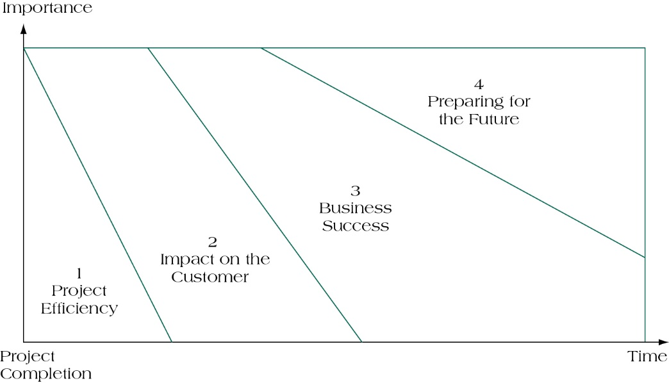
Four dimension of project success (figure 1.4)

Slide 21
Six criteria for IT project success
System
Quality
Information
Quality
Use
User
Satisfaction
Individual
Impact
Organizational
Impact
Copyright ©2019 Pearson Education, Ltd.

Slide 22
Understanding success criteria (table 1.1)

Slide 23
Unsur-unsur proyek

Slide 24
Project management maturity
Project management maturity (PMM) models are used to allow organizations to benchmark the best practices of successful project management firms.
Benchmarking is the practice of systematically managing the process improvements of project delivery by a single organization of a period of time.
Copyright ©2016 Pearson Education, Ltd.
Copyright ©2019 Pearson Education, Ltd.

Slide 25
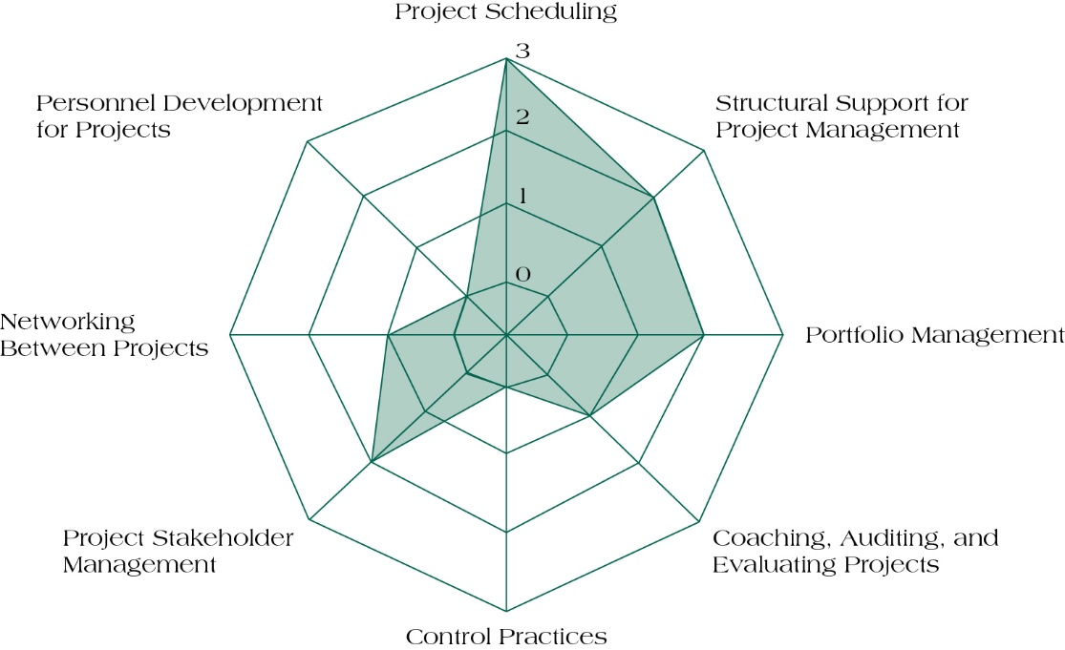
Spider web with embedded organizational evaluation (figure 1.5)
Copyright ©2019 Pearson Education, Ltd.

Slide 26
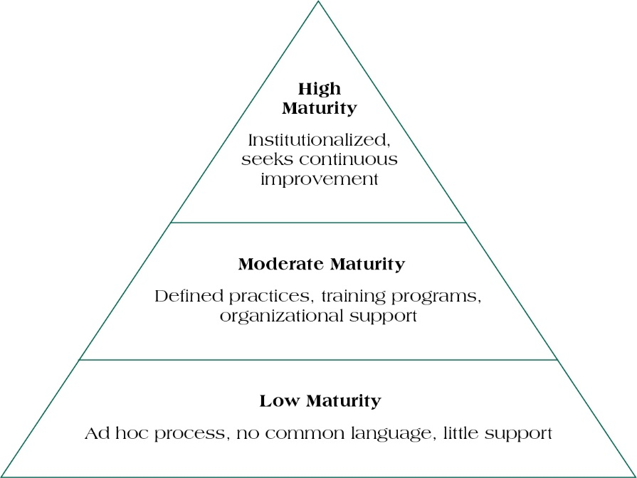
Project Management Maturity Generic Model (Figure 1.6)
Copyright ©2016 Pearson Education, Ltd.
Copyright ©2019 Pearson Education, Ltd.

Slide 27
Summary
Understand why project management is becoming such a powerful and popular practice in business.
Recognize the basic properties of projects, including their definition.
Understand why effective project management is such a challenge.
Differentiate between project management practices and more traditional, process-oriented business functions.
Recognize the key motivators that are pushing companies to adopt project management practices.
Copyright ©2016 Pearson Education, Ltd.
Copyright ©2019 Pearson Education, Ltd.

Slide 28
Summary
Understand and explain the project life cycles, its stages, and the activities that typically occur at each stage in the project.
Understand the concept of project “success,” including various definitions of success, as well as alternative models of success.
Understand the purpose of project management maturity models and the process of benchmarking in organizations.
Copyright ©2016 Pearson Education, Ltd.
Copyright ©2019 Pearson Education, Ltd.

