Slide 1
Resource Management Topic 3
Project Management

Slide 2
Learning Objectives
After completing this chapter, you should be able to:
Recognize the variety of constraints that can affect a project, making scheduling and planning difficult.
Understand how to apply resource-loading techniques to project schedules to identify potential resource overallocation situations.
Apply resource-leveling procedures to project activities over the baseline schedule using appropriate prioritization heuristics.
Follow the steps necessary to effectively smooth resource requirements across the project life cycle.
Apply resource management within a multiproject environment.

Slide 3
OUTLINE
Dasar dasar keterbatasan sumberdaya
Pembebanan sumberdaya
Pemerataan sumberdaya
Grafik pembebanan sumberdaya
Pengelolaan sumberdaya di dalam proyek berganda.
Copyright ©2019 Pearson Education, Ltd.

Slide 4
Dasar dasar keterbatasan sumberdaya

Slide 5
Types of Constraints
Physical
Time
Resource
Mixed
Copyright ©2019 Pearson Education, Ltd.

Slide 6
Activity precedence example (table 3.1 and figure 3.1)
Copyright ©2019 Pearson Education, Ltd.

Slide 7
Pembebanan sumberdaya

Slide 8
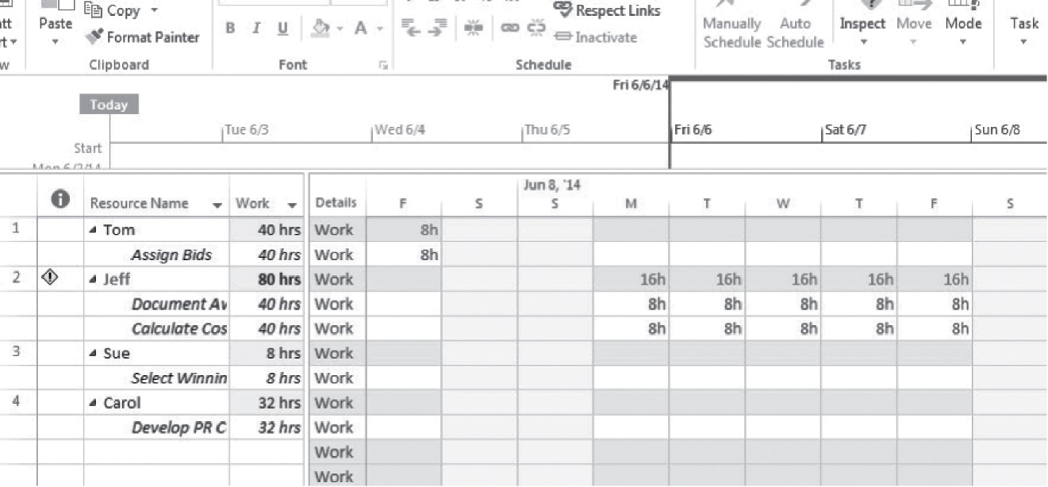
Resource-Loading Chart Demonstrating Overallocation (figure 3,2)
Copyright ©2019 Pearson Education, Ltd.

Slide 9
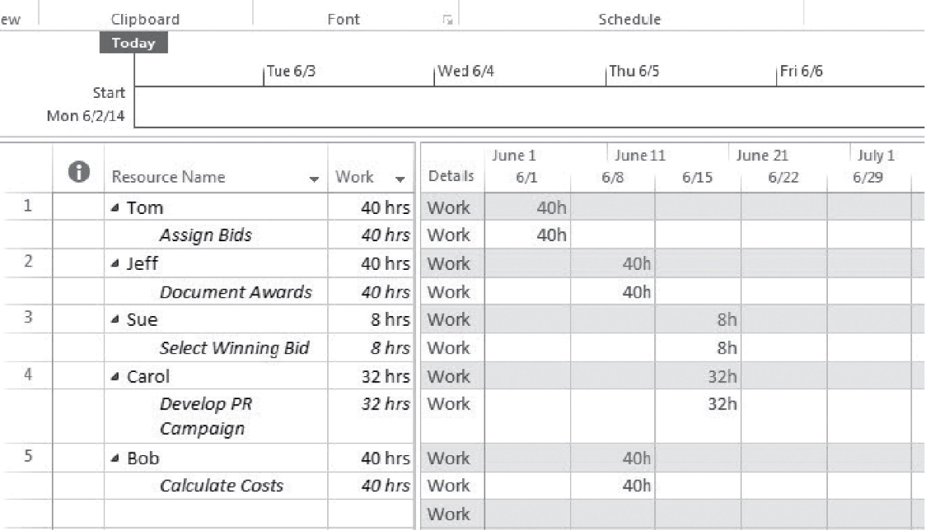
Resource Usage Table (figure 3,4)
Copyright ©2019 Pearson Education, Ltd.

Slide 10
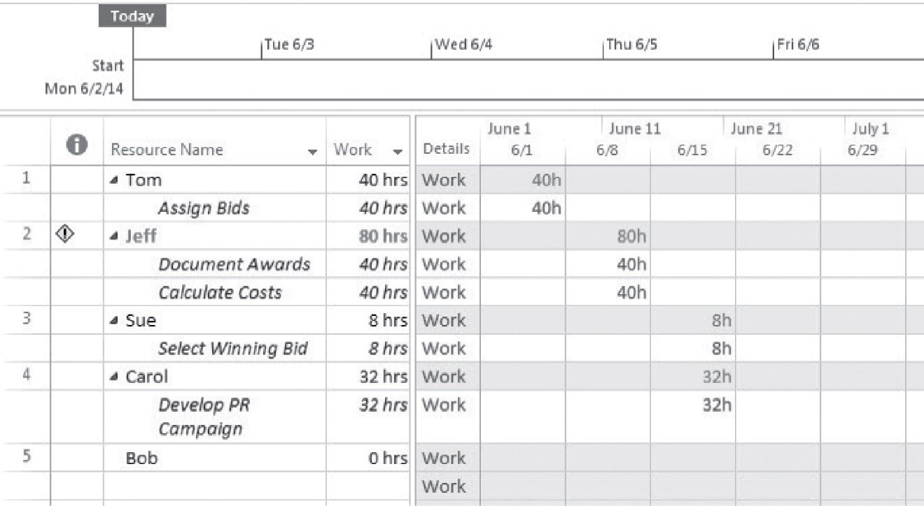
Example of Resource Usage Table with Overallocation (figure 3,5)
Copyright ©2019 Pearson Education, Ltd.

Slide 11
Pemerataan sumberdaya

Slide 12
Resource Leveling
A process that address the complex challenges of project constraints
Objectives:
To determine the resource requirements so that they will be available at the right time
To allow each activity to be scheduled with the smoothest possible transition across resource usage levels

Slide 13
Prioritization Rules for Leveling
Smallest amount of slack
Smallest duration
Lowest ID number (FCFS)
Greatest number of successor tasks
Requiring the most resources
Copyright ©2019 Pearson Education, Ltd.

Slide 14
General Procedure for Leveling
Create a project activity network diagram.
Develop resource loading table.
Determine activity late finish dates.
Identify resource overallocation.
Level the resource loading table.
Copyright ©2019 Pearson Education, Ltd.

Slide 15
Grafik pembebanan sumberdaya

Slide 16
Construct a resource-loading chart
To construct a time-limited resource loading chart for resource scheduling, there are six main steps to follow:
Create activity network.
Produce table for each activity, resource requirements, duration, early start time, slack, and late finish time.
List activities in order of increasing slack.
Draw an initial resource-loading chart with each activity scheduled at its earliest start time.
Rearrange activities within their slack to create a profile that is as level as possible
Use judgment to interpret and improve activity leveling.
Copyright ©2019 Pearson Education, Ltd.

Slide 17
Sample project network (figure 12.17)
4 B 5 Res = 2
5 D 9 Res = 7
9 E 11 Res = 3
0 A 4 Res = 6
11 F 12 Res = 6
4 C 7 Res = 2
Copyright ©2019 Pearson Education, Ltd.

Slide 18
Creating Resource Loading Charts
Activity | Resource | Duration | ES | Slack | LF
A | 6 | 4 | 0 | 0 | 4
B | 2 | 1 | 4 | 0 | 5
C | 2 | 3 | 4 | 4 | 11
D | 7 | 4 | 5 | 0 | 9
E | 3 | 2 | 9 | 0 | 11
F | 6 | 1 | 11 | 0 | 12
Copyright ©2019 Pearson Education, Ltd.

Slide 19
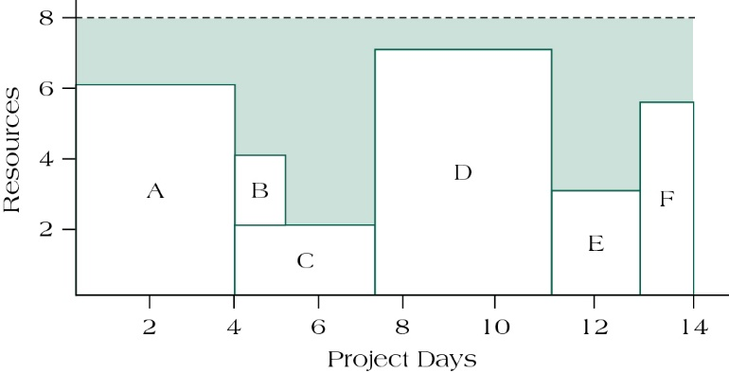
Resource-loading chart (figure 12.18)
Copyright ©2019 Pearson Education, Ltd.

Slide 20
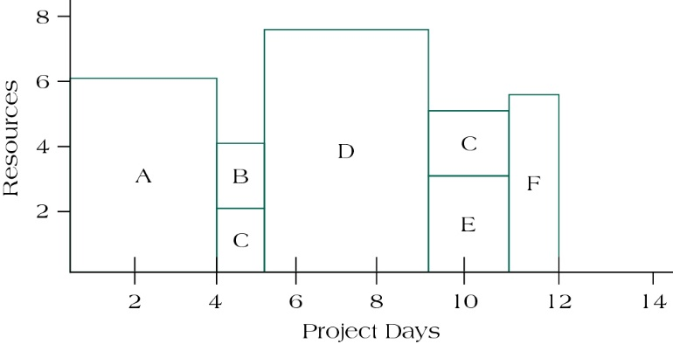
Modified resource-loading chart when splitting task c (figure 12.19)
Copyright ©2019 Pearson Education, Ltd.

Slide 21
Pengelolaan sumberdaya di dalam proyek berganda.

Slide 22
Managing resources in multiproject environments
Schedule Slippage
Resource Utilization
In-Process Inventory
Resolving Resource Decisions in Multiproject Environments
First In Line
Greatest Resource Demand
Greatest Resource Utilization
Minimum Late Finish Time
Mathematical Programming
Copyright ©2019 Pearson Education, Ltd.

Slide 23
Summary

Slide 24
Summary
Recognize the variety of constraints that can affect a project, making scheduling and planning difficult.
Understand how to apply resource-loading techniques to project schedules to identify potential resource overallocation situations.
Apply resource-leveling procedures to project activities over the baseline schedule using appropriate prioritization heuristics.
Follow the steps necessary to effectively smooth resource requirements across the project life cycle.
Apply resource management within a multiproject environment.
Copyright ©2019 Pearson Education, Ltd.

Slide 25
REFERENCES
Pinto. J.K. (2019). Project Management: Achieving Competitive Advantage. Pearson Education Limited. London. ISBN:9781292269146
Copyright ©2019 Pearson Education, Ltd.

