Slide 1
Project Evaluation And Control
Topic 12
Project Management

Slide 2
LEARNING OUTCOMES
After completing this chapter, you should be able to:
Understand the nature of the control cycle and four key steps in a general project control model.
Recognize the strengths and weaknesses of common project evaluation and control methods.
Understand how Earned Value Management can assist project tracking and evaluation.
Use Earned Value Management for project portfolio analysis.
Understand behavioral concepts and other human issues in evaluation and control.
From Appendix 13.1: Understand the advantages of Earned Schedule methods for determining project schedule variance, schedule performance index, and estimates to completion.

Slide 3
OUTLINE
Proses Kontrol Proyek
Alat bantu pengawasan dan pengendalian proyek
Earned Value Management
Faktor penentu keberhasilan proyek

Slide 4
PMBOK Core Concepts
Project Management Body of Knowledge (PMB0K) covered in this chapter includes:
Control Schedule (PMBoK 6.7)
Control Costs (PMBoK 7.4)
Earned Value System (PMBoK 7.4.2.1)
Forecasting (PMBoK 7.4.2.2)
Performance Reviews (PMBoK 7.4.2.4)

Slide 5
Proses Kontrol Proyek

Slide 6
Control Cycles – General Model
Setting a goal.
Measuring progress.
Comparing actual with planned performance.
Taking action.

Slide 7
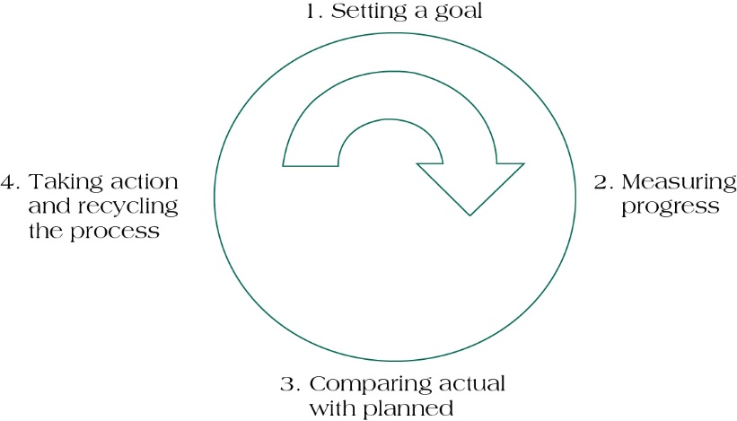
The Project Control Cycle
(figure 13.2)
Source: Pinto (2016)

Slide 8
Alat bantu pengawasan dan pengendalian proyek

Slide 9
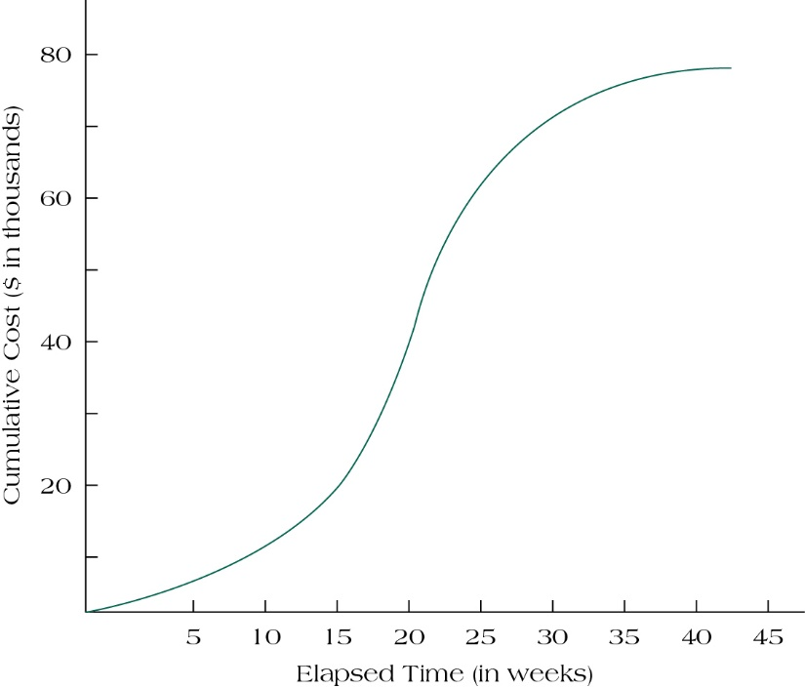
Project S-Curves
(figure 13.3)
Source: Pinto (2016)

Slide 10
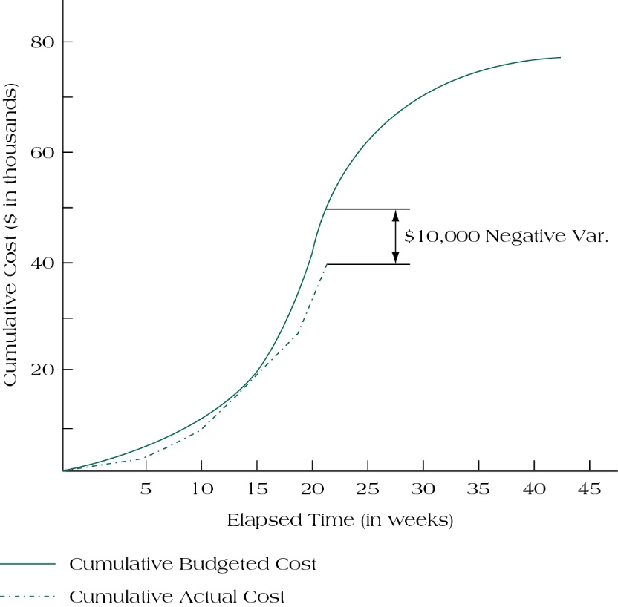
PROJECT SIERRA’S S-CURVE SHOWING NEGATIVE VARIANCE
(FIGURE 13.4)
Source: Pinto (2016)

Slide 11
Milestone Analysis
Milestones are events or stages of the project that represent a significant accomplishment.
Milestones:
Signal completion of important steps
Motivate team and suppliers
Offer reevaluation points
Help coordinate schedules
Identify key review gates
Signal other team members when their participation begins
Delineate work packages

Slide 12
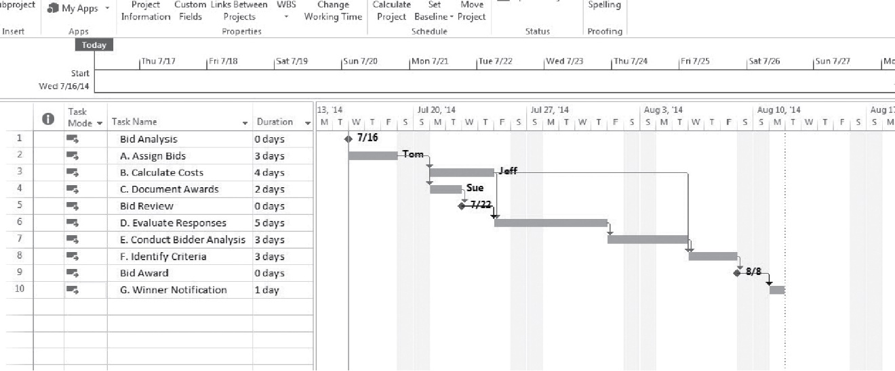
Gantt Chart with Milestones
(figure 13.5)
Source: Pinto (2016)

Slide 13
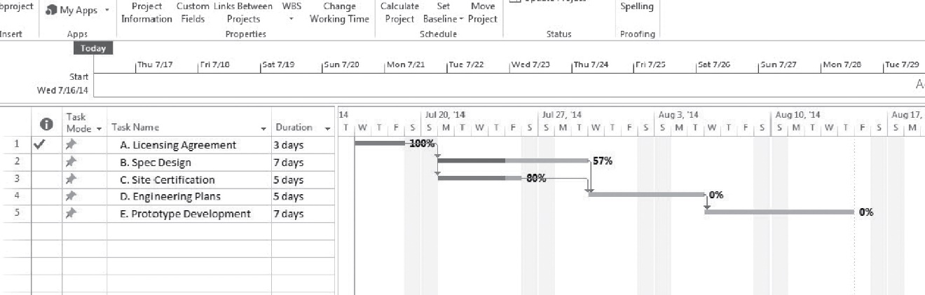
ASSESSING PROJECT BLUE’S STATUS USING TRACKING GANTT CHART
(FIGURE 13.6)
Source: Pinto (2016)

Slide 14
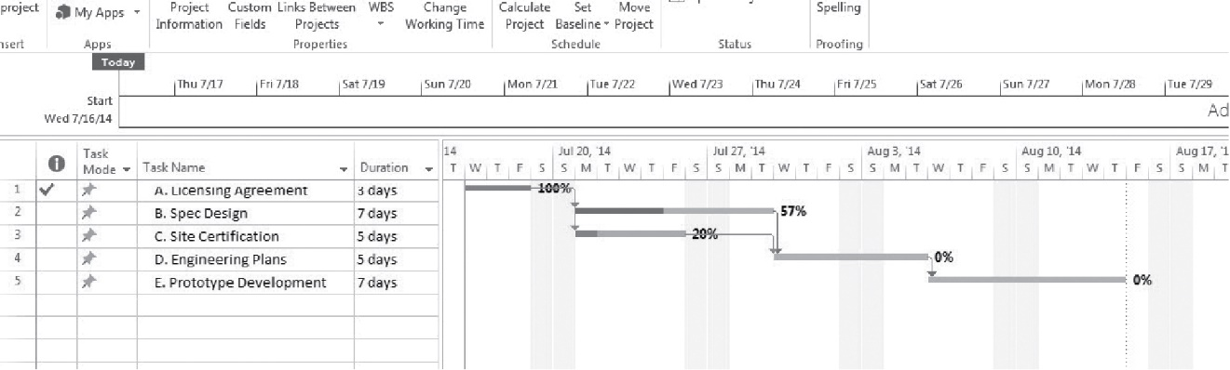
Tracking Gantt with Project Activity Deviation
(figure 13.7)
Project status is updated by linking task completion to the schedule baseline.
Source: Pinto (2016)

Slide 15
Earned Value Management

Slide 16
Earned Value Management
Earned Value Management (EVM) recognizes that it is necessary to jointly consider the impact of time, cost, and project performance on any analysis of current project status.
Earned Value (EV) directly links all three primary project success Metrics (cost, schedule, and performance).

Slide 17
Earned Value Terms
Planned value (PV)
Earned value (EV)
Actual cost of work performed (AC)
Schedule variance (SV) and Schedule performance index (SPI)
Cost variance (CV) and Cost performance index (CPI)
Budgeted cost at completion (BAC)
Estimate at completion (EAC)

Slide 18
Steps in Earned Value Management
Clearly define each activity including its resource needs and budget.
Create usage schedules for activities and resources.
Develop a time-phased budget (PV).
Total the actual costs of doing each task (AC).
Calculate both the budget variance (CV) and schedule variance (SV).

Slide 19
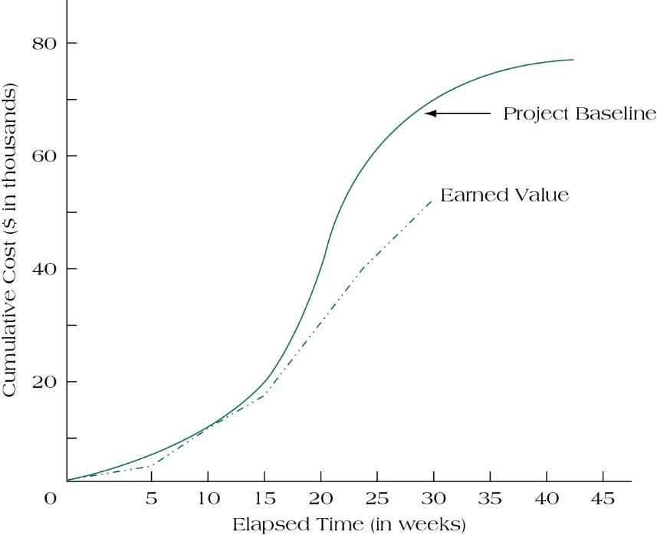
Project Baseline, Using Earned Value
(figure 13.11)
Source: Pinto (2016)

Slide 20
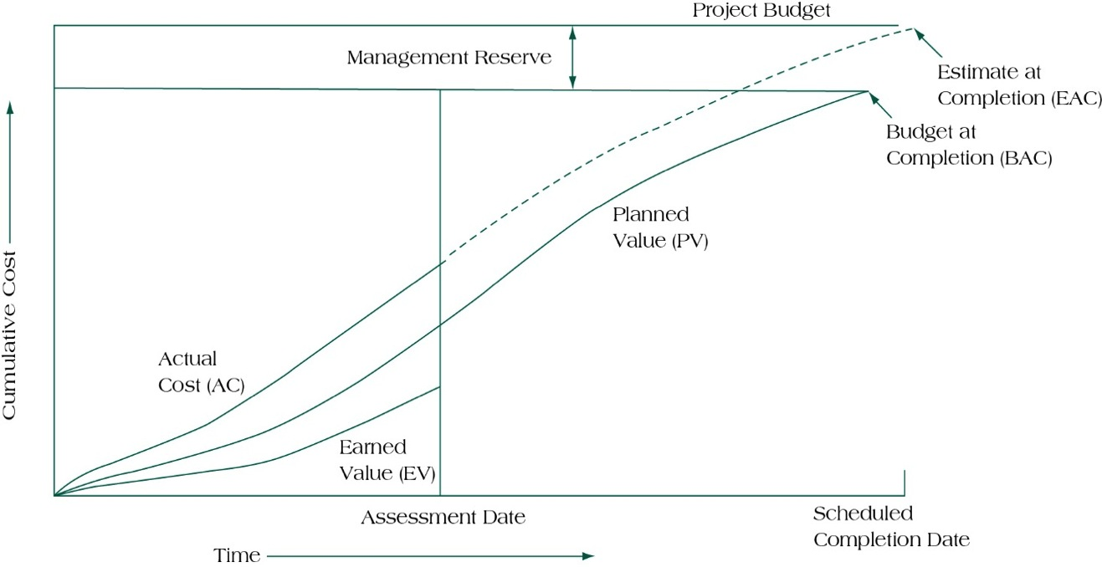
Earned Value Milestones
(figure 13.12)
Source: Pinto (2016)

Slide 21
Earned Value Example
Schedule Variances
Planned Value (PV) = 103
Earned Value (EV) = 44
Schedule Performance Index = .43 = 44/103 = EV/PV
Estimated Time to Completion = (1/.43)x7=16.3 months
Cost Variances
Cumulative Actual Cost of Work Performed (AC) = 78
Cost Performance Index = .56 = 44/78 = EV/AC
Estimated Cost to Completion = $210,714 = (1/.56)x$118,000

Slide 22
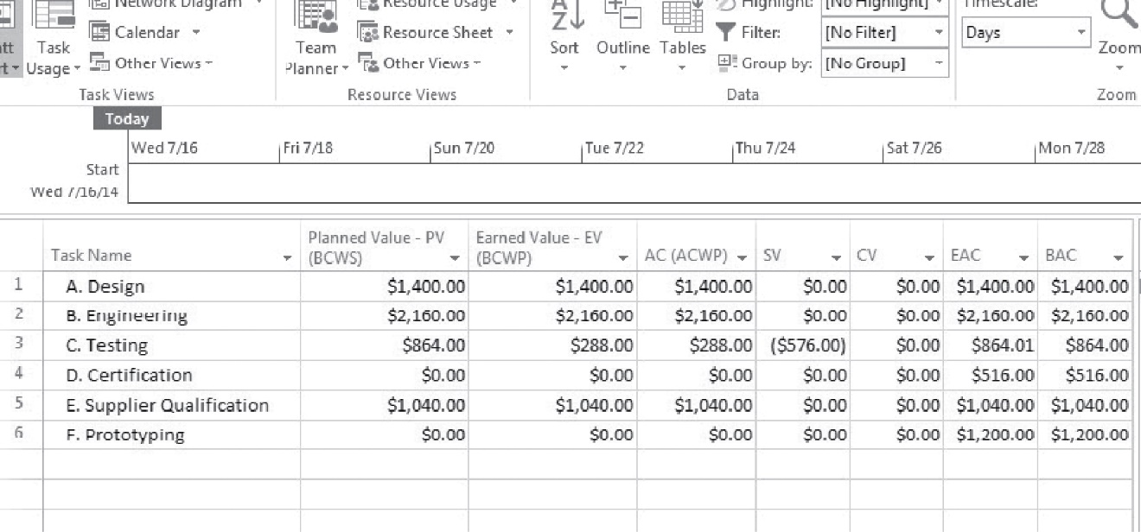
Earned Value Report for Project Atlas
(figure 13.16)
Source: Pinto (2016)

Slide 23
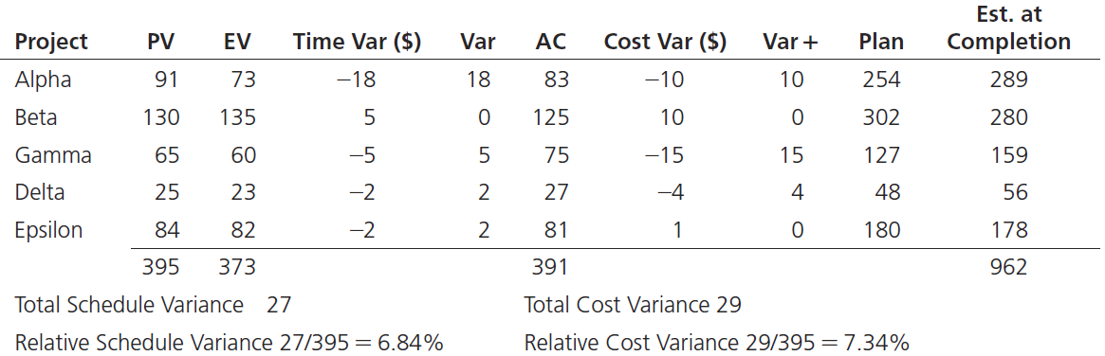
Using earned value to manage a portfolio of projects
(table 13.9)
Source: Pinto (2016)

Slide 24
Completion Values in EVM
Accurate and up-to-date information is critical in the use of EVM.
0/100 Rule
50/50 Rule
Percentage Complete Rule

Slide 25
Faktor penentu keberhasilan proyek

Slide 26
Human Factors in
Project Evaluation & Control
Project coordination and relations among stakeholders
Adequacy of project structure and control
Project uniqueness, importance, and public exposure
Success criteria salience and consensus
Lack of budgetary pressure
Avoidance of initial overoptimism and conceptual difficulties

Slide 27
Critical Success Factors in the
Project Implementation Profile
Project mission
Top management support
Project plans & schedules
Client consultation
Personnel
Technical tasks
Client acceptance
Monitoring & feedback
Communication channels
Troubleshooting

Slide 28
Summary
Understand the nature of the control cycle and four key steps in a general project control model.
Recognize the strengths and weaknesses of common project evaluation and control methods.
Understand how Earned Value Management can assist project tracking and evaluation.
Use Earned Value Management for project portfolio analysis.
Understand behavioral concepts and other human issues in evaluation and control.
Understand the advantages of Earned Schedule methods for determining project schedule variance, schedule performance index, and estimates to completion.

Slide 29
Membangun Jaringan Aktivitas dengan Activty on Arrow (AoA)

Slide 30
REFERENCES
Pinto. J.K. (2016). Project Management: Achieving Competitive Advantage. Pearson Education Limited. London. ISBN:978-1-292-09479-3, Chapter 5

