Slide 1
Intercultural Communication
Komunikasi Antar Budaya Per. 1
Naurissa Biasini

Slide 2
Books
Communications between cultures
Larry A Samovar, Richard E Porter, Edwin R McDaniel, 2015, Boston: Wadsworth
Komunikasi Lintas Budaya
Larry A Samovar, Richard E Porter, Edwin R McDaniel, 2010, Jakarta: Salemba Humanika
Komunikasi Antar Budaya di Era Budaya Siber
Rulli Nasrullah. 2014. Jakarta: Kencana

Slide 3
Intercultural Communication: A Requirement for the Interdependent Global Society
The Interdependent Global Society
Intercultural Cooperation
Technology
Developing Intercultural Awareness

Slide 4
The Interdependent Global Society
01

Slide 5
Why do we have to learn this?
Now look around you!
Do your friends come from the same region as you?
Do they look like you?
Do they have the same culture? Language? Habit? Norm?
Have you ever feel uncomfortable when meeting new people?
Have you seen something strange done by your friends? Or other people?
Different culture = different communication?

Slide 7
The world is now changing at a much faster pace, requiring rapid adjustment to evolving technology and changing social conditions.
Our interactions with people of different cultures have become common in the classroom, the workplace, and the healthcare setting, and with growing frequency in our neighborhood.
The term “globalization” originally implied an emerging development, a work in progress, but can now be characterized as both an existing condition and a continuing dynamic.
With rare exceptions, our lives are increasingly dependent on people and events in other parts of the world.

Slide 8
02
Intercultural Cooperation

Slide 9
Globalization has raised awareness of existing and emerging conditions that influence many aspects of our planet and society.
The global community is currently faced with a broad spectrum of circumstances that present national governments with pronounced demands on financial and physical resources.

Slide 10
The Challenges!
Social challenges
Humanitarian and legal cooperation
Ecological concerns
Political questions
Security issues

Slide 11
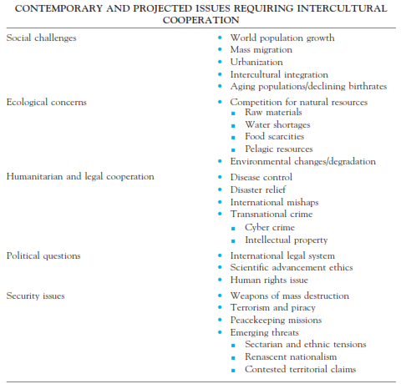

Slide 12
Technology
03

Slide 13
How technology changes us?
Information technology (IT) has globalized and democratized access to information!
No longer are literary, scientific, legal, and educational materials the provenance of circumstantially advantaged segments of society.
With minimal investment in either money or time, anyone in almost any place in the world can access the Internet for knowledge, entertainment, communication, and other reasons.
No longer does one have to travel to a library, locate an expert, purchase a book, send a letter, or even reason out a problem for oneself.
A vast body of knowledge is readily available. Even when it is written in another language, a translation can often be obtained online.
The ubiquity and accessibility of information has made “I don’t know, but I can look it up" the mantra of the digital generations.

Slide 14
04
DEVELOPING INTERCULTURAL AWARENESS

Slide 15
We need to be aware of…
INDIVIDUAL UNIQUENESS
OBJECTIVITY
GENERALIZING
COMPROMISE IN INTERCULTURAL COMMUNICATION
COMMUNICATION IS NOT THE UNIVERSAL SOLUTION

Slide 16
What is Intercultural Communication?
Intercultural communication occurs when a member of one culture produces a message for consumption by a member of another culture.
Intercultural communication involves interaction between people whose cultural perceptions and symbol systems are distinct enough to alter the communication event.

Slide 17
Co-Culture
The Dominant Culture
Within the dominant culture, you will find numerous co-cultures and specialized cultures.
Some co-cultures share many of the patterns and perceptions found within the larger, dominant culture, but their members also have distinct and unique patterns of communication that they have learned as part of their membership in the co-culture.
These co-cultural affiliations can be based on race, ethnic, gender, age, sexual preference, etc.
This is the group that usually has the greatest amount of control over how the culture carries out its business.
This group possesses the power that allows it to speak for the entire culture while setting the tone and agenda that other will usually follow
They control religious institution, media, government, education, military, etc.

Slide 18
What is Culture?
Culture is a set of human-made objective and subjective elements that in the past have increased the probability of survival and resulted in satisfaction for the participants in an ecological niche, and thus became shared among those who could communicate with each other because they had a common language and they lived in the same time and place. (Triandis)
Budaya adalah seperangkat elemen obyektif dan subjektif yang dibuat manusia yang di masa lalu telah meningkatkan kemungkinan bertahan hidup dan menghasilkan kepuasan bagi para peserta dalam ekologi, dan kemudian dibagi di antara mereka yang dapat berkomunikasi satu sama lain karena mereka memiliki bahasa yang sama dan mereka tinggal di waktu dan tempat yang sama.

Slide 19
The Basic Functions of Culture
To improve the adaptation of members of the culture to a particular ecology, and it includes the knowledge that people need to have in order to function effectively in their social environment. (Triadis)
To set the limits on behavior and guides it along predictable paths. (Haviland)

Slide 20
Elements of Culture
History
Religion
Values
Social Organizations
Language

Slide 21
Characteristics of Culture
Culture is learned
Culture is shared
Culture is transmitted from generation to generation
Culture is based on symbols
Culture is dynamic
Culture is an integrated system

Slide 22
Any Questions?

Slide 23
Arigatou!
Please keep this slide for attribution

